Slide 1
Who Should Learn What? Why?
Some Useful Historical Background
E-Lecture #3
Notes:
HI! Welcome to this e-lecture on “Who Should Learn What? Why? Some Useful Historical Background.”
This lecture is designed to help you understand how who attends public schools in the United States has changed over time, and how the public’s perceptions of these changing students’ capacities and needs has influenced what curricular opportunities students have been offered. Because we will be surveying about a century of American history in this single lecture, this will be more of a whirlwind tour rather than a comprehensive historical account. But I hope this lecture will give you sufficient context to understand better our readings and class conversations around tracking, de-tracking, and curriculum access.
This lecture also helps to move us from the macro level of the first two lectures, where we were essentially comparing and seeking patterns among schools and districts, to the meso level, in which we look at practices and comparisons within schools. Our first lecture, for example, examined segregation and desegregation at the school and district level. Who attends what schools, where, and why, and how does this impact young people’s educational opportunities? The classes for which this lecture provides some background examine segregation and desegregation within single schools. Who takes what classes and why, what do these different classes get taught, and how does this impact young people’s educational opportunities? Similarly, our school finance lecture compared resource allocations among schools and districts in order to assess the impact on students’ opportunities. This lecture provides historical background to enable us to look in class at the allocations of curricular resources within schools, among kids, and ask who accesses which curricula and why. So we are essentially taking the kinds of questions and ideas that we struggled with in the first two class sessions and wrestling with them one level closer to the ground. This lecture itself doesn’t do so, but in combination with the other assigned readings, it is designed to give you the historical and conceptual background that you need in order to work through these “meso-level” issues in class.
Finally, let me remind you that if you do not know how to use this software program, including accessing the script via the notes tab, the outline of slides, or other resources, please revisit slide 2 of the first e-lecture. As always, the PowerPoint for this presentation is also available on the iSite as well as via the Attachments button at the top right corner of this screen.

Slide 2
Framing Questions:
Is educational equity best achieved through curricular standardization or variability?
Are there some skills and domains of knowledge that all students should learn?
How can we best respect student diversity while achieving equitable results?
Why are so many apparently integrated (i.e. diverse) schools internally segregated by class, race/ethnicity, and/or perceived ability?
Is there a way to overcome this while still maintaining appropriate mechanisms for student choice?
Notes:
Please remind yourself of the framing questions that guide these two classes on curriculum access.

Slide 3
Main Ideas
Since the early 20th century…
Who attends American schools has radically changed and expanded
What they are expected to learn has radically changed, expanded, and been fiercely contested
Why they are expected to learn has been bitterly disputed
How we can and should provide equitable educational opportunity—and whether such opportunity is measured by sameness or difference—has been fought over in part in response to the above issues.
Notes:
In order to be able to tackle these framing questions successfully in class, you need some historical perspective. This lecture, therefore, focuses on four main ideas about how American public education has changed since the early 20th century.
First, who attends American public schools has radically changed and expanded.
Second, what the students are expected to learn has radically changed, expanded and been fiercely disputed.
Third, why they are expected to learn has been bitterly disputed.
And fourth, how we can and should provide equitable educational opportunities - and whether such opportunities are measured by sameness or difference- has been fought over in part in response to the above issues.
This last idea is really the focus of the two days that we are spending thinking about tracking, de-tracking and curriculum access. For this reason, I am going to focus on the first three main ideas—who, what and why—in this lecture.

Slide 4
Who attends US schools? How have attendance patterns changed over the past century?
Notes:
To start with, let’s think a little bit about who attends US schools and how attendance patterns have changed over the past century.

Slide 5
A Century of Expanding Enrollment:
Growing population → more children attending school
Increased % of youth population attend school
Children attend school for more years
US and hence school population has become more diverse by race, ethnicity, country of origin
Students with special needs increasingly enrolled in (and not expelled from) public schools
Growing urban population → more children attending urban schools
Notes:
We have basically seen a century of expanding enrollment for a number of reasons.
First, the growing population in the US has led to more children attending schools. There are simply many more school-age kids in the United States now than there were 100 years ago.
Also, there has been a huge increase in the percentage of the youth population attending school.
Further, children attend school for more years
As you all know, the United States has become more diverse, and schools are more welcoming of diverse students. These factors have also expanded enrollment. Schools’ openness to diversity comes in many forms.
Kids who were previously viewed as uneducable now are viewed as educable. This is especially true of students with special needs, who were often legally denied any public school services at all, or who were kicked out of school as quickly as they were admitted. These students now enroll and stay in public schools and hence contribute to the expanding population of school kids.
Finally, urban populations have been growing massively over the past century, which have expanded the number of children who are attending schools in urban areas. There are several reasons for the growth in urban areas. First, as you may already know, the preponderance of immigrants that have come to the US since the 19th century have ended up going to urban areas. Second, the Great Migration north of African Americans, particularly around the WWII era, helped to expand cities. Lastly, cities themselves saw a lot of growth as farms decreased and rural life became less necessary for the majority of the population. Now more Americans live in cities than in rural areas. A century ago, the reverse was true.

Slide 6
# of Students Attending U.S. Public Schools, 1900-2007
# of students in millions
Sources: http://www.census.gov/statab/hist/HS-20.pdf, http://nces.ed.gov/fastfacts/display.asp?id=65, (http://nces.ed.gov/pubs2010/2010309.pdf
Notes:
This graph shows very clearly the growth in the number of young people enrolled in public schools over the past 110 years or so. You may also notice the sharp peak which represents the baby boomer era. After this peak, you can see the numbers have tapered off a little bit. That’s partly because of lowered birthrates, especially compared to the baby boomer years, and partly because we’ve reached relative saturation: few school-age children in the United States fail to attend school. Even so, we are almost at peak enrollment, although the greatest number of students were enrolled in public schools in the US in 2000.

Slide 7
Percentage of Youth Enrolled in School
1950-2008 (all races)
Source: http://www.census.gov/population/socdemo/school/TableA-2.xls
Notes:
In addition to the sheer numbers changing, the percentage of young people enrolled in school has changed. As a note, we are only able to find data starting with the 1950’s.
Using this data, you can see that an increasing number of 5 and 6 year olds have enrolled in school over time and the number of 16 and 17 year olds has also increased over time. This graph also reinforces the point I made about saturation. Although in the early to mid part of the century, there were many school-age students who were not enrolled in school, this is not the case today, as you can see in the blue bar representing 10-13 year olds.

Slide 8
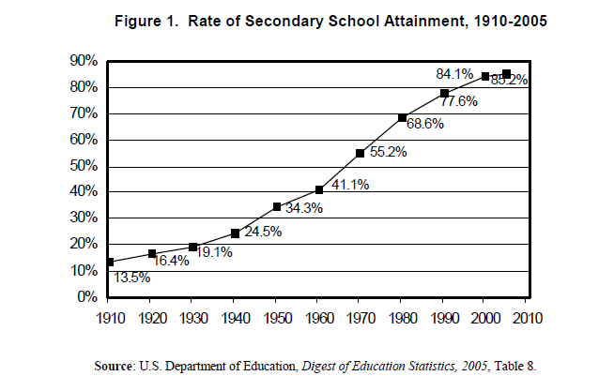
Rate of HS Attainment 1910-2005
Notes:
This graph shows something similar to the previous one but focuses on the rate of high school attainment. You can see that there is a steady rise in the number of youth that have graduated from high school over time. On the other hand, this rise seems to be tapering to a level well under 100%, which is of obvious concern to many people.

Slide 9
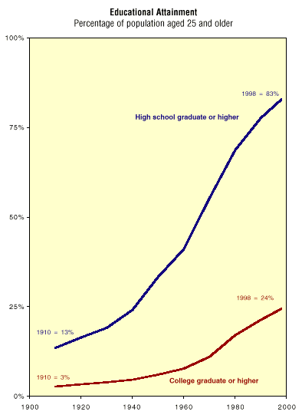
Educational Attainment 1910-1998:
% of population age 25 and older
1910
13% high school grads
3% college grads
1998
83% high school grads
24% college grads
Source: Caplow, Hicks, & Wattenberg, 2001
Notes:
This graph is a different way of looking at this data. It shows the same data as before but also includes college graduation rates. Although the number of people graduating from college is higher than it has been in the past, it is much much lower than we would like it to be today.

Slide 10
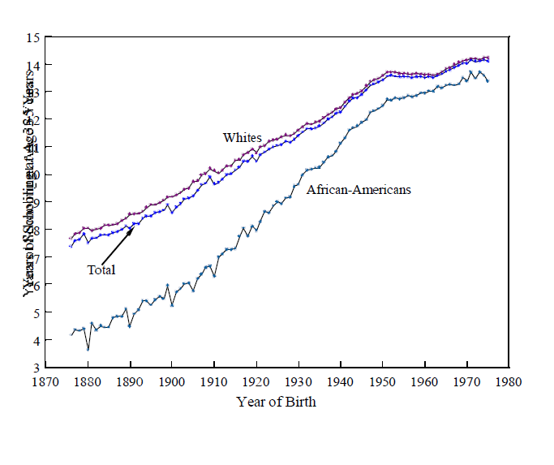
Educational Attainment 1910-1998:
% of population age 25 and older
Years of Schooling by Birth Cohort,
All U.S. Natives and by Race: 1876-1975
Average Number of Years of School Attended
14
13
12
11
10
9
8
7
6
5
4
3
Source: Bradford DeLong, Goldin, & Katz, 2002
Source: Caplow, Hicks, & Wattenberg, 2001
Notes:
We can also look at the number of years that people have been in school. This graph shows the average years of schooling attained by African American and White kids born between 1876 and 1975.
Unfortunately, data aren’t available for other racial and ethnic groups. A lot of the education statistics I present focus just on blacks and whites because these are the groups that political scientists, sociologists and others have been studying for an extended period of time. As I’ll discuss in a few minutes, too, groups such as Asian Americans were kept to a very small percentage of the population for most of the 20th century because of outright discrimination and a ban on immigration. To the extent possible, I will try to provide data that is more expansive, but unfortunately it’s usually limited to Whites and African Americans.
You can see in this graph that the number of years that kids attend school rose quite consistently and rapidly until about 1950. It has continued to rise since then, but at a much slower rate

Slide 11
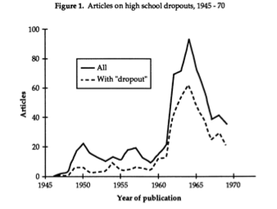
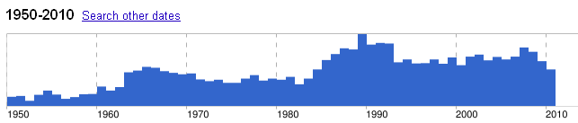
The “Dropout Problem” Begins
Articles on high school dropouts, 1945-1970
Google search timeline of “dropout” by year of use
From: Dorn, S.(1993). Origins of the ‘dropout problem.’ History of Education Quarterly 33 (3), 353-373
Notes:
One way to interpret the data on previous slides is to conclude that the vast majority of Americans in the first half of the twentieth century dropped out of school. This, however, would be a failure of historical imagination. High school completion has not always been an expectation or norm, in large part because it was until fairly recently perfectly easy to get a good job without a high school diploma.
The notion of a “high school dropout” therefore did not emerge until almost 1950, as you can see from this graph of the number of articles about high school “dropouts” that were published from 1945-1975. The data show that this topic did not truly emerge as a problem until about 1960. Previously, young people leaving school were not necessarily viewed as a concern, especially if the young people were not members of the elite. We see similar results in a Google search timeline I just conducted of “dropout” by year of use. The 1960s show the first wave of concern about “dropouts,” with another spike from the mid-1980s to 1990s.

Slide 12
Pause and Think
Pause and think:
What achievements and opportunities do these trends represent?
What challenges do these trends pose?
What assumptions do you make about and what explanations do you have for these trends?
What surprises you?
What questions remain?
Notes:
You’ve now seen lots of graphs that show trends in school attendance and persistence over time. At this point, take some time to pause and think about the meaning of the data you’ve seen. You might want to think about the following questions:
What achievements and opportunities do these trends represent?
What challenges do these trends pose?
What assumptions do you make about and what explanations do you have for these trends?
What surprises you?
What questions remain?
Then when you are ready, press play again.

Slide 13
Who attends public school?
Focus on immigration
Notes:
Let’s now move from looking at changes in the sheer number of kids attending school over time to changes in who is attending school. As the title of this slide indicates, immigration is one big factor in changing who attends public schools over the course of the 20th and early 21st centuries. There have also been other big shifts in school attendance by race, class, and gender. Because immigration, especially linguistic diversity, is so contentious with respect to contemporary urban education policies, however, I will concentrate in this lecture on the role of immigration in school attendance.

Slide 14
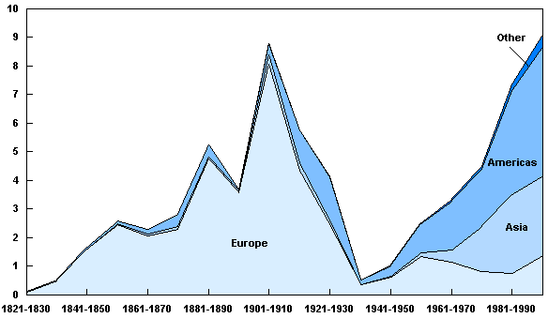
Immigration to the United States, by Region of Origin, 1821 to 2000 (Millions, by decade)
Largest Sources: Ireland 780,700
Germany 434,600
Largest Sources:
Austria-Hungary: 2,145,300
Italy: 2,045,900
Largest Sources: Mexico 1,655,800 Philippines 548,800
From: Congressional Budget Office, A Description of the Immigrant Population (November 2004) (http://www.cbo.gov/doc.cfm?index=6019&type=0)
Source: Department of Homeland Security, Office of Immigration Statistics, 2003 Yearbook of Immigration Statistics (September 2004).
Notes: Arrivals by land were not completely enumerated until 1908. The Americas comprise Latin America and Canada.
Notes:
To begin with, let’s look at the number of immigrants that come to this country and their origins. Take a moment to examine this graph. In addition to the obvious peaks in immigration at the turn of the 20th century and then again into the 21st century, you can also see a change in the origins of immigrants. The majority of immigrants were European at the turn of the 20th century; they are now majority non-Europeans at the turn of the 21st century.

Slide 15
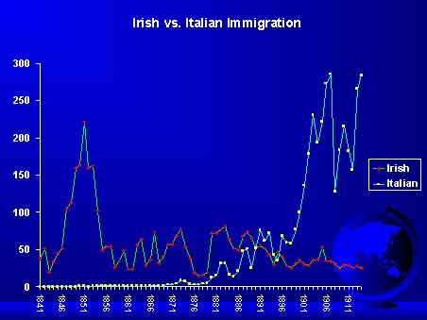
Irish vs. Italian Immigration 1841-1911
http://history.wisc.edu/archdeacon/404tja/graph/ppg007.html
Notes:
It is important to remember that although we now tend to lump Europeans together, Europeans were by no means seen as an undifferentiated group in the 20th century.
There is a really wonderful book called How the Irish Became White that both documents the profound prejudice against Irish immigrants in the 19th century, and explains how that prejudice eventually gave way. In the 19th century, Irish were deeply discriminated against. There were signs on businesses all over Massachusetts, for example, saying “No Irish need apply.” Irish were considered to be lower order, lower class, dirty—all the classic accusations hurled at new immigrant groups. Over time, however, as newer European immigrant groups such as Italians started pouring in, Italians and other Southern Europeans became the newly perceived threats to the established social order while Irish were assimilated into the so-called “white race” and no longer perceived as a threat. This pattern generally repeats itself with each new wave of immigrants.

Slide 16
Comparing European Races
“Our qualified Americans have mainly been of two or more principal races – the Germans, the Irish, and the Scandinavians – all of whom have inherited… sentiments, principles, and habits of mind similar in the main, and which…made America.
But when the time comes, visible in the not far distant future, when in addition to these, we shall have large and influential groups and organizations of Italian-Americans, Croatian-Americans, Russian-Americans, and a host of others, each with its own set of racial and national prejudices and interests, the solidarity of the nation will be in a precarious position.”
- Henry Fairchild (sociologist), The Nation, 1911
Notes:
Illuminating this tension, here is a quote from a prominent sociologist, Henry Fairchild. Pause the recording to read the quote to yourself. [wait] As you can see, the undifferentiated notion we have of Europeans as being “white” did not exist then and certainly did not play out as them being a uniformly privileged group.

Slide 17
Racial conceptions in early 20th c.
Northern vs. southern Europeans
Profound suspicion of Catholics by Protestants
Asians incapable of citizenship
Poverty and ignorance are hereditary
Scientific studies of criminal families
U.S. eugenics movement—ended only by horror of Nazis in Germany
Notes:
To move us forward, I am going to talk briefly about racial conceptions in the early 20th century. I again want to acknowledge that this is a whirlwind history. This lecture is designed to just activate prior knowledge for those of you who are familiar with these concepts and to help bring those of you who are less familiar with these patterns up to speed so you can participate in our discussions and simulations in class.
Let me start first by giving some background about the racial classifications. As I mentioned, Northern Europeans were seen as superior to Southern Europeans.
Further, Protestants were deeply suspicious of Catholics, especially their loyalty to American political leaders versus the Pope. As a result, in the 19th century there were a number of deadly anti-Catholic riots. These subsided by the twentieth century, but there was still considerable hostility and suspicion.
At this time, Asians were excluded entirely from citizenship. They were not permitted to naturalize, and if a woman who was a U.S. citizen wanted to marry an Asian man, she lost her citizenship rights. Asians were also forbidden to own land. Thanks to the fourteenth Amendment, natural-born Asian-Americans were automatically citizens. But generally Asians were considered to be incapable of being citizens.
Additionally at this time, it was thought that poverty and ignorance were biological and hereditary.
Thus there were a lot of studies of impoverished families and criminal families that attempted to show how these ills were passed down the line.
These studies and beliefs actually led to a very strong Eugenics movement in the United States from the turn of the 19th century through the 1930’s. The consequences of these beliefs led to the forced sterilization of thousands of women, the mentally ill and those deemed criminally inclined. This was obviously quite horrific. The Supreme Court upheld such laws in their 1927 ruling in Buck v. Bell. In his majority opinion, Justice Oliver Wendell Holmes, Jr., ruled, that “It is better for all the world, if instead of waiting to execute degenerate offspring for crime, or to let them starve for their imbecility, society can prevent those who are manifestly unfit from continuing their kind.” He famously concluded the opinion with the statement that “three generations of imbeciles are enough.” (http://en.wikipedia.org/wiki/Buck_v._Bell) The Eugenics movement ended only after Americans faced the full horror of Nazis in Germany. For those of you that are interested in this, Facing History and Ourselves has a really fantastic teacher resource book on the Eugenics movement in the United States.

Slide 18
20th century U.S. immigration policy
Virtually unrestricted from Europe until 1920s
1882 (repealed 1943) – Chinese Exclusion Act prohibits entry of Chinese laborers
1921, 1924 – Quota acts
  large visa allotments for northern and western Europeans
  smaller allotments for eastern and southern Europeans
  Asians are “aliens ineligible for citizenship”
1943 (ended 1965) – “Bracero” program to bring in non-resident agricultural laborers from Mexico
1948 – Displaced Persons Act admits refugees
1965 – Hart-Celler Immigration Act ends national-origin quota system in favor of policies based on needed job skills and family reunification
From: Ueda, R. (2001). Historical patterns of immigrant status and incorporation in the United States. In G. Gerstle& J. Mollenkopf (Eds.), E Pluribus Unum: Contemporary and Historical Perspectives on Immigrant Political Incorporation. New York: Russell Sage Foundation.
Notes:
This leads us then to think about how conceptions of race at that time translated into immigration policy. As you may know, immigration was virtually unrestricted from Europe until 1920’s. I say from Europe because the Chinese Exclusion Act prohibited entry of Chinese laborers. This was not repealed until 1943.
There were also two very significant quota acts in 1921 and 1924 that were intended to recapture the complexion of the country before the turn of the 20th century. Building on the racial categories we saw in the last slide, politicians agreed that the population in 1880—which was mostly of northern and western European origin, assuming one ignores former slaves of African origin—was the desired population for the United States. Immigration policy was thus shaped to rebalance the population toward that end. These two quota acts hence specified that the percentage of immigration visas distributed had to match the population balance in 1880. There were thus large visa allotments for northern and western Europeans, smaller allotments for eastern and southern Europeans, and virtually no allotments for anyone else. This includes virtually no visas being offered to Africans, even though African-Americans made up a large percentage of the U.S. population in 1880. These mostly former slaves and their descendants were not considered to be relevant to the population measures at the time. The quota acts also declared Asians to be “aliens ineligible for citizenship,” as we discussed previously.
Jumping forward to 1943, we can see the beginning of the Bracero program to bring in non-resident agricultural laborers from Mexico. This was the start of Mexican migrant farmworkers. They were specifically not brought in as immigrants, but rather as relatively short-term laborers. This program officially ended in 1965. There have been various other programs bringing in migrant farm workers since, but they have been less formal and legalized.
In 1948, the Displaced Persons Act began to admit refugees in response to WWII. These refugees were not subject to the same strict quotas by place of origin as other immigrants were.
Finally, in 1965 the old quota act was ended and was replaced by policies that favored economic growth and family unification. Prior favoritism toward western and northern European nations, and toward Europe in general, was also scrapped in favor of a wider-ranging and more egalitarian model that permitted immigration from around the world. Legal immigration has thus shifted heavily toward immigrants from Africa, Asia, and Central and South America, and away from European immigrants.

Slide 19
Immigration to the United States, by Region of Origin, 1821 to 2000 (Millions, by decade)
Largest Sources: Ireland 780,700
Germany 434,600
Largest Sources:
Austria-Hungary: 2,145,300
Italy: 2,045,900
Largest Sources: Mexico 1,655,800 Philippines 548,800
From: Congressional Budget Office, A Description of the Immigrant Population (November 2004) (http://www.cbo.gov/doc.cfm?index=6019&type=0)
Source: Department of Homeland Security, Office of Immigration Statistics, 2003 Yearbook of Immigration Statistics (September 2004).
Notes: Arrivals by land were not completely enumerated until 1908. The Americas comprise Latin America and Canada.
Notes:
If we go back to looking at the chart that shows us immigration by region over time, we can see that 1965 is suddenly when we get this shift in the demographics of immigrants due to these revised policies.

Slide 20
Cities as Immigrant Destinations: Boston, e.g.
1847: Boston adds >37,000 Irish immigrants to existing population of 114,000
1920: Half of the U.S. population—but ¾ of immigrant population—lives in cities of more than 2,500
1930: 12% of Boston residents are immigrants
1990: 115,000 immigrants make up 20% of Boston population
1998: Mayor Menino establishes “Office of New Bostonians”
2007: Immigrants = 28% of Boston’s population
Sources: Tyack, D. (1974). The one best system: A history of American urban education. Cambridge, MA: Harvard University Press.; http://www.bostonredevelopmentauthority.org/pdf/ResearchPublications//New%20Bostonians%202009.pdf
Notes:
As I mentioned, urban areas were popular sites for immigrant settlement. Since we have been focusing in class on Boston as one of our case study cities, you may find it interesting to learn about Boston’s immigration patterns. Look over the information on this slide and then press play when you are ready to go on.

Slide 21
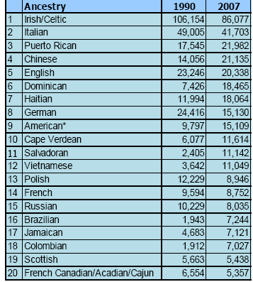
Boston in 1990 vs. 2007:
Ancestry/Countries of Origin
* Note: “American” refers to people who identified their ancestry as “American,” “United States,” a region such as “Southerner,” or a U.S. state.
Source: http://www.bostonredevelopmentauthority.org/pdf/ResearchPublications//New%20Bostonians%202009.pdf
Notes:
So, aligned to what we’ve learned about shifting patterns of immigration nationwide, Boston residents’ countries of origin have shifted radically over the long term, and even in just the last 20 years. You can see that even though people who claim Irish and Italian ancestry still make up the greatest number of people in Boston, once we combine groups, the Irish and Italians are pretty quickly outnumbered. Non-whites, in fact, make up about 50.5% of the population; Boston is now a majority-minority city.

Slide 22
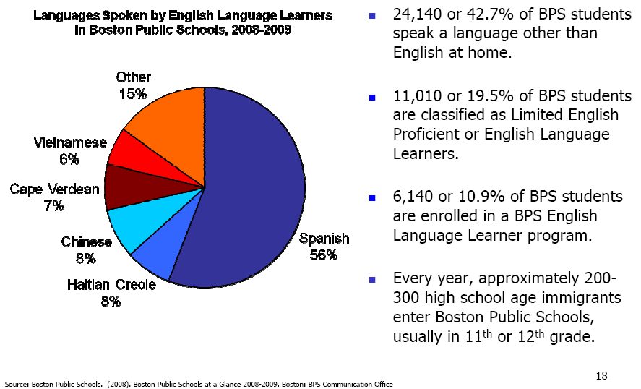
Boston Youth: Linguistic Diversity
Source: http://www.bostonredevelopmentauthority.org/pdf/ResearchPublications//New%20Bostonians%202009.pdf
Notes:
If we turn to Boston’s youth population in particular, it is even more racially and ethnically diverse than Boston’s population as a whole. The Boston Public Schools, similarly, have been majority-minority for much longer than the overall Boston population. If we take a look at the linguistic diversity represented in BPS, for example, you can see that close to half of BPS students speak a language other than English at home and a full fifth are classified as English Language Learners (or ELLs). Additionally, every year, BPS brings in 200-300 high school-age immigrants; most of whom are served at Boston International High School, which was specifically designed for older immigrant students.

Slide 23
Pause and think:
What similarities and differences do you see between immigration at the turn of the 20th century and today?
What implications do these similarities and differences have for education?
What legacies of this era are present in schools today? What are their effects?
Keep these questions in mind…
Notes:
Since we have again covered a lot of material, including whipping through a lot of data, this is another good time to pause and think about the significance of what you’ve been learning. I suggest you ask yourself the following questions:
What similarities and differences do you see between immigration at the turn of the 20th century and today?
What implications do these similarities and differences have for education?
What legacies of this era are present in schools today? What are their effects?
Please keep these questions in mind as we turn from our first framing question about who attends public schools and how has that changed over time to our second framing question about what this changing array of students gets taught.

Slide 24
What Should Students Learn?
Why Should Students Learn?
Notes:
We now turn to our second and third big ideas I want to explore in this lecture: What Should Students Learn? and Why Should Students Learn? How one answers these questions obviously depends upon who one’s students are and what one judges of their capacities, needs, and prospects. Hence, we will build upon what we’ve learned about the influx of various immigrant groups over time, the popular perception of these groups’ native capacities and deficiencies, and the expansion of public schools’ reach in general, to make sense of how these two questions were answered historically. In this section of the lecture, I focus on the first half of the 20th century, in particular on the Progressive Era. Progressivism was the dominant ideology in the United States from approximately 1910-1940. As you’ll see, many of the debates that we contend with today are echoed in Progressive-era debates

Slide 25
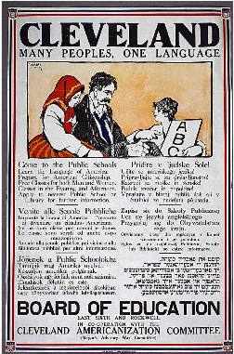
Immigrant Students’ Needs (1912):
“Our public schools are filled with a conglomerate mass of foreigners and children of foreigners sprung from generations of ignorance and untrained intelligence. To make good citizens of these through a few years of schooling is a stupendous task. Anything that can be devised to enhance mental and physical condition, which as a rule carries with it moral tone, should be considered worth trying. What this country needs at this time more than all else is the elevation of its citizenship.” New York Times, 1912
Sources: Patricia Graham, Schooling America; Lecture by Patricia Graham, S460, October 28, 2009
Notes:
Let’s start with a newspaper article that was published in 1912, expressing concerns about Southern European immigrants’ coming over and taking over schools. Pause this lecture to read this excerpt to yourself. You can see here a combination of both “the what” and “the why” questions as we discussed earlier and an extreme concern about the threat that immigrant students pose to the society as a whole.
Also highlighting this sentiment is a poster from Cleveland about the need to be teaching English. Take a minute to look that over.

Slide 26
Boston School Report, 1869:
“[N]ot every pebble is capable of taking the luster of the brilliant diamond….This should be constantly borne in mind by committees and educators… that all the institutions of learning that capital can build, as High Schools, will be unable to furnish brains for the masses to complete with credit the higher courses of instruction. This is a wise ordering of Providence.” (quoted in Reese, 1995, p. 204)
Notes:
These concerns and the notion that there were children who inherently weren’t as capable as others were not solely in response to immigration, nor did they arise only in the 20th century. For example, here’s an excerpt of a Boston School Committee Report from 1869.

Slide 27
William T. Harris, future U.S. Commissioner of Education, 1871
“The first requisite of the school is Order: each pupil must be taught first and foremost to conform his behavior to a general standard… conformity to the time of the train, to the starting of work in the manufactory, and to other characteristic activities of the city requires absolute precision and regularity.”
- William T. Harris, Superintendent of St. Louis
From: Tyack, D. (1974). The one best system: A history of American urban education. Cambridge, MA: Harvard University Press.
Notes:
Furthermore, students’ intellectual capacities are not the only consideration. Even if all students were equally capable, what they should learn is arguably decided by what they are being prepared to do, and the nature of the world they are presumed to be entering.
In this respect, this statement from the superintendent of St. Louis Schools was in many ways far ahead of its time in arguing that industrial norms should regulate both what students learn and how they learn it. There is a very clear vision here of the aims of education in a worldly context—as appalling as this vision might seem to some of us 140 years later.

Slide 28
Committee of Ten, National Education Association (1892)
“[E]very subject which is taught at all in a secondary school should be taught in the same way and to the same extent to every pupil so long as he pursues it, no matter what the probable destination of the pupil may be, or at what point his education is to cease.”
- Chaired by Charles Eliot, Harvard president
http://tmh.floonet.net/books/commoften/mainrpt.html
Notes:
There was some backlash against these points of view. The National Committee on Education appointed the so-called the Committee of Ten to consider whether or not they should try to have some common standards among high schools to rationalize college admissions. Charles Elliot, who was then the President of Harvard, was the chair of the commission. The commission published a report in 1892 that took radical exception to the BPS Committee report and stated that all youth should get the opportunity to get an education that would prepare them for college.
Take a moment to read this excerpt of their statement. [Pause] It is worth noting that this statement does not say that all kids should in fact be college-bound. It was acceptable to the Committee of Ten that some—even the vast majority—of students not avail themselves of the opportunities to take courses needed for college entrance. You can also see here the indifference to students’ leaving school at different times; remember, this was long before the conception of a school “dropout” was invented. But the Committee did care that all kids have the opportunity to take courses needed for college entrance, and that every class they did take would be taught in a way that developed their minds and help them be successful. They firmly rejected the idea that some students should learn how to translate analytic texts and others just learn the basics. In this respect, the Committee of Ten firmly rejected what we would today call tracking.

Slide 29
Report of the Social Studies Committee of the National Education Association, 1916
“[T]he key note of modern education is ‘social efficiency,’ and instruction in all subjects should contribute to this end.”
Notes:
I am now going to focus on a set of quotations and views from 1916 and a little later because this is when the progressive era of education really got going. The debate ended up working along a couple of different dimensions. I am going to show the ideas to you and then give you a schematic framework through which to think about them. Let’s start with this quotation from the NEA’s Social Studies Committee in 1916. In sharp contrast to the student-oriented stance of the Committee of Ten, you can see here a society-oriented stance. Whatever society needs, education should provide.

Slide 30
Ellwood Cubberley, future Dean of Stanford School of Education, 1916:
“Our schools are, in a sense, factories, in which the raw products (children) are to be shaped and fashioned into products to meet the various demands of life. The specifications for manufacturing come from the demands of twentieth-century civilization, and it is the business of the school to build its pupils according to the specifications laid down.” (Public School Administration)
Notes:
You can see here an echo of William T. Harris, 45 years on.

Slide 31
John Dewey, 1916
“Education is a social process; education is growth; education is not a preparation for life but is life itself.”
Notes:
The same year, John Dewey takes a radically different view of how schools should proceed. He makes his famous claim in Democracy in Education that “Education is a social process; education is growth; education is not a preparation for life but is life itself.”

Slide 32
Two Poles of Progressivism
Child-centered
Social efficiency
Notes:
So what we get are really two poles of progressive ideas. The first is that schools are a method for achieving social efficiency. Under this conception, schools should be efficient in how they operate internally and also efficient in what they produce: namely, young people who are equipped to take on the roles that society needs them to fulfill. Schools fundamentally serve society’s needs. The other poll of progressivism is child-centered. Under this conception, schools should serve the child by meeting the child’s needs, not society’s. Here, schools are evaluated by how well they serve children’s needs, not by how efficient they are in functioning and meeting social demands. Both of these poles were very strong in the Progressive Era.

Slide 33
How do we promote equitable educational outcomes?
Notes:
As you might expect, different progressives therefore gave quite contrasting answers to the question of how society can and should promote equitable educational outcomes.

Slide 34
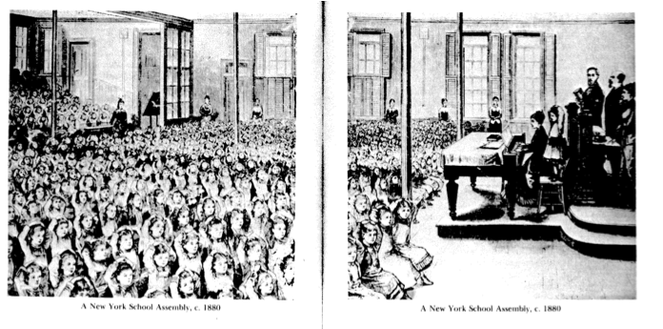
Systematization
Social efficiency
Innovations included:
classification of students into grades
examinations
textbooks
administrators
teacher certification
From: Tyack, D. (1974). The one best system: A history of American urban education. Cambridge, MA: Harvard University Press.
Notes:
The social efficiency approach resulted in the systemization of schools.
Innovations of progressive education in the social efficiency model included the shift from one room schoolhouses to multi-room, consolidated schools that separated students into age-specific grades. Standardized assessments were introduced at this time. Textbooks grew in size and number, and districts more frequently purchased the same textbook for all schools in the district rather than asking each school to choose their own. Administrators increased in power, especially at the central district level. District capacity, which had been minimal, grew enormously during this period. Teacher education and certification grew and were standardized as well.

Slide 35
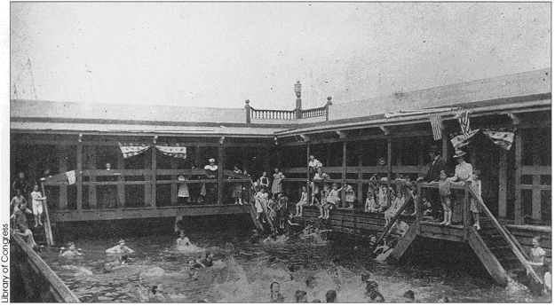
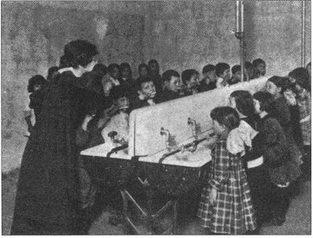
Individualization
Child-centered
Social efficiency
Innovations included:
importance of play
emphasis on child’s physical, social, and emotional development
learning by doing
vocational education
“comprehensive” schools
practical arts
ImageSource:http://www.fordham.edu/academics/colleges__graduate_s/undergraduate_colleg/fordham_college_at_l/special_programs/honors_program/honors
Notes:
On the other hand, there was significant individualization.
The innovations here were spurred by both schools of thought. In part there was the notion that if you are starting where the child is, then you should think about the child’s interests. The photos display some pedagogical approaches to this, including the importance of play, emphasis on social-emotional health, and learning by doing. Vocational schools were also often meant to respond to students’ expressed interests and needs, as were comprehensive schools, which provided far more educational opportunities and varieties of courses than smaller and more isolated schools could do. Comprehensive schools could provide different math classes for children of various academic levels, as well as classes in cooking, handiwork, home economics, and other “practical arts” that could meet every child’s needs and interests.
At the same time, the social efficiency approach also supported vocational, comprehensive, and practical arts education as means of meeting society’s domestic and workforce needs. Society needed well-trained and efficient housewives; schools were well-equipped to provide them. This strategy was therefore also supported on grounds of efficiency. If there was a need for farmers, we would train farmers. If a student was mathematically untalented, we wouldn’t waste their time or our resources on teaching them high-level mathematics. If a girl showed an aptitude for baking, she would soon develop the skills she needed to feed and care for her family. The emphasis on children’s social-emotional development was also favored by social efficiency activists as much as child-centered educators. There was a concern that especially immigrant and poor children had poor healthcare or poor socio-emotional development because they were being raised by parents who were ignorant and backwards, and that they would hence pull down the quality of society. This is one way to understand the photo of the teacher’s training children how to wash their hands. The school was the bulwark of decency against the ravaging hordes, working to Americanize youth and prepare them to enter the workforce. These practices can on the other hand be viewed from the individualization perspective as meeting children’s and family’s needs because tenement living was, as everyone agreed, really horrible. In this respect, schools were serving students by providing healthcare, trainings for parents, and access to basic sanitation.
In any case, as you can see, these two notions of progressivism are often integrated although they would seem to be radically opposed.

Slide 36
Pause and think:
How do the Progressive movement’s approaches to education address the shifting population and changing social, economic, and political context of the era?
How did the purposes and practices of schooling shift as a result?
What legacies of this era are present in schools today? What are their effects?
What surprises you? What questions remain?
Notes:
It’s time again to stop and think.
These first two questions allow you to check your understanding. These last two questions ask you to consider what the implications are of the history we’ve learned, and what questions remain.

Slide 37
From 1950-2010:
A Super-Duper-Duper-Duper
Whirlwind History
Notes:
At this point, having looked at the first half of the 20th century in some detail, I am going to take you on what my kids might call a super-duper-duper-duper whirlwind tour of the latter half of the century. This is not to give you depth of knowledge, obviously. But I hope it will give you context as we talk about standards, tracking and assessment and accountability over the next few sessions of the course.

Slide 38
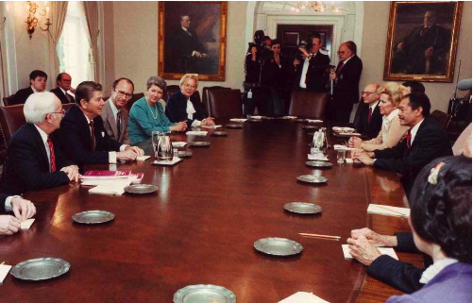
1917, 1946: Federal aid to schools for vocational, agricultural, and home ec education
1958: National Defense Education Act (response to Sputnik) funds improvements in science, math, and foreign language instruction
1965: Elementary and Secondary Education Act (ESEA), including Title I funding for disadvantaged children. Requires reauthorization every 5 years.
1964: Title VI of Civil Rights Act
1972: Title IX of Education Amendments
1973, 1975: Section 504 of Rehabilitation Act, Education for All Handicapped Children Act
prohibit race, sex, special needs discrimination in education
1980: Department of Education created (at Cabinet level)
1983: A Nation at Risk
“A basic promise is not being kept. More and more young people emerge from high school ready neither for college nor for work. This predicament becomes more acute as the knowledge base continues its rapid expansion, the number of traditional jobs shrinks, and new jobs demand greater sophistication and preparation.”
Notes:
In the next few slides, I will provide you with a timeline of the federal government’s role in education. We will stay on these slides for an extended period of time as I go through the timeline. The notes for this part of the lecture are therefore relatively long. A handout with the notes specifically for this timeline is available as an attachment to this lecture and on the i-site. If you like reading the notes along with the lecture, you may want to print them out to help you follow along.
1917, 1946: The first federal involvement in education at all in the United States was in 1917, when Congress voted to give federal aid to vocational schools. This obviously fits into the notion of vocational education that was being developed in the Progressive Era that we discussed earlier and the differentiation among what students were expected to learn and given the opportunity to pursue. It was renewed in 1946.
1958: In 1958, in response to the Soviet Union’s shooting a rocket called Sputnik into space, the National Defense Education Act was approved. This was the second congressional intervention in schooling. This act was designed to fund science, math and foreign language instruction. As the title of the Act implies, education was seen here as directly serving the national defense. It’s quite amazing to think that even as of 1958, there had been only two instances of federal involvement in education, and that neither of these focused on literacy or many other core school functions. Nor did they serve particular student populations.
1965: The Elementary and Secondary Education Act, or ESEA, constitutes Congress’ first focused attempt to address educational inequities in the United States, by creating Title 1 funding for disadvantaged children. It was part of the Civil Rights Movement. This act requires re-authorization every five years.
1964: Title VI of Civil Rights Act
1972: Title IX of Education Amendments
1973, 1975: Section of Rehabilitation Act Education for All Handicap Children Act
Other Acts passed during the Civil Rights Movement also addressed educational inequities and discrimination. Title VI of the Civil Rights Act prohibits racial discrimination. Title IX prohibits sex discrimination, while Section 504 mandated inclusion and appropriate services for students with special educational needs. It was not until the 1970’s when children with identified special needs even started to get anything consistent in terms of treatment or education and stopped being expelled from school or denied admittance.
1980: Department of Education Created at Cabinet Level. Although it’s hard to imagine it now, given the influence that the U.S. Department of Education exerts over American education, it wasn’t created until 1980.
1983: Nation at Risk
This was not a federal initiative but an incredibly influential report that you all have read for our first class on tracking. This report was written by a combination of college presidents, Nobel Prize winners, and business leaders. It decried the state of American education. Below you can see a quote that represents the main ideas of the report as you read it and also a picture of the authors on the left there. Please pause and take a moment to read the quote.
A Nation at Risk was incredibly influential. It directly criticized local control over schools, which was a sacrosanct American commitment. It also slammed the idea that schools should provide differentiated educational opportunities to different kinds of students. Remember that the explosion of being able to take home economics instead of taking math or taking consumer economics instead of trig all started during the Progressive Era when it was thought that to serve children as they were, we should meet them where they were at and provide the kind of education that they wanted. As we saw from a social efficiency perspective, too, it was thought not to make sense to train students in calculus who were not going to go on to become engineers. Why waste the resources? These internal school tracks were further emphasized and expanded with Brown v. Board of Education in 1954 because with desegregation came integration, obviously. Even if students could not be segregated from one another by school, they could still be separated within the school by academic track. For example, a school could create an honors track and then set admissions so that African Americans do not get in. For reasons both honorable and horrific, therefore, tracking was well entrenched in American secondary education by the early 1980s. A Nation at Risk said that this kind of tracking was really unacceptable because we were graduating too many students who did not have what they needed to compete in the new global economy.

Slide 39
1917, 1946: Federal aid to schools for vocational, agricultural, and home ec education
1958: National Defense Education Act (response to Sputnik) funds improvements in science, math, and foreign language instruction
1965: Elementary and Secondary Education Act (ESEA), including Title I funding for disadvantaged children. Requires reauthorization every 5 years.
1964: Title VI of Civil Rights Act
1972: Title IX of Education Amendments
1973, 1975: Section 504 of Rehabilitation Act, Education for All Handicapped Children Act
prohibit race, sex, special needs discrimination in education
1980: Department of Education created (at Cabinet level)
1983: A Nation at Risk
1980s – 2000s: States and professional groups develop content standards, assessments, and accountability mechanisms
2002: ESEA reauthorized as No Child Left Behind Act of 2001
2004: Individuals with Disabilities Education Act revamped
Notes:
1980’s-2000’s: In response to A Nation at Risk as well as other factors, the 1980-2000’s saw the start of the educational landscape that we know today with states and professional groups developing curricular standards, assessments and accountability mechanisms. We will talk more about this when we go into our accountability lecture. However, it is important to note that before 1980, no state had state-wide standards or frameworks or anything else of the kind. There were no state wide tests required for graduation. Some districts had tests, but the late 1980’s were the first time that states consistently started to develop some common standards and assessments. Texas was a leader in this process, as I’ll explain in the next lecture.
2002: Elementary and Secondary Education Act, which remember from earlier in our timeline had to be re-authorized every five years, was re-authorized and re-christened the No Child Left Behind Act (or NCLB) in 2001. NCLB was a bipartisan effort, heavily sponsored by President George Bush and Senator Edward Kennedy. I am going to assume you know some about the outline of NCLB, which I’ll go into in detail in my next e-lecture on Accountability. But I will point out here that NCLB emphasized the importance of making sure that all students are able to meet state standards. In service of this goal, NCLB required that data be disaggregated so that schools could no longer hide the performance of any one group under the strong performance of another. Even if a school’s overall achievement is very high, it is dinged under NCLB if any group of kids—poor kids, African American kids, or special needs students—are achieving at significantly lower rates.
2004: 2004 saw a major revamping of the Individuals with Disabilities Education Act (known as IDEA). IDEA brought about tons of important changes in how schools are expected to serve students with special needs.

Slide 40
1917, 1946: Federal aid to schools for vocational, agricultural, and home ec education
1958: National Defense Education Act (response to Sputnik) funds improvements in science, math, and foreign language instruction
1965: Elementary and Secondary Education Act (ESEA), including Title I funding for disadvantaged children. Requires reauthorization every 5 years.
1964: Title VI of Civil Rights Act
1972: Title IX of Education Amendments
1973, 1975: Section 504 of Rehabilitation Act, Education for All Handicapped Children Act
prohibit race, sex, special needs discrimination in education
1980: Department of Education created (at Cabinet level)
1983: A Nation at Risk
1980s – 2000s: States and professional groups develop content standards, assessments, and accountability mechanisms
2002: ESEA reauthorized as No Child Left Behind Act of 2001
2004: Individuals with Disabilities Education Act revamped
2009-??: Race to the Top, ESEA reauthorization
2010: Common Core Standards
Notes:
2009: NCLB is still the law of the land, because Congress hasn’t managed to agree on a reauthorization since 2001. (The Obama administration has converted NCLB’s name back to ESEA, but that’s as far as anyone’s gotten.) ESEA reauthorization is now more than five years overdue. Everyone agrees that NCLB needs major overhaul. Everyone agrees, too, on the importance of keeping NCLB’s insistence that all students be given the opportunity to learn at a high level. Get any more detailed than that, however, and you’ll uncover a lot of contention. Beginning in 2009, therefore, President Obama and Secretary of Education Arne Duncan decided to exercise control over schools, districts, and states by setting up financial incentive schemes, most prominently Race to the Top. Using relatively small amounts of money, Race to the Top has incentivized states to pass laws that vastly expand charter schools, tie teacher evaluation and teacher pay to students’ standardized test scores, change their testing regimes, revise curricular standards, and make other significant changes. In these respects, Race to the Top is changing schooling practices across the nation despite the lack of legislative mandate. We will talk more about Race to the Top in class and in the next e-lecture.
2010: Finally, in what might be the most seismic shift in American education at least in the past decade (since NCLB), over 40 states have recently adopted “Common Core Standards” in math and English. Developed by a private group and unveiled in 2010, these Common Core Standards are intended to serve as the centerpiece of nationwide curricular standards—and hence also nationwide student assessment—in math and English. Race to the Top funding is partly conditional on states’ adopting the Common Core, so they have had a strong incentive to do so. I describe this shift as seismic because it is the first time in American educational history that nationwide standards are being adopted and implemented.

Slide 41
What should we be preparing young people for?
“We don't believe that local educators need a prescription for success. But they do need a common definition of success—focused on student achievement, high school graduation and success and attainment in college.”
Arne Duncan, U.S. Sec’y of Education, Sep. 24, 2009
Source: www.chicagotribune.com/news/chi-cps-career-schools-05-jan05,0,5889164.stor
Notes:
As you should expect given what I’ve said about Race to the Top, Education Secretary Arne Duncan holds very different educational goals and conceptions of the world than many of those whom I quoted from the Progressive Era.
Here is an excerpt from a major speech Secretary Duncan gave on September 24th, 2009. [Pause] Notice that Duncan is not emphasizing the social-emotional and physical needs of the child, social efficiency, or child-centered learning as we saw in the Progressive Era. He is rather articulating a very clear focus on academic achievement, high school graduation and college success.

Slide 42
Arne Duncan on ESEA Reauthorization:
Let us build a law that demands real accountability tied to growth and gain both in the individual classroom and in the entire school—rather than utopian goals—a law that encourages educators to work with children at every level, the gifted and the struggling—and not just the tiny percent near the middle who can be lifted over mediocre bar of proficiency with minimal effort. That's not education. That's game-playing tied to bad tests with the wrong goals.
Let us build a law that discourages a narrowing of curriculum and promotes a well-rounded education that draws children into sciences and history, languages and the arts in order to build a society distinguished by both intellectual and economic prowess. Our children must be allowed to develop their unique skills, interests, and talents. Let's give them that opportunity.
Let us build a law that brings equity and opportunity to those who are economically disadvantaged, or challenged by disabilities or background—a law that finally responds to King's inspiring call for equality and justice from the Birmingham jail and the steps of the Lincoln Memorial.
Let us build an education law that is worthy of a great nation—a law that our children and their children will point to as a decisive moment in America's history—a law that inspires a new generation of young people to go into teaching—and inspires all America to shoulder responsibility for building a new foundation of growth and possibility. …
Let us finally and fully devote ourselves to meeting the promises embedded in our founding documents—of equality, opportunity, liberty—and above all—the pursuit of happiness.
More than any other issue, education is the civil rights issue of our generation and it can't wait—because tomorrow won't wait—the world won't wait—and our children won't wait.
Source: http://www.ed.gov/news/speeches/2009/09/09242009.html; emphases added
Notes:
Duncan’s statements are interesting enough—and important enough as we try to understand urban education today—that I wanted to pull out a larger chunk of the same speech. I have put the main ideas in bold.

Slide 43
What should we be preparing young people for?
Chicago to overhaul vocational education over next 7 years; aim to serve 25,000 students (Jan. 5, 2010 article in Chicago Tribune):
"In today's economy, it is essential that we graduate students with the skills they need to go directly into a good job and a long-term career," Chicago Mayor Richard Daley.
"The horrible irony of this recession is that even with these large unemployment numbers, there are key jobs in health care and manufacturing where businesses can't find people.…We've put out this cultural message in this country that every job requires a college degree. So young kids don't look at these jobs as an option,“ Rachel Unruh, associate director of The Workforce Alliance in Chicago.
Source: www.chicagotribune.com/news/chi-cps-career-schools-05-jan05,0,5889164.stor
Notes:
Interestingly although Duncan’s view certainly reflects the view of the Gates Foundation and many others working in education at the moment, his is not the only public position. This article, from Chicago where Duncan used to be superintendent, takes us back to Progressive Era debates in a fascinating way.

Slide 44
Conclude by thinking:
Pause and think:
How can we provide equal educational opportunity within schools and classrooms?
When do we realize equity by treating students the same, and when do we realize equity by treating them differently?
Should we measure students against the same or different standards?
How do your answers to these questions reflect your beliefs about whom we should teach what and why?
Notes:
Finally, take one last opportunity to pause and think about what you learned in order to apply it to the educational landscape today. Ask yourself:
How can we provide equal educational opportunity within schools and classrooms?
When do we realize equity by treating students the same, and when do we realize equity by treating them differently?
Should we measure students against the same or different standards?
How do your answers to these questions reflect your beliefs about whom we should teach what and why?
Thank you for listening and I look forward to seeing you in class.

