Slide 1
Inequities Beyond School
Notes:
We know that kids attending U.S. public schools are increasingly segregated by race and ethnicity, class, and English Language Learner status. We know that urban schools, especially, tend to serve disproportionately high numbers of low-income students of color, many of whom speak a language other than English at home. We have talked about whether and how these segregation patterns matter with respect to the quality of schooling different students receive. We’ve also considered the symbolic significance of schools’ ethnoracial and class composition. What do youth and adults learn about society’s opportunities and values when they see segregated schools? What do they learn when they are told that high-quality education can’t be achieved unless there are white, middle-class students and families in their schools? These are questions that we’ve wrestled with implicitly or explicitly throughout the course.
What we haven’t directly addressed, however, is why these differences among students matter with respect to their own educational needs and assets. Why should a poor kid be any less likely on average to succeed in school than a wealthy kid, all other things being equal? It seems demeaning in the extreme, even racist, to suggest that a student’s race alone has any bearing on his or her capacity to succeed in school. So long as an all-Hispanic school gets the same level of funding as an all-white school receives, shouldn’t their students be considered equally likely to achieve? This e-lecture addresses such questions, exploring how and why characteristics such as poverty, ethnoracial status, and home language impact students’ school performance, and what schools, communities, and other institutions could do to mitigate or reverse these outcomes.

Slide 2
Framing Questions
What features of students’ and families’ out-of-school background characteristics and experiences influence their in-school achievement?
Why do these differences impact school achievement?
How can schools, families, communities, and other institutions mitigate these differences—independently or in partnership—in order to promote equitable educational outcomes? Who should do this work, where, and in what ways?
Notes:
As a reminder, we have three clusters of framing questions for today’s class.
First, we want to find out what features of students’ and families’ out-of-school background characteristics and experiences influence their in-school achievement.
Second, Why do these differences impact school achievement?
And finally, plans for action. How can schools, families, communities, and other institutions mitigate these differences—independently or in partnership—in order to promote equitable educational outcomes? Who should do this work, where, and in what ways?
My purpose in this e-lecture is not so much to answer these questions directly. Our readings and in-class activities are really focused on doing that. Rather, my purpose here is to help make explicit the empirical and theoretical assumptions that underlie questions like these in the first place. I will pay particular attention to the assumptions implicit in the first two questions: that differences in kids and families are likely to affect students’ educational outcomes, what differences are likely to matter, and why. As we’ll see, for example, some characteristics of urban children’s, families’, and communities’ lives negatively impact students’ school performance not because they are inherently harmful, but because they are poorly matched to schools’ practices and expectations. How educators, scholars, families, and policy makers interpret these mismatches—as deficits in the student or family that have to be remediated, as deficits in the school that have to be fixed, or as opportunities for partnership and collective transformation—has implications for the third set of questions: how schools, families, communities, and other institutions can mitigate these differences.
I’m sure this all seems a bit abstract right now. So let’s dive into the material!

Slide 3
What features of students’ and families’ out-of-school background characteristics and experiences influence their in-school achievement?
Notes:
So, you are used to how this goes by now. Let’s start with our first framing question! What features of students’ and families’ out-of-school background characteristics and experiences influence their in-school achievement?

Slide 4
Features of students’ outside lives that affect their success in school
Physical health
Language
Childrearing and other cultural practices
Enrichment opportunities
Mental health
Mobility
Summer Learning
Notes:
Unsurprisingly, there are a bunch of features of students’ outside lives that affect their success in school. I’ve scattered these, not bullet pointed them, because they don’t operate in some kind of linear or hierarchical order with one another. Rather, they interact with one another, cluster depending on other characteristics of the families or communities in which students live, and so forth.
These features are huge in predicting and explaining students’ success in school. Although up until now we have been focusing on the ways in which schools themselves structure, promote, and impede students’ success, that is frankly only a very partial picture to explain what, why, and how students learn. You know from the Coleman report that outside of school factors were found to swamp factors internal to school in explaining student achievement. Despite the relentless focus on schools as engines of equalized opportunity, this remains true. Richard Rothstein, whose book Class and Schools brings together much of this information in a contemporary context, points out that “no analyst has been able to attribute less than two-thirds of the variation in achievement among schools to family characteristics of their students” (14).

Slide 5
Features of students’ outside lives that affect their success in school
Physical health
Language
Childrearing and other cultural practices
RACE/ETHNICITY
CLASS
Enrichment opportunities
Mental health
Mobility
Summer Learning
Notes:
These factors, in turn, are of course highly correlated with families’ ethnoracial group membership and especially with their socioeconomic status, or class. So when we ask why poverty or race are so tightly correlated with school performance independent of the resources and quality of the school itself, these factors—health, after-school and summer learning opportunities, mobility—provide a substantial portion of the answer. They are tightly, even causally, linked to student learning. It’s hard to learn if you can’t see the board because of undiagnosed vision problems, for example, or if you’re out of school frequently due to unstable living situations or chronic asthma. They are also tightly, even causally, linked to class, and in some cases to race or ethnicity. Home language use and cultural practices are the most obvious examples of these latter relationships. Putting these links together, then, low-income students of color often learn less than they could, even in high-quality and well-resourced schools, because they are disproportionately subject to difficulties that impede learning in school.

Slide 6
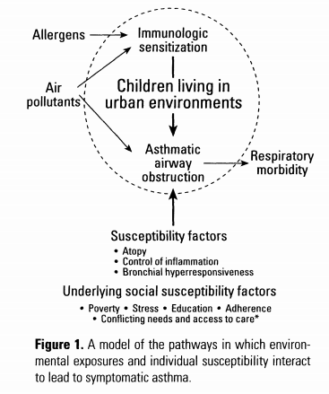
Physical and Mental Health
asthma
undiagnosed vision problems
lack of dental care
other health issues
hunger
lack of sleep
trauma
anxiety
Rothstein, Richard. 2004. Class and Schools. Washington: Economic Policy Institute.
Notes:
For example, let’s spend a couple of minutes on students’ physical and mental health. Happy, confident, energized, physically healthy kids are going to find it easier to learn, all other things being equal, than will kids who are depressed, scared, hungry, exhausted, hurting, or traumatized. This is common sense; there is also good research to back up these common sense claims. In his 2004 book Class and Schools, Richard Rothstein summarizes much of this literature.
Asthma, for example, has become the greatest cause of school absence. Even when students are in school, those with asthma are more likely to be drowsy, less attentive and irritable because the disease keeps them up at night. Rates and effects of asthma are also highly correlated with race, class, and urban living. “Low income children with asthma are about 80% more likely than middle class children with asthma to miss more than seven days of school a year because of the disease” (Rothstein, p. 40). In the United States, the asthma hospitalization and morbidity rates for nonwhites are more than twice those for whites. Asthma also disproportionately limits African Americans’ activity level; about 30% of African Americans with asthma have restricted activity because of their disease. Environmental allergen exposure such as that found in many low-income urban neighborhoods increases asthma rates, as do lack of good medical care, emotional stress, depression, and anxiety.

Slide 7
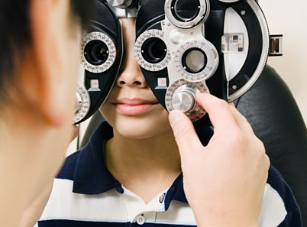

Physical and Mental Health
asthma
undiagnosed vision problems
lack of dental care
other health issues
hunger
lack of sleep
trauma
anxiety
Rothstein, Richard. 2004. Class and Schools. Washington: Economic Policy Institute.
Notes:
Undiagnosed vision problems are another challenge that low-income children of color disproportionately face, and that significantly impedes their success in school. It’s hard to read, learn math, or copy down one’s homework if you can’t see the board! About 25% of children overall have vision problems, but this doubles in some poor communities and communities of color (Rothstein, 37). While public schools are required to test all students for vision problems annually, schools’ vision screening tends not to test for farsightedness or for difficulties with tracking, conditions that also severely affect a child’s ability to succeed in school. According to several studies, uncorrected vision problems are strongly linked with juvenile delinquency. 70% of juvenile offenders are thought to have undiagnosed vision problems (Gould and Gould, 2003).

Slide 8
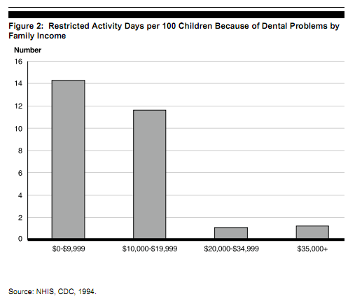
Physical and Mental Health
asthma
undiagnosed vision problems
lack of dental care
other health issues
hunger
lack of sleep
trauma
anxiety
GAO, “Oral Health: Dental Disease Is a Chronic Problem Among Low-Income Populations,” GAO/HEHS-00-72, April 2000, www.gao.gov/new.items/he00072.pdf.
Notes:
Interestingly, lack of dental care also has significant implications for students’ learning. Toothaches distract kids and also keep them out of school. According to the U.S. General Accounting Office, “Poor children suffer nearly 12 times more restricted-activity days, such as missing school, than higher-income children as a result of dental problems.”

Slide 9
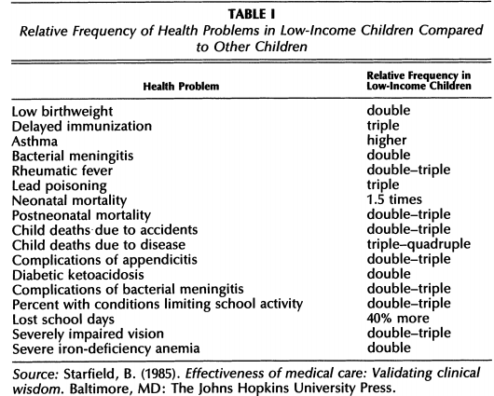
Physical and Mental Health
asthma
undiagnosed vision problems
lack of dental care
other health issues
hunger
lack of sleep
trauma
anxiety
Notes:
These aren’t the only health issues that disproportionately affect low-income children and children of color, of course. Take a look at this chart to see what other health challenges low-income children face.

Slide 10
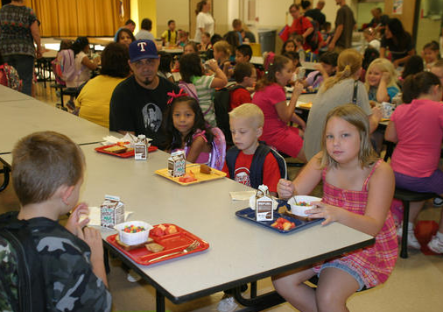
Physical and Mental Health
asthma
undiagnosed vision problems
lack of dental care
other health issues
hunger
lack of sleep
trauma
anxiety
Notes:
Hunger impacts students’ academic achievement and health in profound ways. In national health data, children aged 6 to 11 who reported not having enough food to eat were more likely to have significantly lower arithmetic scores, to have repeated a grade, seen a psychologist, and had difficulty getting along with other children. The impact of hunger on teenagers is dramatic: hungry teens were more than twice as likely to have seen a psychologist, almost three times as likely to have been suspended from school, almost twice as likely to have difficulty getting along with others, and four times as likely to have no friends. These outcomes are at least in part related to the experience of hunger itself, rather than being caused by other underlying issues. Thus, students who take advantage of school breakfast programs learn more, pay greater attention to academic tasks, visit the school nurse less often, and show fewer behavioral problems.
Lack of sleep also obviously profoundly affects students’ readiness and capacities to learn, as do exposure to trauma and anxiety, both of which also are strongly correlated with poverty.

Slide 11
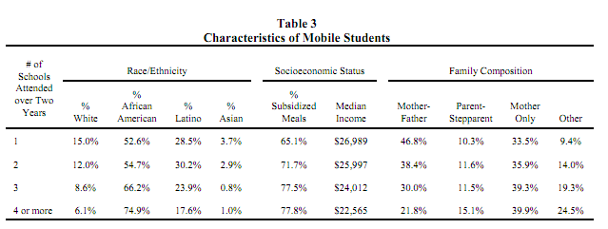
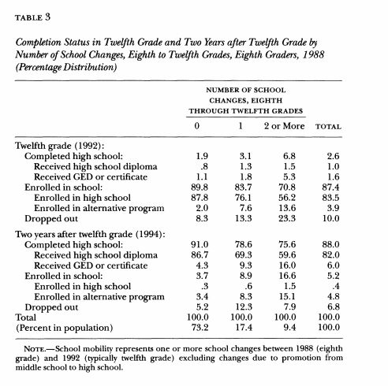
Mobility
Kerbow, David. 1996. “Patterns of Urban Student Mobility and Local School Reform.” Journal of Education for Students Placed at Risk 12: 147-69.
Student Mobility and the Increased Risk of High School Dropout. Russell W. Rumberger and Katherine A. Larson American Journal of Education , Vol. 107, No. 1 (Nov., 1998), pp. 1-35.
Notes:
Along with differences in physical and mental health risk factors, low income students and students of color are more likely to have high levels of mobility negatively affect their schooling. Take a minute to examine this table demonstrating the relationship between the number of different schools students had attended within two years and their demographic characteristics.
Rothstein points out that this level of mobility disrupts the learning of all students, not just those who change schools. “Schools with high mobility are often disrupted by the need to reconstitute classrooms to avoid placing all newcomers together, or because classes get too large or small from new arrivals or departures…So high mobility depresses achievement not only for children who move—each move means readjusting to teachers, classmates, and curriculum—but also for stable children in these schools whose classes are reconstituted and whose teachers use more discrete units and are thus unable to integrate instruction over time. Teachers with mobile students are more likely to review old than introduce new material, and less able to adjust instruction to the individual needs of unfamiliar students.” (Rothstein, 46)
As students get older, the consequences of mobility become more severe. As illustrated in this table, a University of Chicago study found that students who changed high schools between 8th and 12th grades were more likely to drop out of school or to enroll in alternative programs than were students who did not change schools. (Rumberger and Larsen, 21).

Slide 12
Language
Native language spoken
  Languages other than English
  Standard American English (SAE)
  Black English or other variants
Vocabulary
  Size
  Social vs.
  academic
  Content
 | Professional |  | Working-class |  | Welfare
 | parent | child | parent | child | parent | child
Average utterances per hour | 487 | 310 | 301 | 223 | 176 | 168
Recorded vocabulary size | 2176 | 1116 | 1498 | 749 | 974 | 525
Average different words per hour | 382 | 297 | 251 | 216 | 167 | 149
Tracking and High School English Learners: Limiting Opportunity to Learn. Rebecca M. Callahan. American Education Research Journal, Vol 42, No. 2 (Summer, 2005), pp. 305-328.
Notes:
Let’s turn now to how the language use in children’s homes and communities can influence students’ achievement in school.
About 20% of school age youth speak a language other than English at home, and over 10% are considered limited-English-proficient (LEP) or English Language Learners (ELLs). This number has been skyrocketing. During the 1990s, for example, ELL enrollment more than doubled, while overall student enrollment rose only 13%. (Callahan, 2005, p305)
In many public school classrooms, English Language Learners are educated differently than their English-speaking peers. While ELL policy differs from state to state, most states focus on teaching English, segregating English Language Learners into classrooms that are focused on English language acquisition until “enough” English has been mastered.
Furthermore, there are differences in grammar, vocabulary, and academic status between speakers of so-called Standard American English and other variants of English such as Black English. These differences can end up impeding students’ progress if their language is disrespected, forbidden to be spoken, or treated as a deficit or even disability by teachers. For example, many students who speak Black English have been inappropriately diagnosed with reading problems when they say words differently from how a Standard American English speaker would read the words on a page, or when they substitute Black English phonemes for Standard American English phonemes.
Even among those families and communities who do speak Standard American English, the form of English most privileged in schools, there are significant social class differences in how that language is used to communicate with children and others. Let’s consider vocabulary, for instance. A famous study by Hart and Risley (1992/2003) examined the language practices of 40 families of diverse race and class backgrounds over a 2 ½ year period. This included the time before, during, and after all the children learned to talk. As you can see from this table, professional parents speak to their children twice as frequently, using double the vocabulary size and range, than do poor parents. Presumably as a result, children in higher-income families also therefore use a far richer vocabulary than do children in poor families. One of the most striking results is that when 3-year-olds of professional mothers talk to their mothers, they use more words than do mothers on welfare when talking to their own 3-year-olds. This finding created enormous waves when it was first made public.
Let me make sure, however, that we are clear on how to interpret this data. When 3-year-olds of professional mothers talk to their mothers, they use more words than do mothers on welfare when talking to their own 3-year-olds. But that does not mean that preschoolers in professional families have larger vocabularies on average than low-income mothers do. Low-income mothers use large vocabularies with friends, at work, and when speaking to older children or other adults. What it does show is that not only are higher-income three year-olds being exposed to more language than their lower-income peers, but they are also actively producing more language than their peers are even being exposed to, because of the different ways in which mothers restrict their own language use when talking to young children.
The nature of the vocabulary also differs in ways that influence students’ subsequent school performance. Children who are exposed to academic language—such terms as “reason, hypothesize, evidence, cause, predict”—are better equipped to succeed in school than those who are exposed at home solely to social language, unless the school explicitly teaches academic language to all children. Parents’ use of these terms is also highly correlated with socioeconomic status.

Slide 13
Language
Native language spoken
  Languages other than English
  SAE
  Black English
Vocabulary
  Size
  Social vs. academic
  Content
How language is used
  Imperative, descriptive, interrogative
  Tone
  Patterns of linguistic interaction
Forms
  Spoken
  Written
  Read aloud
Notes:
As many of you likely know from having read Lisa Delpit’s seminal article, “Other People’s Children,” other aspects of home language use beyond vocabulary also have significant impacts on students’ subsequent school achievement. In that work, Delpit reveals how many white, middle class families frame commands as questions (“Would you like to put the scissors away?”) and ask children questions to which the adults already know the answer (“What color is that?” “Is it time for dinner?”). She argues that many families from other cultural backgrounds use language differently, using clear imperative language when directions are being given and asking questions only when the speaker truly does not know the answer. Families from different cultures may also adopt contrasting tones to express the same idea or emotion, and structure conversational patterns differently—for example, having an adult direct the conversation, encouraging children to initiate talk, talking over one another, or engaging in call and response. Delpit argues that white, middle-class language-use practices are most frequently adopted in schools, and hence put students who are not white or middle-class at a significant disadvantage.
Finally, students’ early and on-going exposure to different forms of language—spoken, written, read aloud—significantly correlates with their success in school, and is also highly correlated with race and especially class.

Slide 14
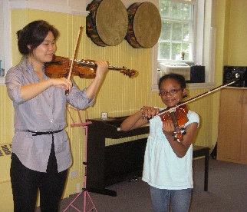
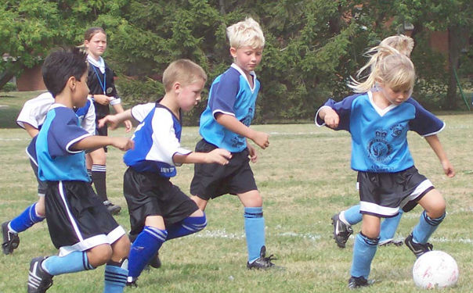
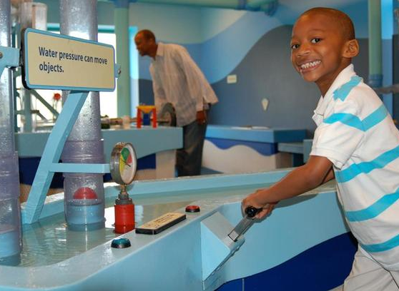
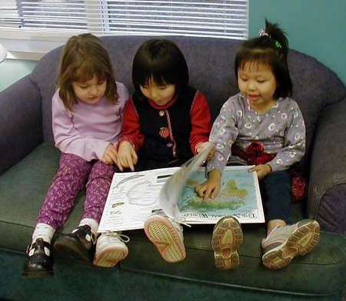
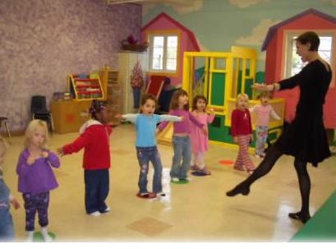

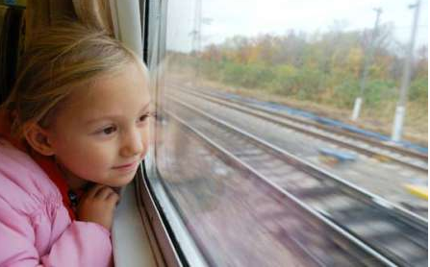

Enrichment Opportunities
Notes:
Higher income students also are more likely to succeed in school because their families have more disposable income to spend on school-related resources and enrichment activities. These may include supplemental resources for the home such as books, kits, musical instruments and computers, as well as fees for museum or zoo entry, lessons and classes after school, concerts and plays, sports, and travel.

Slide 15
Enrichment Opportunities
Percent of respondents in 2010 who use the internet and/or send and receive e-mail at least occasionally:
Education | Hispanics | Whites | Blacks
No hs diploma | 42 | 46 | 43
High School grad | 68 | 64 | 58
Some college or more | 91 | 90 | 84
Annual household income | Hispanics | Whites | Blacks
< $30K | 42 | 46 | 43
$30K - $49K | 68 | 64 | 58
$50K + | 91 | 90 | 84
http://www.pewhispanic.org/2011/02/09/latinos-and-digital-technology-2010/
Notes:
Consider internet use, for example, which influences students’ ability to complete homework and other school-related tasks. According to research by the PEW Hispanic Center, Latinos and Blacks are significantly less likely than whites to have a home internet connection (55% vs. 75%); this difference persists even if the sample is limited to internet users (85% vs. 96%). More significant than race, however, is class. As you can see by examining these tables, racial differences in internet use are relatively negligible, but income and education differences are incredible.

Slide 16
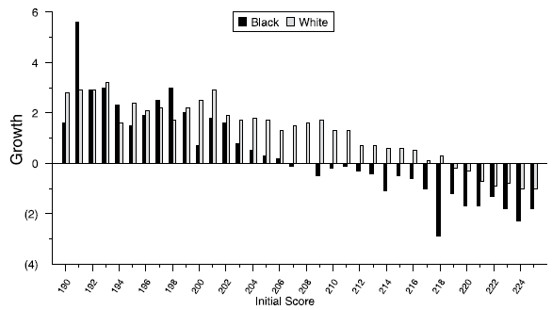
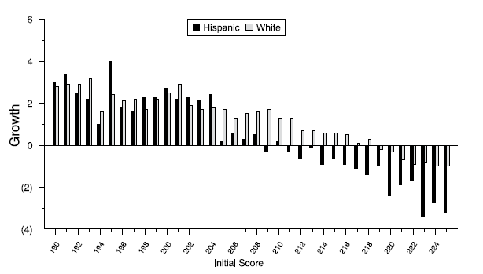
Summer Learning
Average Reading Achievement Level
Summer of Reading
Achievement
Trajectories
Middle-Income Students
no summer school
Low-Income Students
no summer school
Source: Martha S. McCall, et al., Achievement Gaps: An Examination of Differences in Student
Achievement and Growth, Northwest Evaluation Association, November 2006.
K
Summer
1st
Summer
2nd
Summer
3rd
Summer
4th
Summer
Summer Score Changes in Reading for Black, Hispanic, and White Sixth-Grade Students, 2004
Notes:
As you know from the Teacher e-lecture, school-related enrichment opportunities are especially disparate in the summer, and accounts for the most significant growth in the gap between poor and higher-income students, and between white students and black and Hispanic students especially at the higher achievement levels. By the end of fifth grade, low-income children are approximately 2 ½ years behind their more affluent peers, primarily because of summer learning loss.

Slide 17
Cultural Differences
“Parents differ by class in the ways they define their own roles in their children's lives as well as in how they perceive the nature of childhood. The middle-class parents, both white and black, tend to conform to a cultural logic of childrearing I call "concerted cultivation." They enroll their children in numerous age-specific organized activities that dominate family life and create enormous labor, particularly for mothers. The parents view these activities as transmitting important life skills to children. Middle-class parents also stress language use and the development of reasoning and employ talking as their preferred form of discipline. This "cultivation" approach results in a wider range of experiences for children but also creates a frenetic pace for parents, a cult of individualism within the family, and an emphasis on children's performance.” (Annette Lareau, p. 748)
Notes:
It would be wrong to suggest, however, that it is solely financial resources that determine middle-class kids’ greater access to lessons and other enrichment activities as compared to working class and poor kids. Rather, as Annette Lareau has shown in her seminal work on Unequal Childhoods, cultural and philosophical differences in child-rearing practices are also a significant factor. Read this quotation from her before moving on.

Slide 18
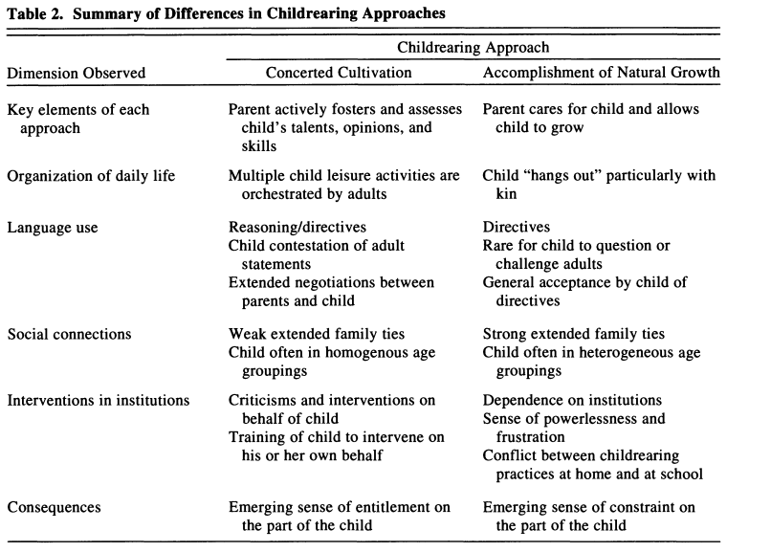
Concerted Cultivation versus Natural Growth
Invisible Inequality: Social Class and Childrearing in Black Families and White Families. Annette Lareau. American Sociological Review, 67(5), pp. 747-776.
Notes:
By contrast, Lareau describes the childrearing philosophies of working class parents as motivated by “the accomplishment of natural growth.” She says, “These parents believe that as long as they provide love, food, and safety, their children will grow and thrive. They do not focus on developing their children’s special talents. Compared to middle-class children, working-class and poor children participate in few organized activities and have more free time and deeper, richer ties within their extended families.” (pp. 748-749)
This table does not show the many benefits of “accomplishment of natural growth” child-rearing approaches that Lareau identifies in her work. In addition to deeper ties with family, she emphasizes children’s capacity for self-direction, independence, and conflict resolution, among other benefits.
Nonetheless, these cultural differences have significant consequences for students’ success in school. You can see this in the last two rows of Lareau’s table. “Cultivated” children and parents both tend to have a greater sense of entitlement to more and better educational services and to be taken seriously in school. There is also greater cultural congruence between cultivated activities and most schools, whereas the skills and habits developed by children under the “accomplishment of natural growth” approach often go unrecognized or are even culturally at odds with school personnel’s expectations for children.

Slide 19
Pause and think:
What features of students’ and families’ out-of-school background characteristics and experiences influence their in-school achievement?
Why do these differences impact school achievement? Are they inevitable?
Notes:
As usual, I’ve flooded you with data. So, pause and think to yourself, how would you now answer the first framing question? What features of students’ and families’ out-of-school background characteristics and experiences influence their in-school achievement? Also, though, start thinking about the second framing question. Why do these differences impact school achievement? I’ve obviously given some indications of the “why” already. But it’s worth asking, is the impact of these differences on school achievement inevitable? After you think about these questions for a few minutes, click to move forward, and we’ll start exploring this second question.

Slide 20
Intrinsic vs. Constructed Inequities
Intrinsic Factors
Asthma
Emotional Distress
Lack of Sleep
Physical Hardship
Hunger
Constructed Factors
Home Language
School Readiness
Incoming Skills
Mobility
Language
Poverty
Notes:
Although I have thus far talked as if these all inevitably impact kids’ educational achievement, that’s not actually accurate. Some are intrinsic, or absolute, because they impact students’ likelihood of learning no matter what. Others have an effect only because of how schools themselves are constructed; they could operate in a way that reduced or even eliminated their effects on students’ learning.
Intrinsic, or absolute, factors, include most of the physical and emotional challenges I talked about before: health problems, emotional distress, lack of sleep, physical hardship, and hunger. These are likely to impact a students’ achievement level regardless of what happens once students walk through the [school] door.
But many of the other differences do not necessarily impact students’ achievement; it depends on how those differences are constructed by the school.
Consider students’ home language, for instance. Speaking Spanish at home is not intrinsically educationally harmful. It’s essential to school success, in fact, if one attends a Spanish-speaking school! Rather, Spanish is an educational limitation only if is treated as a deficit rather than an asset, and if the school’s expectations for children’s language development and use are based on the assumption that all students are monolingual English speakers. This is often true in monolingual English schools, but there is no reason to view this as necessary or even sound educational practice. On a personal note, our family has experienced this shift in our language status w/our daughters at the Hernandez, a dual-immersion Spanish-English bilingual school in the Boston Public Schools. Our being monolingual English speakers is a clear deficit—but not one we had ever experienced as a deficit before, since we and our children had always also attended monolingual English schools. In this respect, dual-immersion bilingual schools, and/or benefits of bilingualism could make non-English home language a plus rather than a problem.
“School readiness” measures are also often constructed as deficits rather than measuring intrinsic challenges to learning. First of all, we set school readiness standards by what is considered “normal.” Phonemic awareness is a relevant skill coming in only because schools expect students to have it. If they didn’t, then children’s lack of it wouldn’t be a problem. Also, there are a lot of skills that students have that are considered irrelevant, or more to the point, are just not considered at all. Consider, for example, generosity, awareness of the natural world, technological prowess, and street smarts. Any one of these could be considered relevant to school-based learning, and a meaningful difference that tracks demographic differences. But they aren’t, so a child’s ability to navigate a mile from home to school, for example, is considered irrelevant when assessing school readiness.
Some of the differences we’ve examined arguably fall in the middle. Mobility is an absolute harm because the instability can be upsetting and disruptive to children. Breaks in friendships are hard no matter what. But it’s also in part a constructed harm because U.S. schools are so diverse in their curricula and pedagogies. In other countries, mobility might not be so problematic because there’s a consistent curriculum across the nation or even district. Language is absolutely necessary for eventual school success, and it has to matter that upper income preschoolers on average may have a larger active vocabulary than poor adults, and that kids are exposed to such different amounts and kinds of language (positive vs. negative, open vs. closed, etc.) based on class. At the same time, schools could do much more to prevent this from being treated as a deficit. Let’s go to the next slide to consider poverty.

Slide 21
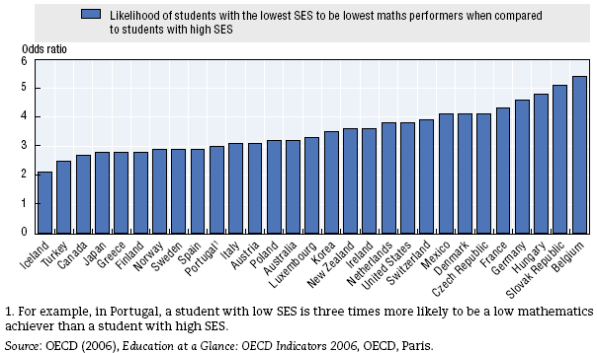
Global correlations of class and school achievement
http://isites.harvard.edu/fs/docs/icb.topic867664.files/OECD_Equity%20in%20Education.pdf
Notes:
The fact that poverty will always influence but need not inevitably determine students' educational success is captured well by this graph. The intrinsic relationship between poverty and school success is brought home by the fact that in even the most educationally egalitarian countries, the poorest students are more than twice as likely to do poorly in math than are the wealthier students in those countries. On the other hand, the fact that income need not determine educational destiny can be found in the comparison between the countries on the left-hand side of the graph with the countries on the right side. If poor students in France are more than four times as likely to perform badly in math than wealthy French youngsters, while poor Turkish students are only 2 ½ times as likely to do poorly in math, then that suggests that there are cultural or other educational practice effects at work. The educational inequities on the right-hand side of this graph are constructed, not intrinsic.

Slide 22
How can schools, families, communities, and other institutions mitigate these differences—independently or in partnership—in order to promote equitable educational outcomes? Who should do this work, where, and in what ways?
Notes:
These analyses bring us, then, to our final framing question.

Slide 23



Who, Where, What, How?
Change or even eliminate the underlying inequities
Notes:
Many argue that equitable educational outcomes will be achieved only once equitable student inputs are achieved: in other words, only once all children are free from hunger, trauma, untreated health problems, and so forth. This is the premise behind the so-called “Broader, Bolder” group, which is led in part by Richard Rothstein. They argue that it is unfair to educators and an abdication of our responsibility to students and families if we focus even the majority of our attention on school reform, absent a relentless focus on social welfare and economic reforms. These include support for universal healthcare, universal high-quality preschool access, and so forth.

Slide 24
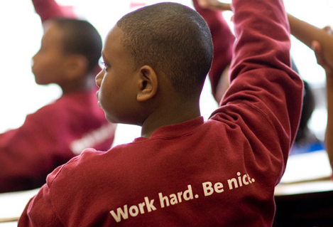

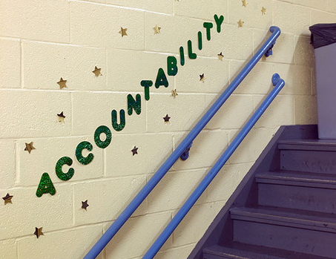
Who, Where, What, How?
Change or even eliminate the underlying inequities
Change the schools
Notes:
A counter-approach is to focus relentlessly on changing the schools, as they are more directly under public control than job creation is, say, and because the results can be seen and felt immediately, in the here-and-now. They also serve kids most directly. Other approaches that emphasize the need for more comprehensive social reform are derided as an “excuse” for failing poor kids.

Slide 25
Who, Where, What, How?
Change or even eliminate the underlying inequities
Change the schools
  No Excuses charter movement
  Culturally congruent education
  Personalization/Individuation
    data
    technology
    Montessori
    apprenticeship
Notes:
The most prominent of these school-focused approaches is probably the No Excuses charter movement. Their approach is to construct schools so as to provide everything students need to succeed within their four walls. At its most effective, these include tutors, an extended school day and year, contracts requiring teachers to be available by cell phone until late at night, and on-site health care, as well as highly trained teachers and rigorous curriculum. They also tend to emphasize students’ acquisition of cultural knowledge and practices that replicate middle-class approaches and that will equip students to succeed in middle-class-dominated worlds of career and college.
As we know from previous classes, however, the “no excuses” model is not the only approach to whole school reform that tries to eliminate inequities in educational outcomes. There are also a number of schools that pursue culturally congruent education, including freedom schools, bilingual or immersion schools, or single-sex or single-race academies. A number of urban districts include one or more public schools that are specifically targeted toward African American boys, for instance, to Hmong or other ethnic minority groups, or to recent immigrants in general.
Personalization or individuation of schooling is also coming to the forefront as a means of reforming schools to eliminate educational inequities. These may come in the form of data-driven instruction, where students are assessed frequently for specific target skills and knowledge and moved up levels as they meet their targets, or offered reteaching and remediation if they fail to succeed. Many direct instruction programs, like Success for All, use this kind of model. Many urban districts are also trying to implement this kind of constant benchmarking and formative assessment across the subject areas and across the year. Often, these approaches are enhanced or mediated by technology. The boldest of these are like the School of One, where there are no grade-level or whole-class lesson plans, but rather a menu of lessons available to each student as he or she needs it. A non-technologically-mediated version of this approach may arguably be found in Montessori education. A very different model of personalization can be found in Big Picture schools and others that pursue apprenticeship and externship models. With these schools, students aren’t matched with lessons designed to develop preselected targeted skills and knowledge. Rather, students are given the opportunity to identify their own learning goals and work in authentic, adult-oriented settings in order to gain the skills and knowledge they most care about.

Slide 26
Who, Where, What, How?
Change or even eliminate the underlying inequities
Change the schools
Both/and: Tackle underlying inequities in part through and with school reforms
  Community schools
  Surround care in schools (extended day, enrichment activities, health clinics, etc.)
  Harlem Children’s Zone
Notes:
There are also some prominent initiatives that take a “both/and” approach to the first two bullets of eliminating underlying inequities through social means and changing the schools. One that has come and gone and sometimes come again over the past century is the community school model. One form of this model envisions the school as involved not only in serving the children who walk through its doors each day, but also in serving these children’s families and neighborhood. School experts, and often students under their guidance, are deputized out into the local community to do community mapping exercises, to disseminate healthier eating or sanitation practices, or to advocate for improved policies and services. Another approach to community schooling brings families and other residents into the school. Rather than the school reaching out into the neighborhood, community members are drawn into the school thanks to health clinics, social service offices, recreation centers, English language and computer classes, and other resources being located within the school building. The Harlem Children’s Zone represents a third “Both/and” approach, where neither the school nor political, social, and economic reform are privileged above the other, but are seen to go hand-in-hand in order to improve the life-chances of children living in about 84 blocks of Harlem.

Slide 27
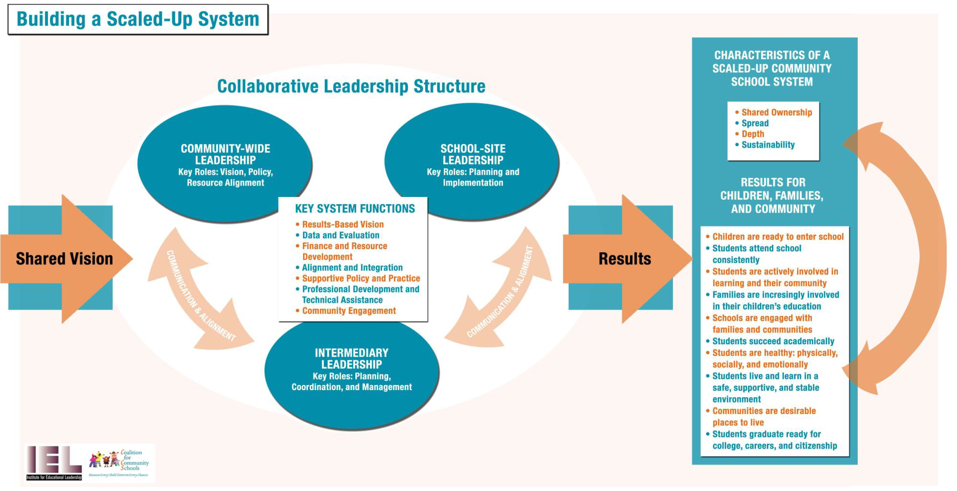
Both/And
Notes:
The Coalition for Community Schools represents another model for providing more comprehensive support for families by connecting schools and community organizations through intermediaries in the school. In this model, the school, the community, and intermediaries work to provide a more comprehensive set of services to students and families.

Slide 28
Who, Where, What, How?
Change or even eliminate the underlying inequities
Change the schools
Both/and: Tackle underlying inequities in part through and with school reforms
Change the paradigm: Shift from deficit- to asset-based approach. Rethink who has the answers to these questions in the first place.
Notes:
Finally, there are reformers who reject both the “teach as if it doesn’t matter” model, and the surround-care model.
Some believe that communities need to reeducate schools, not the other way around. If they can help schools recognize the assets that students and families bring to the table, as well as respond appropriately to their self-identified needs and aspirations, then the vicious link among poverty, ethnoracial and linguistic minority status, and school achievement may be broken. Community organizers and reformers such as Logan Square in Chicago, the Boston Parents Organizing Network here in Boston, and the Industrial Areas Foundation, which sponsors interfaith community organizing nationwide, are good examples of these.
On the opposite side of the spectrum is what I think of as the “shut it out” approach to schooling, where background differences are supposedly eliminated by minimizing or even eliminating children’s exposure to diverse families and communities. These include boarding schools, as well as highly extended day schools in which students show up before breakfast and leave after dinner.

Slide 29
Pause and think:
Will acknowledging the necessity of doing more than academics, and stuff outside schools, let educators off the hook?
Does not acknowledging this necessity let politicians and the greater public off the hook?
Will it enable educators to focus on and improve what they can, and hold politicians and others accountable for providing kids what they need to succeed?
Will it lead people to give up on public schools and self-segregate even further?
What will you do? Where will you put your energies?
Notes:
I expect within the next 5 years, some of these movements will converge in terms of what they actually believe is “best practice.” The “no excuses” model has done more and more to pull families in, provide health and social services, and provide other kinds of community support. The “broader, bolder,” “we need sound jobs and health policies” approach has spent more time recently on school improvement and especially teacher training and development issues.
But where they may not converge is their theory of change with regard to educational improvement. Will acknowledging the necessity of doing more than academics, and stuff outside schools, let educators off the hook? Or does not acknowledging this necessity let politicians and the greater public off the hook? Will it enable educators to focus on and improve what they can, and hold politicians and others accountable for providing kids what they need to succeed? Or will it lead people to give up on public schools and self-segregate even further?
There is enormous contention right now about whether schools can eliminate inequities of outcomes if they just try hard enough. Arguments against include findings that so-called 90-90-90 schools, schools with 90% poverty, 90% minority, and 90% proficient students, are very few and far between, and their achievements tend to be shockingly short-lived. KIPP graduates turn out to have only a 35% college graduation rate, and that’s after lots of winnowing given that many KIPP and other charter schools hemorrhage students between 9th and 12th grades. On the other hand, a 35% college graduation rate is in some cases 6 times the rate of the surrounding district. There are other examples of success, too, that don’t follow a “no excuses” model: High Tech High in San Diego, Boston Arts Academy, and the Big Picture Schools network, of which the Met was a founding member. It is clear that high-quality schooling can make a difference on its own. We just don’t know how much.
So, where will you put your energies as you work in or with urban schools and districts??

