Slide 1
E-Lecture 2:
School Finance
Notes:
Welcome to our e-lecture on school finance. If for some reason you do not remember how to navigate through this e-lecture or use Articulate, please return to the first e-lecture, on school segregation and desegregation. Press the forward arrow to advance to the next slide. Remember, it may take a few seconds for the next slide to load depending on your connection speed.

Slide 2
SCHOOL FINANCE
How are schools financed in the United States?
How does the financing of urban district schools compare to financing of suburban or rural district schools, on the one hand, and to urban charter schools, on the other?
How significant is equitable financing for equitable educational outcomes?
What does, can, and should money get used for in urban school systems?
How is federal financing through ARRA and RTTT changing the answers to these questions?
Notes:
As a reminder, we will focus on the following framing questions for our class session on School Finance. Press pause to give yourself time to read them to yourself, and then press play to proceed. This e-lecture will focus on the first three framing questions in particular.

Slide 3
How are schools financed in the United States?
Combination of local, state, and federal funds
Avg. contribution: 45% local, 45% state, <10% federal – but wild variations in local vs. state ratios
2010 federal funding about 10.5% -- record high
Notes:
Let’s start with some basic information about how schools are financed in the United States.
All public schools are funded by a combination of local, state, and federal funding, with local and state sources providing the bulk of public school funding. On average, schools receive about 45% of their funding from the city or school district itself, and 45% of their funding from the state, with less than 10% of their funding coming from the federal level. There are, however, wild variations in the amount of local versus state funding a district receives, depending on the structure of the relationship between school districts and states, how wealthy or poor the district is, how wealthy or poor the state as a whole is, and other issues. Hawaii, for example, is a single district state; all funding of public schools in Hawaii therefore comes from state level. By contrast, in other states local districts may fund the lion’s share of expenditures, with especially wealthy districts funding up to 70 or 80% of their own budget.
Because of the federal stimulus package, the American Recovery and Reinvestment Act known as ARRA, federal funding in 2010 is higher than it’s ever been at 10.5%. This is thanks to the $50 billion provided to states to “stabilize” their school systems, and another $50 billion in various other education-related stimulus funds. But even at these levels, federal education spending is a relative drop in the bucket compared to local and state sources.

Slide 4
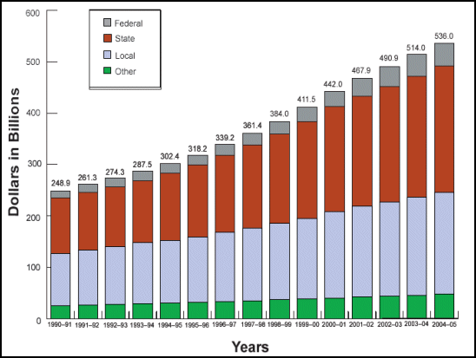
Total U.S. Expenditures for
Elementary & Secondary Education
How are schools financed in the US?
over ½ trillion $ per year!!!
Source: http://www.ed.gov/about/overview/fed/10facts/edlite-chart.html
Notes:
This graph shows the total amount of US expenditures for elementary and secondary education broken down by federal, state, local, and other funding sources. Other funding sources may refer to philanthropic contributions, parental contributions to the PTA, partnerships with local universities, etc. You can see that the relative expenditures have remained pretty constant over time, but the total amount of spending has skyrocketed. So in just the last 20 years, the amount of money spent on education in the United States has more than doubled, and it is continuing to increase.
As you can see we now spend half a trillion dollars per year on education in the United States! We will come back to the question of what we’re getting for all of this money a little later in the lecture.

Slide 5
How are schools financed in the United States?
Combination of local, state, and federal funds
Avg. contribution: 45% local, 45% state, <10% federal – but wild variations in local vs. state ratios
2010 federal funding about 10.5% -- record high
Local funding source: property taxes
State funds follow variety of models:
  fixed per-pupil allocation
  redistributive by district
  redistributive by student characteristics
  incentives-based and/or performance-oriented
Notes:
As you probably know, local school funding comes from one source: property taxes. This has a historical explanation, but no moral justification. It would be hard to find anyone who could offer a straight-faced principled justification for this method of school financing, as the result is that poor communities in the U.S. are able to raise and spend less money on education than wealthier communities can and do. Wealthy areas with high-worth houses and land can in fact tax themselves at relatively low rates and still collect far more in school funding than poor areas with low-value property that tax themselves at much higher rates. As I’ll discuss in a few minutes, these disparities can run into the thousands of dollars per school-age child, and hence millions of dollars per school or district. Linking back to our class on segregation and desegregation, this fact accounts for some of the reluctance of wealthier communities—say, some suburban districts—to merge with poorer, often urban or rural districts. It is not in their interest to merge with districts that provide a lower tax-base with respect to property values.
Whether property taxes make up the bulk of districts’ funding, stay at the district level, and/or are used for essential versus supplemental services varies significantly state to state. Oftentimes, a state will provide a baseline of general funds and then local property taxes will make up the rest of school funding including anything “extra.” In other cases, local property taxes form the base of school districts’ support and the state props up especially poor districts. In this respect, state funds follow a variety of models.
They may give districts certain set amount of money for every student they serve, regardless of the characteristics of either the students themselves or the district.
They may redistribute funds by district, really meaning by the size of the local property tax base, so that wealthy districts are contributing to poor districts. This is known as “Robin Hood” financing.
States may also redistribute funding based on student characteristics, giving more money to districts that serve students in poverty, English language learners, students with special needs, etc.
And finally, states may offer incentives via performance-based funding, whereby districts are awarded extra funds for doing well and demonstrating the capacity to use funds appropriately and effectively.

Slide 6
How does the financing of urban district schools compare to financing of suburban or rural district schools, on the one hand, and to urban charter schools, on the other?
Notes:
Now that we’ve seen the sheer size of education expenditures in the US, and learned a bit about variations in states’ school financing approaches, I hope you’re wondering how different kinds of districts compare. So this brings us to the next framing question: how does the financing of urban district schools compare to the financing of suburban or rural district schools, on the one hand, and urban charter schools on the other? Let’s start finding out!

Slide 7
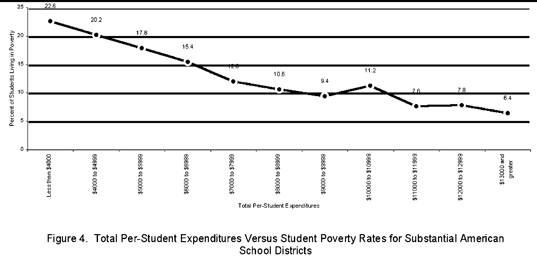
How are school financing and student demographics related?
High-poverty schools tend to have lower levels of funding than low-poverty schools
(1998)
Source: http://epsl.asu.edu/eprp/EPSL-0206-102-EPRP.doc
Notes:
To begin with, let’s start by looking at the relationship between school financing and student characteristics.
This chart shows that school financing basically works exactly against poor kids, in so far as high-poverty schools, meaning schools that serve a lot of poor students, tend to have lower levels of funding than low-poverty schools. So you can see that schools that spent less than $4000 per student in 1998 tended to have almost a quarter of their students in poverty, whereas schools that spent over $13,000 a year in 1998 had an average student poverty rate of only 6.4%. And you can see that the graph is almost uniformly downward so that the more schools spend, the less likely they are to be serving kids in poverty.

Slide 8
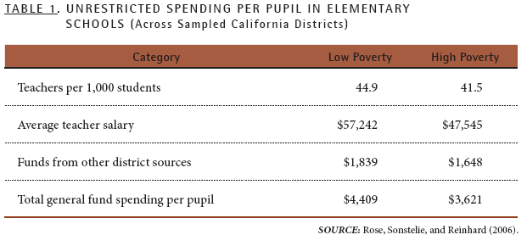
How are school financing and student demographics related?
High-poverty schools tend to have lower levels of funding than low-poverty schools
Hill, Roza, and Harvey, 2009, p. 10.
Notes:
You can see this here, too, in a study of California districts. Not only do low poverty school districts spend more money per capita than high poverty school districts, but they also receive more funds from other district sources and spend almost 20% more on average teacher salary.

Slide 9
How are school financing and student demographics related?
High-poverty schools tend to have lower levels of funding than low-poverty schools
High-minority schools <$ than low-minority schools
 | Gap in Per-Pupil Funding
High-Poverty versus Low-Poverty Districts | –$773 per student
High-Minority versus Low-Minority Districts | –$1,122 per student
Education Trust analyses based on U.S. Department of Education and U.S. Census Bureau data for the 2005-06 school year.
Source: http://www.edtrust.org/sites/edtrust.org/files/publications/files/Funding%20Equity%20Data%20Points.pptx
Notes:
Given what you have now learned about school segregation, you'll probably also not be surprised to find out that
high minority schools tend to get less funding than low minority schools.

Slide 10
How are school financing and student demographics related?
High-poverty schools tend to have lower levels of funding than low-poverty schools
High-minority schools <$ than low-minority schools
Property-tax-based funding chief but not sole culprit
Even federal funds targeted to poor children (e.g. Title I) over-fund low-poverty districts and states and underfund high-poverty ones.
Title I Allocations Per Poor Child in Selected States, 2008-09
MD | IL | KS | GA | TX | WA | AL | ID | UT
$2,067 | $1,822 | $ 1,707 | $1,561 | $1,425 | $1,408 | $1,366 | $1,286 | $1,238
Source: http://www.edtrust.org/sites/edtrust.org/files/publications/files/Funding%20Equity%20Data%20Points.pptx
Notes:
You may think that these differences in funding are substantially due to the differences in property tax base at the district level. Schools that serve a high percentage of kids in poverty are also likely situated in towns that have a relatively low property tax base, and therefore cannot raise as much money as wealthier districts. This is true, and is the main reason for the differences in funding between low and high poverty districts. But there are also some very perverse funding patterns that actually exacerbate the problem.
Because of how federal Title I funds are calculated, for example, even the federal government tends to overfund wealthier districts and states and underfund poor districts and states. This is because the federal government ties its funding to the funding provided by the state.
So if a child lives in a relatively poor state that does not fund schools very well, such as Alabama, then that child also receives fewer funds from federal sources then a child who lives in a wealthier state that funds schools more generously, such as Maryland.

Slide 11
How are school financing and student demographics related?
High-poverty schools tend to have lower levels of funding than low-poverty schools
High-minority schools <$ than low-minority schools
Property-tax-based funding chief but not sole culprit
Even federal funds targeted to poor children (e.g. Title I) over-fund low-poverty districts and states and underfund high-poverty ones.
Local and state funding tend to reduce proportionately when federal compensatory funds are provided
Even supposed within-district equity often hide salary inequities because budgets are done by FTEs, not salaries
Notes:
There have been attempts to overcome this problem by disproportionately funding poorer districts and schools from state and federal sources.
One problem, however, is that districts and states often tend to reduce the funding that they allocate schools when supplemental funding is provided by the state or national government.
Furthermore, even when it appears that school funding is pretty equal, this can often hide quite gross inequities in actual expenditures, because teacher salaries are often not calculated in the budgets at all. Instead, schools are assigned a certain number of FTEs, or full-time teacher equivalent slots, which they use as they see fit—or more to the point as they are able. Schools that serve a lower poverty and lower minority population often are able to attract and retain more highly qualified teachers who earn a higher salary thanks to having more advanced degrees or more years of teaching experience. Two schools with same number of FTEs, therefore, may in fact be spending very different amounts on teacher salaries, with one school spending, say, nearly double what the other spends. These differences usually are not revealed when one compares the budget of one school to another within the district

Slide 12
Ohio: Within-district teacher salary gaps between high- and low-poverty schools
District | Gaps in Average Teacher Salaries Between Highest Poverty and Lowest Poverty Elementary Schools, 2007-08
Akron | -$4,919
Canton | -$6,397
Cincinnati | -$2,637
Cleveland | -$204
Columbus | -$1,509
Olentangy | -$6,246
Source: “No Accounting for Fairness: Equitable Education Funding Remains Elusive in Ohio,”
The Education Trust, December 2008.
Source: http://www.edtrust.org/sites/edtrust.org/files/publications/files/Funding%20Equity%20Data%20Points.pptx
Notes:
This chart reveals these disparities at work in Ohio. There are many other examples.

Slide 13
How does the financing of urban district and charter schools compare?
“In most states … charter schools receive less public funding per student than school districts, and they also lack access to locally generated revenues or funds districts typically receive for facilities, transportation, and other specific functions. Inequitable resources remain a major barrier to quality and scale in the charter school movement and, since charter schools in most states disproportionately serve minority and disadvantaged populations, a civil rights issue.”
--Mead and Rotherham, 2007
Notes:
Turning from comparisons of regular district public schools, let’s now see how district and charter schools compare. Charter schools quite consistently get lower levels of funding than regular district schools. On average, one advocacy group has calculated, charter schools receive only 60% of the funding that regular district public schools receive. This is in part due to straight funding disparities, and also as this quotation testifies to, in part because of disparities in in-kind funding of facilities, central office functions such as payroll and human resources, centralized diagnostic and assessment services, and so forth.

Slide 14
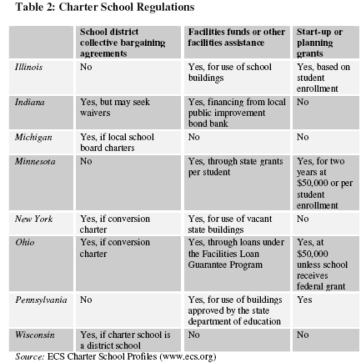
Collective Bargaining, Facilities, Start-Up Grants
Source: http://epsl.asu.edu/epru/documents/EPSL-0803-257-EPRU.pdf, p. 11.
Notes:
You can see examples of the different levels of support that charters receive for funding their operations, as well as the variation in the extent to which they are held to local collective bargaining agreements. Take a moment to look through this chart to get a sense of this range.

Slide 15
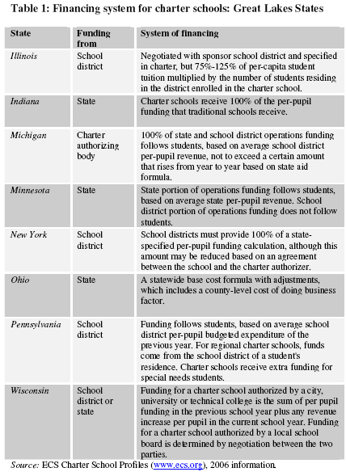
Sample Range of Charter School Funding Formulas
Source: http://epsl.asu.edu/epru/documents/EPSL-0803-257-EPRU.pdf, p. 10.
Notes:
Charter schools may reside within districts, and may even serve students only within a particular district, but their charter to operate as a public school and hence also their funding are often funneled through the state. As with regular district public schools, however, funding mechanisms vary wildly state to state. In some states, districts have to give charters an amount equivalent to their average per-pupil expenditure for every in-district student who attends a charter school. In other states, districts transfer no money directly to charters, although they do lose their portion of state funding for each student who attends a charter rather than a district school. Here you can take a look at a sample range of charter school funding formulas to get an understanding of the variety of approaches states take to funding charter schools in this country.

Slide 16
How does the financing of urban district and charter schools compare?
Charter complaints about state/local funding:
Funding transferred from state or school district is often lower than district’s own per-pupil expenditures
Charters denied in-kind goods and services
Funding fails to take account of start-up costs
District and union complaints about charter funding:
Funds follow students to charters, but often don’t follow them back mid-year
Lack of union contracts → lower teacher salaries and other benefits
Low public oversight or accountability
Notes:
So charter school advocates and operators often complain bitterly about the lack of funding that they get to compete equitably in serving students, especially in so far as most charter schools, as Mead and Rotherham note, tend to serve predominantly low income and minority student populations.
They object that they receive lower levels of funding than local districts spend, either because they receive money only from the state, which may include no district top-up, or because the percentage of funds transferred from the district is lower than the district’s own per-pupil average.
Furthermore, charters point out that even if districts transfer 100% of their per-pupil allocation, this average often fails to take account of many in-kind goods and services provided by the district to their schools, including nursing and other medical services, human resources, data management, facilities upkeep, transportation, curriculum development, professional development, or other services.
Since charters have to find their own buildings, hire new administrators and teachers, recruit students, select curricula, and so forth, they also have many start-up costs that on-going district schools avoid. Charter operators are also frustrated that these costs are rarely covered by public financing.
At the same time, school districts and unions have significant complaints about charter funding.
Every student who attends a charter school costs the district money either indirectly due to lost state financing or more directly due to the district’s being required to transfer funds to the charter school. District officials often object that funds follow students to charters but rarely follow them back. If a student is expelled from or leaves the charter school and return to a regular district public school, the funds often stay in the charters’ coffers. Since many charter schools have an attrition rate of over 50%, this is a significant financial concern for districts.
Furthermore, insofar as many charters are freed from the constraints of union contracts, they also often offer lower salaries and fewer other benefits. They may demand longer work days, a longer school year, Saturday attendance, or additional summer sessions that are uncompensated, along with increased availability to students, say via cell phone until 10 or 11 p.m. Union officials worry that these mandates dilute their strength to negotiate contracts for regular district public school teachers.
Finally, many district and union officials are worried about the relatively low public oversight or accountability that charter schools have, including over the funding that they get. Although charters are in theory awarded for a limited amount of time and schools need to prove that they are living up to their charter, in practice it is relatively rare for a charter school to be shut down by the state. Furthermore, there is little oversight of how charters are spending their money.

Slide 17
How significant is equitable financing for equitable educational outcomes?
Does money matter?
Notes:
So we can see that schools even in the same district are often funded at very different levels from one another, that districts often spend radically different amounts from one another, that charter schools tend to be funded at lower levels than district schools, and that states spend very different amounts from one another on education. We have also seen that the federal government provides about 10% of education funding in the United States, and that even those funds go disproportionately to fund wealthier rather than poorer districts and states.
This all matters, of course, only if how much money the school or district has affects the quality of education is able to provide.

Slide 18
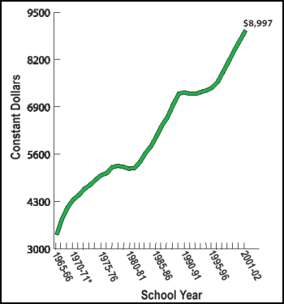
Real spending has tripled in the past half-century. Has the quality of education similarly increased??
In the past decade (2001-2011), average spending has increased another 10%.
Source: http://www.ed.gov/about/overview/fed/10facts/edlite-chart.html
Notes:
Many people fundamentally question this assumption. If we look at this chart for example, we see that in the past 50 years, real spending on education in the United States has more than tripled. As almost anybody would agree, the quality of education provided to kids in the United States has not similarly increased. It may well be that we are serving more kids and needier kids, but it is clearly not the case that we have actually tripled the quality of schooling. In light of this and other data, many scholars suggest that money is not actually at the root of school quality, and hence that inequities in school funding should not in and of themselves be taken to imply that there are inequities in educational provision.

Slide 19
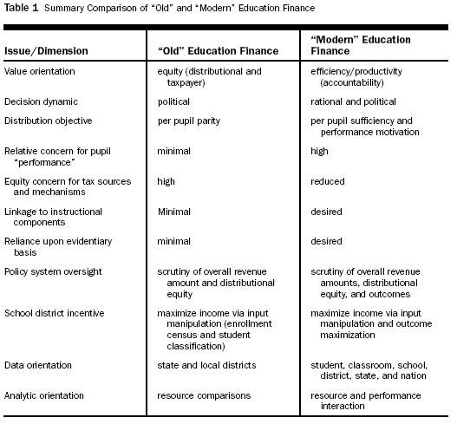
Guthrie, 2006, Table 1
Notes:
Since the conclusion that money doesn't matter with respect to educational quality is to say the least counterintuitive, it may help to look at some analyses of how education is financed—not what dollars come from where, or how many total dollars there are, but how money is allocated once schools and districts have it. This chart provides a nice comparison of so-called old versus new approaches to education finance. As you can see in the middle column, the focus used to be on equal input allocations—in other words, on making sure that schools were receiving the same amount of money per pupil, got the same sets of textbooks, or had the same number of teaching slots. School finance under this “old” model was not at all tied to educational outcomes such as learning. Under so-called new or modern educational finance policy, summarized in the right hand column, the emphasis is much more strongly on outputs as opposed to inputs. The idea is that it's irrelevant if schools get an equal number of dollars to start with if no attention is being paid to whether or not students are actually receiving an equal quality education. Here, money is allocated in order to boost student performance; successful schools or programs may be expanded where others are shut down; schools and districts are given much more control over their budgets to use the money as they see fit to raise student performance as opposed to comply with bureaucratic regulations about how money is expected to be spent, and so forth. Advocates of modern educational finance argue that policymakers' and scholars' obsession with input equity substantially hampered schools' and districts' abilities to use money to good educational ends, while modern educational finance does not suffer these problems.

Slide 20
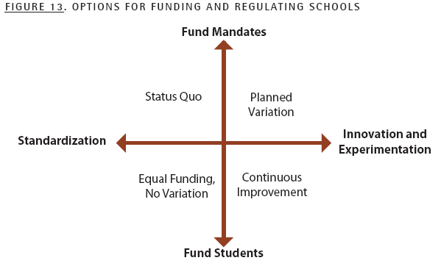
Hill, Roza, and Harvey, 2009, p. 37.
vs.
“Money matters when the real inputs that it purchases matter.” (Ferguson, 1991, p. 483)
Notes:
This graph sums up some of the ideas in the previous slide in a different way. You can see in the top left quadrant, marked the status quo, that what has traditionally been valued is that specific mandates or inputs are funded equitably and in a standardized fashion. These may be anything from class-size maxima to school lunches to numbers of allocated administrative staff to textbook resources to funding for psychological services, whatever. This quadrant is arguably the most focused on input equity. The bottom left quadrant maintains equity of funding but focuses on students as opposed to mandates. This may provide schools or districts more flexibility in how they spend money but continues to view money itself as the determinative factor with respect to educational potential and performance. The bottom right-hand side, however, is where true advocates of modern educational finance tend to sit. They promote the idea that funding should focus on students as opposed to programs or mandates and should be used to fund innovation and experimentation. So long as students are learning and money follows the programs that help students learn faster and better, then equity or standardization should be off the table. This approach to school funding, which frankly minimizes concerns about prima facie equity, may be
posed against such views as
Ron Ferguson’s, where he says that money matters when the real inputs that it purchases matter. Advocates of this view of school financing point out that it is absurd to think that money in and of itself is irrelevant to the potential for school quality. They agree that money can be used badly, and historically especially in urban schools often has been used badly. But they point out that it is not that inputs are irrelevant to school quality or students’ educational outcomes. The point is to make sure that money is spent wisely as opposed to foolishly. In this respect equity would continue to matter.

Slide 21
Pause and think:
Does equity in educational financing matter?
Should we be spending more, less, or the same amount of money on education overall than we do now? How about on urban schools in particular? What else would you want to know to answer these questions?
If you were to look at school or district financing data, what would you want to know in order to assess it? What data matters to you? What values matter to you?
Notes:
Enough ideas have been introduced by now that it’s time to stop and think. It may help for you to think through your answers to the following three sets of questions:
First, given everything that I’ve presented so far, do you think that equity in educational financing matters?
Second, should we be spending more, less, or the same amount of money on education overall than we do now? How about on urban schools in particular? What else would you want to know to answer these questions?
And third, if you were to look at school or district financing data, what would you want to know in order to assess it? What data matters to you? What values matter to you?
Pause this lecture and think to yourself about how you would answer these questions—and/or what might prevent you from giving confident answers to these yet. Make sure to think through the third question, especially, as we will turn next to looking at some specific budget data from local districts.

Slide 22
Source: http://profiles.doe.mass.edu/state_report/ppx.aspx
* What does this chart tell us?
* What else do we need to know?
Notes:
OK, now it’s time to look at some local numbers. Here are the average per-pupil expenditures for a range of districts right around Boston. You can see that in terms of per pupil funding, spending is relatively equitable per student across districts in the Boston area. There are two notable exceptions. Cambridge spends nearly 50% more per student than any other district in the area, and Wellesley, which is the most affluent and whitest town among those listed here, spends significantly less per pupil than other districts. In these respects, local per-pupil funding patterns at the district level around Boston actually contradict some of the overall national patterns we've been discussing thus far.
You might ask yourself, therefore, what does this chart tells us? What else would we need to know in order to make sense of the spending patterns and draw any conclusions from them? For example, does demographic information matter? Boston is the largest district, of course, and is the most “urban.” About one-fifth of Boston school kids are Limited English Proficient, and 75% qualify for free or reduced-price lunch. In all of these districts, somewhere between 16-21% of students have identified special needs. Wellesley and Newton are high-income suburbs. Wellesley is overwhelmingly white, as is Newton although less so. Less than 2% of Wellesley students are Limited English Proficient and only 4% qualify for free or reduced priced lunch. The numbers are slightly higher in Newton’s case, but still well under 10% in both categories. Brookline is an urban/suburban mix in terms of geography, and is a mixed-income and ethnically diverse community, although much of the economic and ethnic diversity comes from international students attending graduate school in the area. Somerville and Watertown are both majority-white, moderately diverse mixed-income towns abutting Cambridge. Does this information help you assess this bar graph, or no?

Slide 23
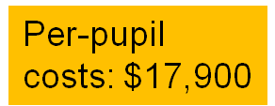
Let’s compare: Boston vs. Newton
Source: MA Dept. Of Education
Notes:
Let's dig a little deeper and compare two local districts: Boston and Newton. I invite you in the next three slides to look at the breakdown of Boston’s and Newton’s per-pupil expenditures with respect to administrative costs, teacher salary costs, the amount of money spent on construction, transportation, etc. Then, look at the bar graph that shows you Boston and Newton directly in comparison with one another. This pie chart breaks down Boston Public Schools’ budget; these are the most up-to-date figures available.

Slide 24
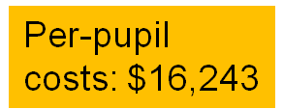
Let’s compare: Boston vs. Newton
Notes:
This pie chart breaks down Newton Public Schools’ budget for the same year.

Slide 25
Boston vs. Newton: What do we learn?
Newton: 5.6% Limited English Proficient (LEP), 19.1% identified special needs (SPED), 7% low-income. 83% passing MCAS English (all grades; Proficient or Adv.); 80% passing MCAS Math
Boston: 18.9% LEP, 20.5% SPED, 74.3% low-income. 45% passing MCAS English; 34% passing MCAS Math
Notes:
This bar graph takes the budgetary data from the last two slides and enables you to compare Boston’s and Newton’s relative expenditures directly. I’ve also provided you some information about Boston’s and Newton’s student demographics and standardized test outcomes on the Massachusetts Comprehensive Assessment System, or MCAS. Pause the lecture to examine the data, and then press play when you’re ready to continue. [Pause briefly] Ask yourself: what do we learn from this? Can you draw any conclusions about whether either district is spending money effectively or appropriately, whether school funding in itself is equitable, or whether equity even matters in this case?

Slide 26


How significant is school financing? Some dilemmas to ponder:
How should differences in student and/or community demographics be taken into account?
Do differences in rates of expenditures on “instructional core” reveal different (perhaps misbegotten) priorities or different student needs?
Should we pay any attention to inputs at all, or are outputs all that matter?
Notes:
These questions comparing Boston and Newton get really to the heart of the school finance question: how do we assess the fairness and appropriateness of financial allocations or expenditures within and between school districts?
How should differences in student and/or community demographics be taken into account?
Do differences in rates of expenditures on “instructional core” reveal different (perhaps misbegotten) priorities or different student needs?
Should we pay any attention to inputs at all, or are outputs all that matter?
Once you've finished pondering these questions, I invite you to move on.

Slide 27
How significant is equitable financing for equitable educational outcomes?
Is this even the right question?
EQUITY
ADEQUACY
EFFICIENCY
Notes:
These questions, and the data that we’ve been examining throughout this lecture, point us to the key framing question for this class: namely, how significant is equitable financing for equitable educational outcomes? One idea that we've been exploring in this lecture is that this may not even be the right question.
Some people care deeply about equity. They charge that it’s criminal that schools that serve high proportions of poor and minority kids tend to get less funding than schools that serve low proportions of such kids. This isn’t because of bean-counting obsessions with inputs, they argue; rather, it’s because high-quality education should be an equal right and an equal outcome. It should not be possible to predict a child’s educational attainment based on her race, ethnicity, or social class, but as we know from our segregation class, many of the schools that serve high poverty, high minority populations also get far worse educational outcomes than schools that don't. Equity in educational financing must be a first and basic principle of educational equity more broadly. But other people say that equity really should not be our basic consideration.
Rather, we should be concerned about adequacy. What really matters is that all students get an adequate education, and we should spend as much as we need to in order to achieve such outcomes. In this case, it might not be enough if urban schools were funded at an equal level to their suburban counterparts, for example, because if even equal funding did not result in equal outcomes, then equity would be a sham. Maybe urban schools would require quite inequitable funding: say, at levels 1 ½ or twice suburban funding levels. On the other hand, to the extent that an urban school does clearly provide an adequate education, then it shouldn't bother us if suburban or wealthier schools are spending more money on extras such as enhanced soccer fields, darkrooms, music recording studios, or whatever. Again, what matters is not equity as such, but a certain baseline level of adequacy. Finally, others argue that there is no way to tell from inputs alone whether school financing is sufficient, and they argue that the focus on achieving a certain level of financing whether on equity or adequacy grounds tends to miss the point and result in massive inefficiencies in educational spending of public resources.
From the perspective of these thinkers, what matters is efficiency. We should allocate and spend money so as most efficiently to deliver effective instruction and educational opportunities to all students. In this respect, the degree of input equity or adequacy is beside the point; what matters is solely that schools spend money appropriately as opposed to on programs that are of dubious effectiveness, and that they help all students receive a high-quality education while stewarding scarce public resources appropriately.

Slide 28
How significant is equitable financing for equitable educational outcomes?
What financing sources should we consider?
public
Grants
other private
Family expenditures
PTA
Notes:
Another question that has arisen both implicitly and explicitly during this lecture is what financing sources we should take into consideration when we are trying to figure out whether or not equitable financing is significant in achieving equitable educational outcomes.
We looked at the very start at financing coming from local property taxes, the state, and the federal government. There are other sources and kinds of educational funding, however, that clearly affect students’ educational opportunities and outcomes. Grants and PTA fundraising are good examples of revenue sources available to schools that may increase or decrease funding inequities. Family expenditures are a totally uncalculated benefit that have massively differential effects on students’ outcomes, and which have not been factored into any of the budgetary calculations we've looked at so far. These include family expenditures on formal educational opportunities, such as afterschool tutoring, piano lessons, or science and computer summer camps. They also include informal educational expenditures such as books and magazine subscriptions, computers and other technology, trips, museum memberships, and so forth.

Slide 29
Another path to inequity: School/District Fundraising
Source: Reich, Rob (2005). "A Failure of Philanthropy: American Charity Shortchanges the Poor, and Public Policy is Partly to Blame." Stanford Social Innovation Review(Winter): 24-33.
Notes:
Turning simply to the formal funds that are available to schools, we can see that private fundraising done by schools or districts can have extraordinarily unequal effect on the amount of funding that's available to schools to spend on each student. Here's an example from California of the per-pupil revenue generated by the top eight California local education foundations, or LEFs. These are organizations that raise money for students in the district, usually by a sending out appeals to parents, holding fundraisers for raffles, sometimes writing grants, etc. You can see that the Woodside school foundation has actually managed to raise an additional $7000 per kid. Woodside, it should be noted, is one of the wealthiest districts in California. It consists of one elementary school that serves less than 500 students. The school has earned the top rating on California's academic performance Index for many years in a row now. By contrast, most districts that serve predominantly low-income and poor students raise little if any money to supplement funding that comes in from the district and the state. You can see the levels of per-pupil fundraising by the most successful urban districts; it’s not very impressive, especially compared to Woodside’s numbers. Ravenswood district, for example, is not on this chart. It’s close to Woodside, but it does not have its own school foundation at all. The district serves about 4500 students in kindergarten through eighth grade, of whom 94% qualify for free or reduced price lunch, as compared to fewer than 10% in Woodside. Ravenswood schools are among the lowest performing in the state, with half of them earning the lowest rating on California's ranking system. Woodside families earn on average almost 4 times the annual income as Ravenswood families do. Even if Woodside and Ravenswood’s per-pupil expenditures were identical according to their official district budgets (which don’t include LEF funding), therefore, the $7000 per student boost plus family-based expenditures in Woodside require that we evaluate actual educational financing as inequitable indeed.

Slide 30
How significant is equitable financing for equitable educational outcomes?
Is this even the right question?
Shouldn’t failing districts get extra resources to help them succeed?
INCENTIVES
Shouldn’t more successful teachers and districts be rewarded for their success and get more money
(e.g. via merit pay)?
How can we equalize school financing without a backlash from wealthy districts?
Notes:
Finally, we return one last time to the question of how significant equitable financing is for equitable educational outcomes and whether or not this is even the right question. Here I want us to think about the question of incentives. As the so-called “new finance” advocates point out, it is an odd idea that we should keep on spending money on people or programs that are doing things badly—in other words, that fail to get educational results. This arguably incentivizes failure. So while many advocates of both equity and adequacy approaches argue that it is districts’ failure to educate students well that signals the need for more money, others argue that this is the exact wrong approach. The business world would never say that an underperforming sector or division should be given additional resources because they are doing poorly. Rather, the idea is that funding should follow success and support more success. Along these lines, therefore, people who think about incentives ask whether more successful teachers and district should be rewarded for their success and get more money, for example via merit pay.
Others ask whether the failing districts should actually get extra resources to help them succeed, viewing the extra money as an incentive to get better and the lack of money as a clear impediment to improvement.
And others worry about how we could equalize school financing without generating a backlash from wealthy districts, who may, say, reduce their own property taxes in order to have less of their money redistributed to other districts. They could then make up the difference in private fundraising through such institutions as PTAs or local education foundations. As you ponder the complexities of school financing in preparation for class, therefore, I invite you to think about incentives—good, bad, or perverse—as well.

Slide 31
Some Sources:
Education Trust (2010). “Funding Fairness.” http://www.edtrust.org/issues/pre-k-12/funding-fairness. Accessed Dec. 3, 2010.
Hill, Paul T., Roza, Marguerite, and Harvey, James. Facing the Future: Financing Productive Schools. Report released Dec. 2008. Center on Reinventing Public Education.
Koski, William S. and Rob Reich “When Adequate Isn’t: The Retreat From Equity in Educational Law and Policy and Why it Matters.” Emory Law Review, Vol. 56, No. 3, 2006. pp. 545-617.
Liu, Goodwin (2007). “Improving Title I Funding Equity Across States, Districts, and Schools.” Working Paper 7, March 2007. School Finance Redesign Project. http://www.crpe.org/cs/crpe/download/csr_files/wp_sfrp7_liu_mar07.pdf. Accessed Jan. 10, 2010.
Mead, Sara and Andrew J. Rotherham (2007). “A Sum Greater Than the Parts: What States Can Teach Each Other About Charter Schooling.” Education Sector Reports. http://www.educationsector.org/usr_doc/CharterSchoolSummary.pdf. Accessed Jan. 10, 2010.
Reich, Rob (2005). "A Failure of Philanthropy: American Charity Shortchanges the Poor, and Public Policy is Partly to Blame." Stanford Social Innovation Review (Winter): 24-33.
Notes:
Here are sources if you would like to pursue some of the ideas presented in this e-lecture in more detail. Remember to post any questions or reactions to the iSite, or e-mail Meira and your TF directly. See you in class!

