Slide 1
T210X E-Lecture Series:
Teachers
by
Meira Levinson
and Rebecca B. Miller
Notes:
Welcome to our e-lecture on teachers in urban schools. If for any reason you do not remember how to navigate through this e-lecture or use Articulate, please return to the first e-lecture for a reminder. Press the forward arrow to advance to the next slide. Remember, it may take a few seconds for the next slide to load depending on your connection speed.
I also want to thank Becca Miller for her work researching and co-authoring this e-lecture.

Slide 2
Framing Questions:
How does teacher quality in urban district schools compare to teacher quality in other settings?
What does teacher quality even mean, and how does one measure it?
Assuming it can be measured, should low teacher quality in urban schools be addressed by changing who teaches, or how they learn to teach, or by making schooling teacher-proof?
How do institutions such as unions, charters, education schools, and district bureaucracies promote or impede the recruitment, training, and retention of high-quality teachers in urban areas?
Notes:
In previous e-lectures we’ve discussed some of the structural, social, and political aspects of urban education; we’ve talked about who attends urban schools; and we’ve talked about debates over their aims and purposes. Today we’re going to focus specifically on the role of teachers in urban schooling. What do we know about who teaches in urban schools and what kind of impact those teachers have on their students and schools? What do we expect of urban teachers and how can we support them in meeting those demands?
This e-lecture will focus on this set of framing questions. Press pause to give yourself time to read them to yourself, and then press play to proceed.
2

Slide 3
How does teacher quality in urban district schools compare to teacher quality in other settings?
Notes:
Let’s start by taking a look at the first framing question: How does teacher quality in urban district schools compare to teacher quality in other settings, such as suburban, rural, or charter schools?

Slide 4
Urban Teacher Quality: The Standard Dire View
“From a policy perspective, urban schools confront an enormous challenge… [U]rban schools systematically receive less qualified teachers than their suburban counterparts and many of the dynamics work to the disadvantage urban students. Not coincidentally, these schools are most in need of teachers who are able to increase the performance of students achieving at the lowest levels…. Throughout the United States, nonurban students are 50% more likely to perform at a basic proficiency level than their urban peers. In high poverty settings, urban students reach basic proficiency half as often as their nonurban peers.”
- Lankford, Loeb, & Wyckoff, 2002
Notes:
The conventional wisdom today is that urban teacher quality is poor in comparison to the quality of suburban teachers, and that regardless of relative capacity, urban teacher quality is insufficient on an absolute scale to help address the educational needs of the students they serve—who as we know, are disproportionately poor, non-native English speakers, and of color. Pause and read this quotation from a highly respected group of researchers to see how the problem is traditionally framed.
What kinds of data and findings are behind statements like this? As we are about to see, a number of studies, usually based on large regional or national data sets from the National Center for Education Statistics, reveal some notable differences in the characteristics and experiences of teachers in urban areas or those teaching in schools with more poor and minority students. Before we dive into these, let me note that I will flip back and forth among measures of teacher quality by place (urban versus suburban versus rural) and by student demographic (high versus low poverty; high versus low minority). This is because different studies were conducted according to one or the other of these measures. We can’t equate these characteristics, since there are very poor rural schools, for example. But we know from previous classes that urban geography and high levels of school poverty often go hand-in-hand. So these are the data we’ll use (especially since they’re the data we’ve got!).

Slide 5
Lay of the Land
3.9 million teachers in U.S.
3.4 million public; 0.5 million private
 | # of teachers
City | 1,085,780
Suburb | 1,380,360
Town | 504,870
Rural | 927,410
About 1/4 of all teachers teach in urban schools.
http://nces.ed.gov/pubs2009/2009324/tables/sass0708_2009324_t12n_01.asp
Notes:
In order to contextualize claims about urban teachers in particular, let's first back up and get a basic lay of the land about who teaches where. Of the 3.9 million teachers in the U.S., the overwhelming majority – 3.4 million – teach in public schools. About 27% of all U.S. teachers work in urban schools. Of the remaining teaching force, most – about 35% -- work in suburban areas, 25% in rural, and about 13% in towns.
So, what do we know about these teachers, and how they differ by where they teach? Let's start by comparing teachers in urban versus non-urban schools. We'll then turn to comparing regular district to charter school teachers.

Slide 6
Degree Attainment
Percentage distribution of school teachers by highest
degree earned & school type, 2007-2008
School type | Less than bachelor’s | Bachelor’s degree | Master’s degree | Higher than master’s degree
All public schools | 0.8 | 47.4 | 45.5 | 7.3
City | 0.8 | 46.0 | 45.5 | 7.7
Suburban | 0.7 | 42.6 | 48.2 | 8.5
Town | 1.0 | 51.8 | 41.2 | 6.0
Rural | 0.9 | 53.0 | 40.3 | 5.8
http://nces.ed.gov/pubs2009/2009324/tables/sass0708_2009324_t12n_05.asp
Notes:
Let’s start with one conventional measure of teacher quality: namely, degrees earned. As you can see from this chart, urban teachers have slightly fewer master’s and doctoral degrees than suburban teachers, and slightly more than those teaching in towns and rural areas. In this respect, urban teachers don’t seem substantially worse or better than others. There are a lot of data in these slides – if you’re interested in studying these figures more closely, remember that you can pause these slides as we go or download the PowerPoint for this e-lecture to review the data later.

Slide 7
Hiring Criteria
Percent of public school districts that required selected criteria when
considering teaching applicants
School type | Full standard state certification for field to be taught | At least emergency or temporary state certification or endorse-ment for field to be taught | Graduation from a state-approved teacher education program | College major or minor in field to be taught | Passing score on the Praxis Series Core Battery Test of Professional Knowledge | Passing scores on the Praxis II: Subject Assessment in a specific content area
All public school districts | 77.4 | 70.9 | 66.4 | 62.6 | 29.1 | 26.9
Central city | 66.2 | 65.1 | 59.8 | 59.3 | 22.5 | 22.8
Urban fringe/ Large town | 77.7 | 74.9 | 64.5 | 60.0 | 33.1 | 29.7
Rural/Town | 79.2 | 68.2 | 68.7 | 65.7 | 26.7 | 25.2
http://nces.ed.gov/pubs2006/2006313.pdf
Notes:
More stark differences start to emerge as we look at the criteria used to vet and hire new teachers. As you can see, the percentage of urban districts (called here “central city”) that require new hires to possess qualifications such as certification, graduation from an accredited teacher education program, or a passing score on the national Praxis test, is significantly lower than the percentage of suburban and rural districts requiring these same qualifications.

Slide 8
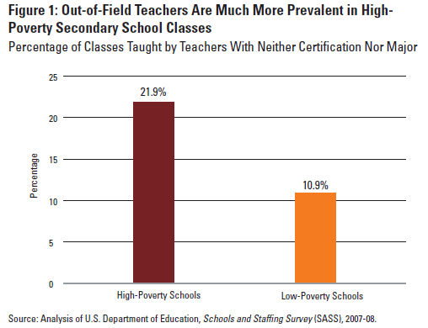
Hiring Outcomes (Degree in Field)
http://www.edtrust.org/sites/edtrust.org/files/publications/files/Not%20Prepared%20for%20Class.pdf
Notes:
These systematic differences in hiring criteria matter, of course, only if the characteristics of teachers who are actually hired also differ systematically. Unsurprisingly, they do. Twice as many classes in high-poverty public schools than in low-poverty schools, for example, are taught by teachers who neither are certified nor majored in the subject they are teaching.

Slide 9
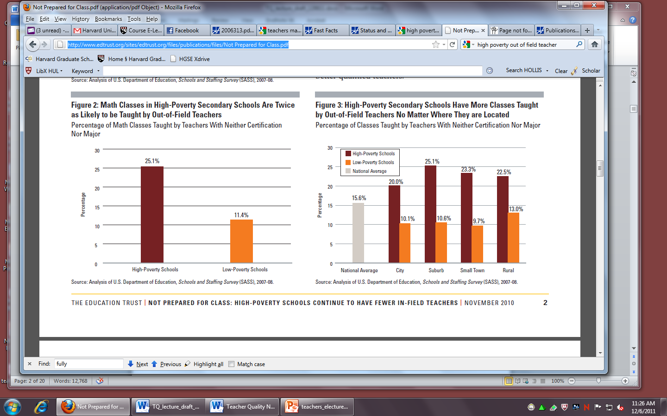
Hiring Outcomes (Degree in Field)
http://www.edtrust.org/sites/edtrust.org/files/publications/files/Not%20Prepared%20for%20Class.pdf
Notes:
The highest proportion of out-of-field teaching in high-poverty public schools happens in math, life sciences, and physical sciences. In math, for example, about a quarter of all classes in high-poverty schools are taught by out-of-field teachers, compared to only 11% in low-poverty schools. Overall, students in high-poverty secondary schools are 77% more likely than students in low-poverty schools to be taught by teachers without degrees in the subject they are teaching. As you can see in this chart, these data about high- versus low-poverty schools apply regardless of whether the schools are urban, suburban, or rural.

Slide 10
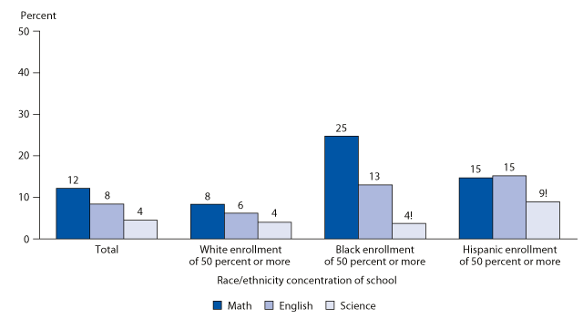
Hiring Outcomes (Degree in Field)
Percentage of public high school teachers with neither a college major nor standard certification in the subject that is their main teaching assignment, by race/ethnicity concentration of schools and subject: 2007–08
http://nces.ed.gov/pubs2010/2010015/figures/figure_9_1.asp
Notes:
As you might expect, nonwhite students are also more likely to be taught by teachers who did not major or obtain certification in the subject they teach. Students in largely minority public schools are 40% more likely to be taught by an out-of-field teacher than those in other public schools. Black and Latino students are twice as likely as a white student to be taught by an out-of-field teacher. In mathematics, 30% of classes in largely minority schools are taught by a teacher who did not major or obtain certification in math compared to 15% of classes with mostly white students. A study of New York schools suggests that teachers working in schools with greater proportions of ELL students are less likely to have full certification.

Slide 11
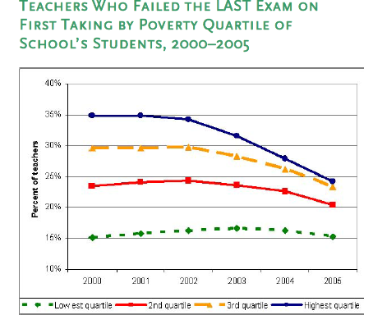
Hiring Outcomes (Certification Test)
http://www.urban.org/uploadedpdf/1001268_narowinggapinnewyork.pdf
Notes:
There is some good news. Here’s data from a study of teachers in New York City public schools who failed New York’s state certification exam. It shows clearly that high-poverty New York City public schools have more teachers who failed their first certification exam compared to the low-poverty NYC schools. However, the gap is narrowing significantly. It’s certainly not negligible—but it is shrinking.

Slide 12
Teaching Experience
2003-04
 | Full-time teaching experience |  | Years teaching at current school
School type | 3 or fewer years | 4 or more years | 3 or fewer years | 4 or more years
All public schools | 17.8 | 82.2 | 42.8 | 57.2
Central city | 20.3 | 79.7 | 47.6 | 52.4
Urban fringe/large town | 17.6 | 82.4 | 42.9 | 57.1
Rural/small town | 14.6 | 85.4 | 35.3 | 64.7
http://nces.ed.gov/pubs2006/2006313.pdf
Notes:
What about teacher experience? There are more novice teachers teaching urban students, as this chart shows. Other research indicates that schools serving low-income and minority students also have a disproportionately large percentage of novice teachers. In the New York City study that I drew on in the last slide, nonwhite children were 50% more likely than white children to have a teacher with no prior experience, though that gap has narrowed over time. Returning to this chart, you can also see that urban teachers have generally spent fewer years in their current school, meaning there’s less consistency among the teaching staff.

Slide 13
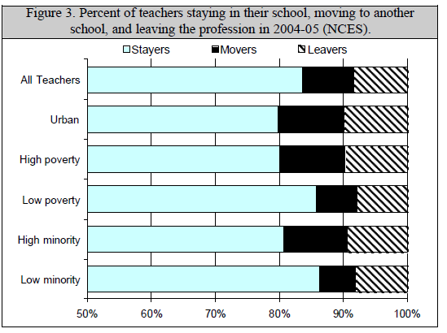
Teacher Mobility
http://www.aspeninstitute.org/sites/default/files/content/docs/education%20and%20society%20program/Ed_AspenTeacherWorkforceDatasheet.pdf
Notes:
Unsurprisingly, teachers working in urban, high-poverty, and high-minority schools are more likely than other teachers to leave their jobs, whether for a job in another school (in the same or another district) or to another profession altogether. Also, it’s usually the teachers with more qualifications – in terms of academic preparation, certification, and experience – who opt to leave urban schools for suburban ones, and to leave high-poverty schools for better-resourced schools.
However, a growing body of research also shows that teachers don’t want to leave urban schools. Among schools that have built positive cultures and mutual respect, teachers stay in urban schools serving low-income minority students at as high rates as they stay in suburban schools serving a more privileged population.

Slide 14
Responses to Teacher Vacancies
2003-2004
School type | Percent of schools with teaching vacancies | Hired a fully qualified teacher | Hired a less than fully qualified teacher | Used long-term or short-term substitutes | Cancelled planned course offerings | Expanded some class sizes | Added sections to other teachers’ normal teaching loads | Assigned a teacher of another subject or grade level to cover vacancy | Assigned an administrator or counselor to teach those classes
All public schools | 73.7 | 92.7 | 16.4 | 30.3 | 3.1 | 12.9 | 9.6 | 9.8 | 2.1
Central city | 75.4 | 90.7 | 19.2 | 42.4 | 3.4 | 15.8 | 10.8 | 12.1 | 2.1
Urban fringe/ large town | 76.9 | 94.2 | 14.4 | 30.0 | 2.5 | 12.0 | 8.9 | 8.7 | 1.5
Rural/small town | 66.6 | 91.5 | 17.6 | 18.4 | 4.1 | 11.7 | 9.9 | 9.6 | 3.4
http://nces.ed.gov/pubs2006/2006313.pdf
Notes:
What do schools do when faced with teacher vacancies? As this table shows, urban districts are more likely than others to fill these positions with substitutes or with teachers who lack full certification. Most of these vacancies are in critical areas, like secondary math and science, special education, and bilingual education. You can also see that urban schools cancel planned courses, expand class sizes, and add to teachers’ normal teaching loads slightly more often than schools in other areas.

Slide 15
District vs. Charter:
Responses to Teacher Vacancies
2003-2004
School type | Percent of schools with teaching vacancies | Hired a fully qualified teacher | Hired a less than fully qualified teacher | Used long-term or short-term substitutes | Cancelled planned course offerings | Expanded some class sizes | Added sections to other teachers’ normal teaching loads | Assigned a teacher of another subject or grade level to cover vacancy | Assigned an administrator or counselor to teach those classes
All public schools | 73.7 | 92.7 | 16.4 | 30.3 | 3.1 | 12.9 | 9.6 | 9.8 | 2.1
Central city | 75.4 | 90.7 | 19.2 | 42.4 | 3.4 | 15.8 | 10.8 | 12.1 | 2.1
Traditional public schools | 73.8 | 92.7 | 16.2 | 30.3 | 3.1 | 13.0 | 9.6 | 9.8 | 1.9
Charter schools | 70.6 | 90.1 | 23.4 | 28.5 | 4.6 | 9.7 | 9.8 | 11.3 | 12.5
http://nces.ed.gov/pubs2006/2006313.pdf
Notes:
Thus far, we’ve been comparing urban schools with suburban and rural schools, or high-poverty, high-minority schools with wealthier schools serving a whiter student population. Let’s turn now to comparing two different types of urban schools: regular district schools versus charter schools. How, if at all, do their teaching populations differ?
Nationally, there are fewer teaching vacancies in charter schools than in traditional public schools. When confronted with those vacancies, though, charter schools are much more likely than traditional public schools to fill those holes with less-than-fully qualified teachers. Charters use significantly fewer long- and short-term substitutes than traditional urban schools do, however, and they don’t expand class size nearly as frequently. Rather, they rely more often on other school personnel, like administrators or counselors, to fill vacancies.

Slide 16
District vs. Charter:
Degree Attainment
Percentage distribution of school teachers by highest
degree earned & school type, 2007-2008
School type | Less than bachelor’s | Bachelor’s degree | Master’s degree | Higher than master’s degree
City | 0.8 | 46.0 | 45.5 | 7.7
Traditional public schools (all) | 1.1 | 50.8 | 40.9 | 7.2
Charter schools | 3.2 | 64.2 | 27.4 | 5.2
http://nces.ed.gov/pubs2009/2009324/tables/sass0708_2009324_t12n_05.asp
Notes:
With respect to degree attainment, charter school teachers are four times as likely not to have even earned a bachelor’s degree, and barely 60% as likely to have earned master’s or other advanced degrees than traditional urban public school teachers.

Slide 17
District vs. Charter:
Teacher Experience
2003-04
 | Full-time teaching experience |  | Years teaching at current school
School type | 3 or fewer years | 4 or more years | 3 or fewer years | 4 or more years
All public schools | 17.8 | 82.2 | 42.8 | 57.2
Central city | 20.3 | 79.7 | 47.6 | 52.4
Traditional public schools | 17.5 | 82.5 | 42.4 | 57.6
Charter schools | 43.4 | 56.6 | 75.3 | 24.7
http://nces.ed.gov/pubs2006/2006313.pdf
Notes:
Teacher experience also diverges significantly between traditional public urban schools and charter schools. Charter school teachers are stunningly less experienced than public school teachers, including urban public school teachers, and they are far less entrenched in their schools.

Slide 18
Pause and think:
Pause and think:
How does teacher quality in urban district schools compare to teacher quality in non-urban district schools, and in charter schools?
Do these findings surprise you?
How do these findings compare to the readings for today?
What measures have we used to draw these comparisons of teacher quality?
Do these seem like the right measures? Why or why not?
Notes:
Okay, now that I’ve overloaded you with data, take some time to pause and think. Start by returning to the original framing question. How does teacher quality in urban district schools compare to teacher quality in non-urban district schools, and in charter schools? Do these findings surprise you? You might think about this question in relation to your own experience or other anecdotal or research-based knowledge. You might also think about this question in relation to the assigned readings for this class. Do they reinforce, complement, or contradict what you learned from those?
Finally, as a way of thinking about the meaning of the data I’ve shown you, and to help you move into the next section of this e-lecture, you might want to think about what measures we used to draw these comparisons of teacher quality. Do these seem like the right measures? Why or why not?
Despite your likely inclination just to move on, I strongly encourage you really to pause and think. Spend at least a few minutes reflecting on how you would answer these questions before you click to the next section of this e-lecture.

Slide 19
What does teacher quality even mean,
and how does one
measure it?
Notes:
Since I’ve already spent a bunch of time showing you comparative data on urban teachers’ credentials and preparation, much of which suggest that both urban district schools and urban charter schools are filled with less qualified teachers, you might ask why I’m raising this question now about what teacher quality means and how we can measure it. Haven’t I already presented lots of measures of teacher quality?
Well, yes and no. We’ve looked at lots of measures of teachers’ years of experience, longevity in schools, personal educational attainment, degrees in their chosen field, and so forth. But none of these characteristics is a direct measure of teaching quality: of how much students learn. It’s plausible to expect that these measures are correlated with student learning. And, when we didn’t have good large-scale measures of student learning, these teacher background characteristics may have been the best proxies we could find for comparing teacher quality across school settings. Now that we are awash in data about student learning, however, these “input” characteristics of teachers are arguably of limited use. Rather than looking at proxies for anticipated student learning, shouldn’t we look at student learning itself?
These are the kinds of questions that lead us to ask, What does teacher quality really mean, and how can and should we measure it? We’ll also then take this back to teachers in urban schools, and see whether using “output” measures of teaching quality reinforces or challenges the conventional wisdom that urban school teachers are worse than others.

Slide 20
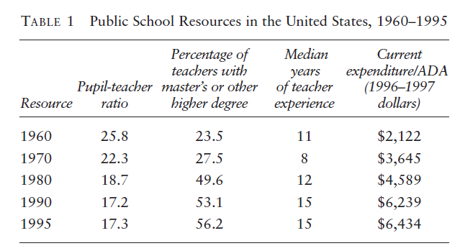
“Inputs” and Teacher Quality
http://edpro.stanford.edu/hanushek/admin/pages/files/uploads/Teacher%20quality.Evers-Izumi.pdf
Notes:
As you may remember from the school finance lecture, “input” measures of resource equity have given way in the last decade or two to “output” measures of student achievement equity. Let's see how this applies to measures of teacher quality. In the 1960s and 70s, school reformers focused on equality, focused on “inputs” such as experienced teachers with degrees in their field, certification from accredited colleges and universities, and so forth. Beginning in the 1980s, however, critics began to comment that all these resource-targeted reforms were ineffective.
This table, by economist Eric Hanushek, demonstrates why. As we can see, teacher input quality grew significantly between 1960 and 1995 in a number of areas. Class sizes shrank, about twice as many teachers had master's degrees, and median teacher experience approximately doubled. Yet, Hanushek notes, there was no corresponding increase in student performance.

Slide 21
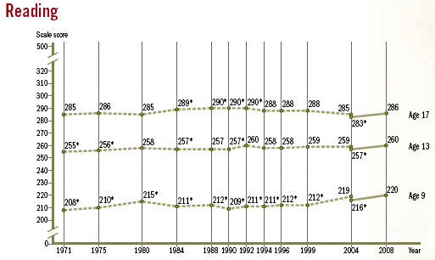
“Inputs” and Teacher Quality
http://motherjones.com/files/images/Blog_NAEP_2008.jpg
Notes:
Students’ performance on the NAEP, the nationwide set of tests known as the “Nation’s Report Card,” for example, remained essentially flat. Hence, he and other critics have argued, we should stop measuring or paying for such characteristics. They don’t matter. What we should measure—and pay for– is teachers’ effect on student learning, as measured by their success on standardized tests. Anything else is a pale proxy measure—and a worthless one, at that.

Slide 22
“Inputs” and Teacher Quality
“The simple position taken here is: if one is concerned about student performance, one should gear policy to student performance.” – Hanushek, 2002
http://edpro.stanford.edu/hanushek/admin/pages/files/uploads/Teacher%20quality.Evers-Izumi.pdf
Notes:
As Hanushek puts it, “The simple position taken here is: if one is concerned about student performance, one should gear policy to student performance.”
Again, you should remember similar criticisms from the school finance e-lecture, where we found out that the amount of money we’ve spent on education has tripled in the last 50 years, while test scores over that period have remained stagnant. This has led some critics to claim that money does not buy higher educational quality, just as the test score data has led critics to claim that teaching experience and advanced degrees do not predict higher teaching quality.
At the same time, I want to note that not all scholars or policy makers draw such conclusions. Others point out that the number, diversity, and needs of students have skyrocketed over the past half-century, as have our expectations for them. We shouldn’t be surprised that NAEP scores have remained stagnant, for example, when we are teaching and testing a vastly more diverse range of students. Remember the countervailing voices in the school finance lecture, too, who argued that while money has certainly been wasted, higher levels of smart expenditures are still necessary to achieve high-level outcomes for all students.

Slide 23
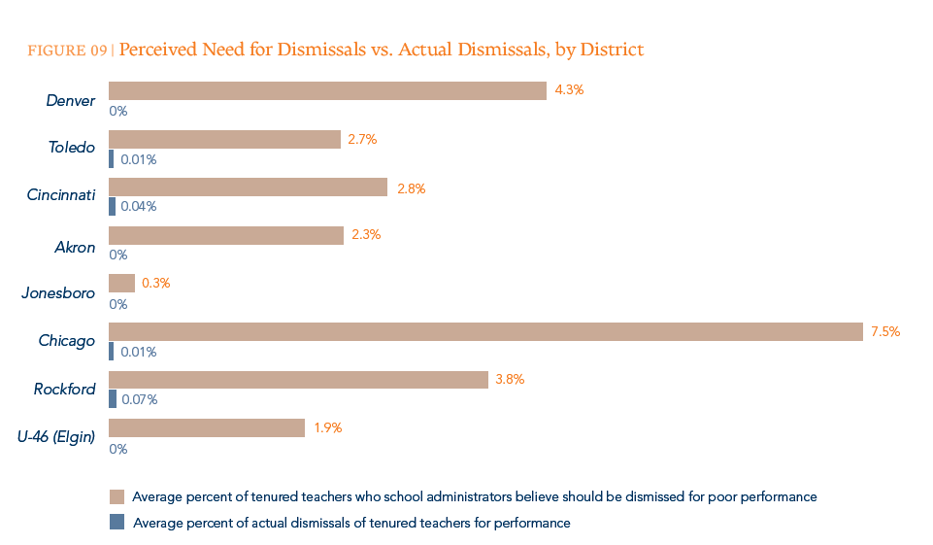
Time-Honored, Output-Oriented Teacher Assessments
Administrator evaluations
Peer evaluations
http://widgeteffect.org/downloads/TheWidgetEffect.pdf
Notes:
Before we turn to standardized measures of student achievement and how these are being used to assess teaching quality, let’s consider some other time-honored assessments of teacher quality that are output- rather than input-oriented.
A number of districts have long had a system of administrator evaluations in place—usually a principal who conducts one or more classroom observations to assess a teacher’s performance, using criteria for evaluation that have been developed locally. A small number of districts have instituted peer evaluation systems, where more experienced teachers evaluate their colleagues’ performance. We’ll come back to these later.
Whether administrator- or peer-led, however, these observational evaluations tend to have significant flaws. They are often based on only a couple of short classroom observations according to evaluation tools in which few observers have been trained. The overall metrics are quite crude. Teachers are usually rated on a simple binary scale as satisfactory or not, or sometimes as needing improvement, satisfactory, or advanced. Even these distinctions end up being meaningless in practice, as teachers are rated overwhelmingly in favorable categories. In one study of 12 districts, upwards of 94% of teachers were rated satisfactory; half of those 12 districts did not dismiss a single teacher for poor performance in the two to five years they were studied. In Chicago, similarly, researchers “found that less than one-half of one-percent of teachers were rated ‘unsatisfactory,’” and only six percent were rated satisfactory. Another quarter were rated as “excellent,” while a full 69 percent earned a “superior” rating! “Based on such findings,” they suggest glumly, “many have questioned whether classroom observations are a hopelessly flawed approach to assessing teacher-effectiveness” (Kane, Taylor, Tyler, & Wooten, 2010). This graph reinforces such concerns.

Slide 24
“Output” Measures: Value-Added
Compare measured changes in test scores over time with predicted changes in test scores
Change that exceeds prediction indicates the “value added” to student learning by a teacher
Notes:
The most popular and influential of the current “output”-based measures of teacher quality are therefore “value-added measures” that are linked directly to student achievement as measured by standardized test scores. The approach uses complex statistical modeling, but the basic idea is to compare measured changes in students’ test scores over some period of time, like a school year, with the change that would be expected based on the students’ prior achievement and demographic factors that are outside a teacher’s influence. Any change over time is considered a result of the student’s experience in a given school or classroom during that period of time. When students’ achievement growth – the positive change in their test scores – exceeds the naturally expected growth, those students’ teachers are considered effective.

Slide 25
“Output” Measures: Value-Added
“If student test achievement is the desired outcome, value-added is superior to other existing methods of classifying teachers. Classification that relies on other measurable characteristics of teachers (e.g., scores on licensing tests, routes into teaching, the path to certification, National Board for Professional Teaching Standards certification, teaching experience, quality of undergraduate institution, relevance of undergraduate coursework, extent and nature of professional development), considered singly or in aggregate, is not in the same league in predicting future performance as evaluation based on value-added.”
Glazerman, Goldhaber, Loeb, Staiger, Raudenbush, & Whitehurst, 2010
Notes:
Advocates of value-added measures suggest that these tools offer much better ways of looking at teacher quality than do studies of teacher “inputs,” or characteristics like certification or undergraduate major. This quote summarizes that perspective. You'll note that these scholars advocate value-added measures under the assumption that raising test scores is the desirable end goal. Whether that should be the case is a topic I'll come back to later.

Slide 26
Critiques of Value-Added Measures
Statistical methods are limited (defining and measuring variables, built-in error, varied findings across studies and time points)
Students are not randomly assigned to teachers
Tests are not given in all years and subjects
Studies don’t capture the effects of the school and other adults on student learning
Little indication of why teachers are effective
Notes:
We’ll talk in greater detail in the e-lecture on assessment how value added teacher assessment is being used in urban schools today, and about the many concerns that statisticians and teachers themselves are raising about such assessment. But since this is such a powerful new approach from a policy standpoint, I don’t want to leave the controversy entirely for another day. It is important as we think about the role of teachers in urban schools to understand both the arguments for and the critiques of value-added measures of teacher quality.
So, what are the critiques? First, Value Added Measurement (VAM) is a statistical technique – it naturally has limitations based on how researchers gather and standardize their data, what variables they choose to look at, and some built-in error. But that error may not be tolerable, especially when individual teachers are in the crosshairs. One study claimed that value-added scores can vary widely from year to year – as many as 10-15% of teachers who rank in the top quintile for performance in one year might be in the bottom quintile the next year. Sometimes student test scores vary from year to year for reasons having nothing to do with either teachers or the characteristics that statisticians control for in their studies.
How students are assigned to teachers also matters and can affect value-added measures. Berkeley economist Jesse Rothstein has shown, for example, that value-added models can use teacher effects in FIFTH grade to explain students’ test score gains in FOURTH grade. This is nonsensical, of course. Rothstein explains that this shows how susceptible such measures are to student-assignment effects. Effective teachers tend to be awarded high-performing students, which may be nice for them both, but then makes it impossible to know how to evaluate their value-added scores.
Others criticize that, because these measures generally use standardized test scores as an outcome, the measures are only effective in the grades where statewide tests are given, and only in the few areas that are tested by mandate. Beyond that, critics assert that value-added measures usually compare teachers within a school. They are limited in their ability to compare across schools or districts because of the way the models are constructed. This means that the measures aren’t good at capturing the effect that comes from a given school instead of a given teacher, which is a problem given that students don’t only interact with one teacher during the school year – there is a whole array of teachers, aides, administrators, counselors, and peers who take part in students’ schooling.
Perhaps most troubling to people working in teacher preparation and professional development, these studies don’t tell us much, if anything, about why a teacher is effective and what kinds of things others might learn from them. Again, we’ll come back to many of these concerns later in this e-lecture, and in the Assessment e-lecture.

Slide 27
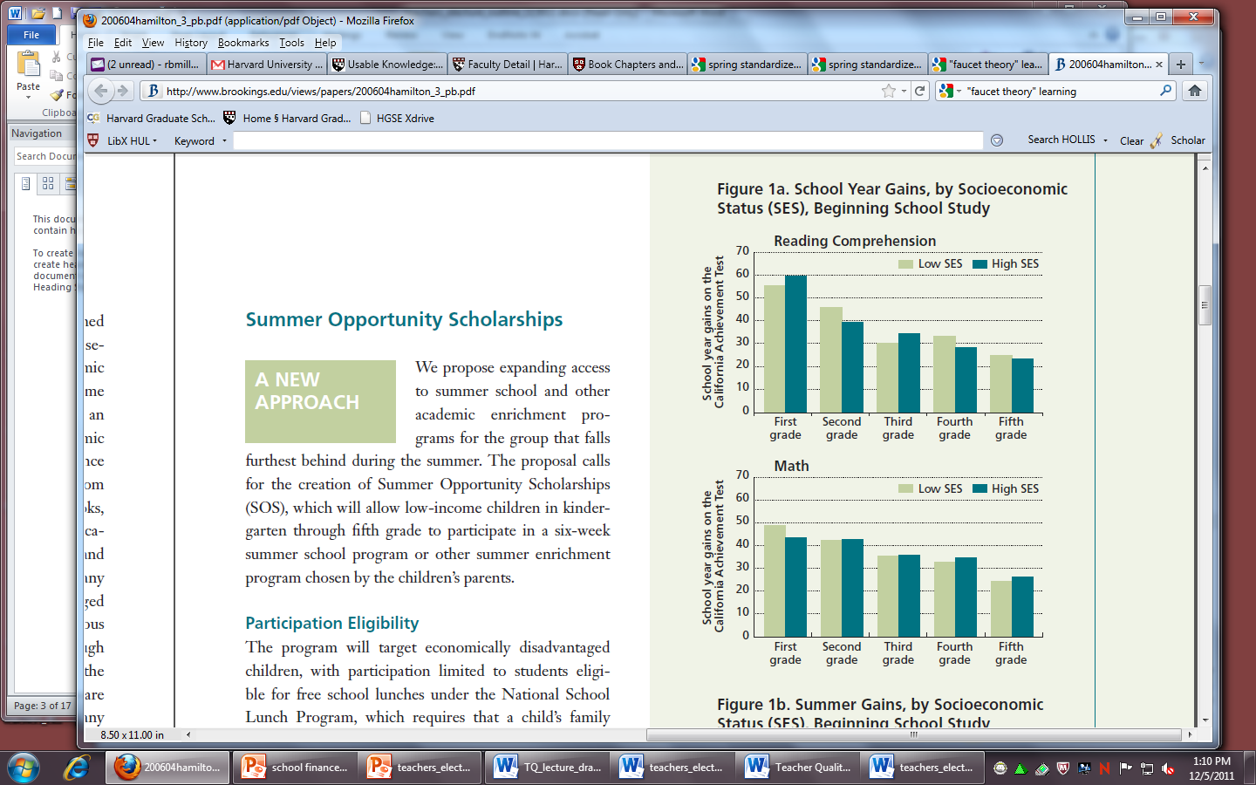
Comparative Teacher Quality:
Low vs. High SES (Reading)
School Year Gains, by Socioeconomic Status, Beginning School Study
http://www.brookings.edu/views/papers/200604hamilton_3_pb.pdf
Notes:
Notwithstanding the significant concerns over value-added measures as a tool for individual teacher assessment, it’s clear that such statistics can tell us something important about student learning in the aggregate. So, let’s return to the first framing question for a moment, and ask how teacher quality in urban vs. non-urban districts compares, in this case on value-added lines. Do teachers who teach low-income students, for instance, consistently teach them less than teachers in high-income schools teach their students? That is certainly what the comparison of academic majors, certification, and experience in the first section of this e-lecture might have led us to assume, and what the “conventional wisdom” I cited earlier seems to indicate. Is this the case?
In a word, no. A developing body of research, including work by Jimmy Kim here at HGSE, has found that students from different backgrounds make remarkably similar gains in learning during the school year. In fact, they say, MOST of the achievement differences found in the first nine years of schooling can be attributed to differences in learning over the summer, not during the school year. Let’s take a look at these data.
This chart demonstrates the relative school year gains of 665 Baltimore students who started first grade back in 1982. It compares the reading comprehension gains among children whose parents are relatively better educated and high-earning (these are “high SES” kids) to those among children whose parents are less educated and lower-earning (“low SES” kids). Their school year reading comprehension gains are measured by their fall versus spring scores on the California Achievement Test. We see that over the course of each school year in first through fifth grades, high and low SES students learned about the same amount.
To the extent that these gains tell us anything about teaching quality, which presumably they do to some degree, this suggests that teachers of low SES students are of at least as high quality as teachers of high SES kids are. In fact, given that teachers of low SES students are likely facing more challenging teaching circumstances—lower-funded schools, lesser parent involvement, higher rates of student mobility, and so forth—these data could be interpreted to suggest that these teachers are of much higher quality than those serving more privileged students.

Slide 28
Comparative Teacher Quality:
Low vs. High SES (Math)
School Year Gains, by Socioeconomic Status, Beginning School Study
http://www.brookings.edu/views/papers/200604hamilton_3_pb.pdf
Notes:
We see very similar data for students’ math gains during the school year. Again, low and high SES students seem to have similarly-qualified math teachers across the entirety of elementary school.

Slide 29
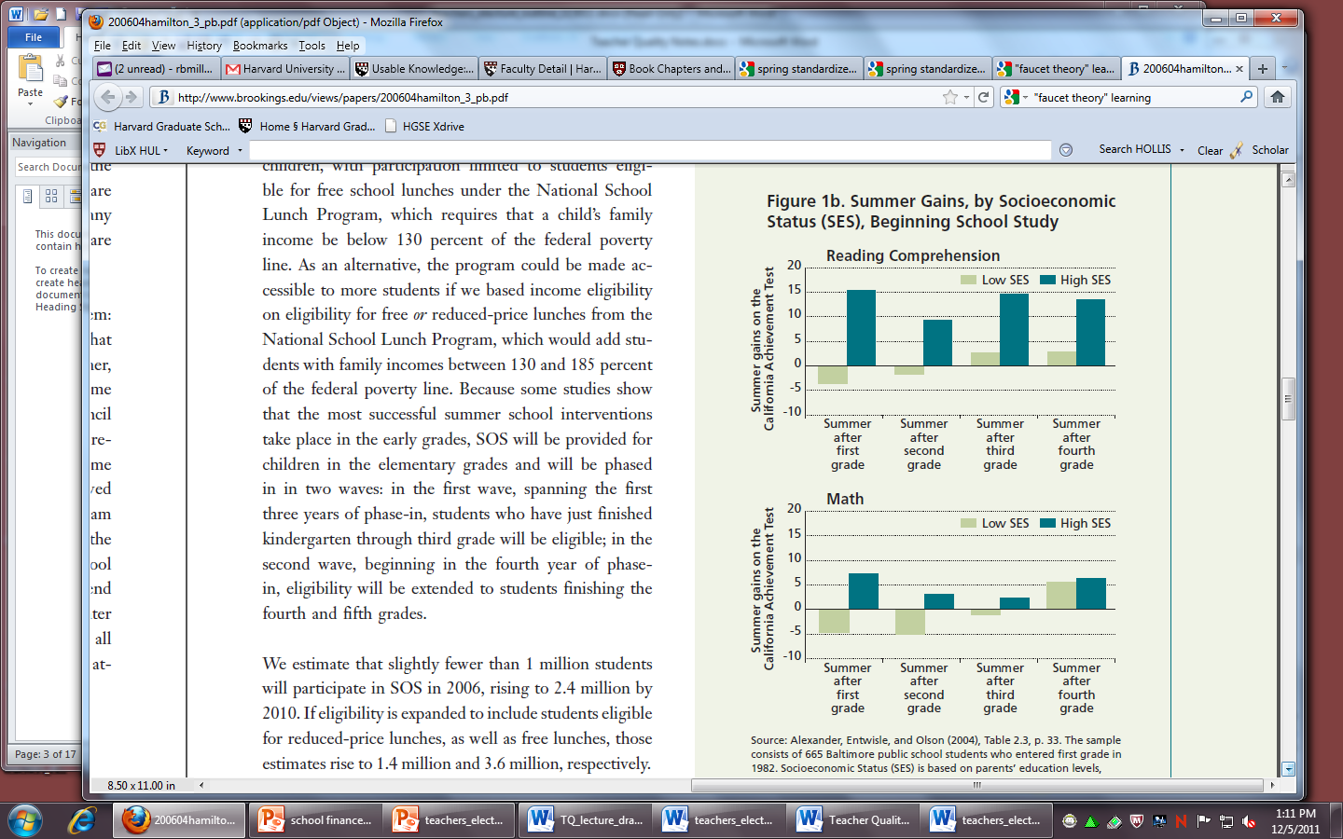
Comparative Summer Learning:
Low vs. High SES (Reading)
Summer Gains, by Socioeconomic Status, Beginning School Study
http://www.brookings.edu/views/papers/200604hamilton_3_pb.pdf
Notes:
But how can this be? We know from prior classes (and incessant media coverage) that low-income students of color on average learn much less in school than higher-income white students do. So how do we make sense of these data showing that they learn about the same amount during each and every elementary school year?
Researchers are finding that most of the achievement differences found in the first nine years of schooling can be attributed to differences in learning over the summer, not during the school year. Here are the data on students' summer reading comprehension gains and losses, for instance. You'll see that in contrast to the relatively equal levels of in-school learning during the year, high and low SES students diverge wildly in their reading comprehension learning over the summer. The next slide shows similar evidence about math.

Slide 30
Comparative Summer Learning:
Low vs. High SES (Math)
Summer Gains, by Socioeconomic Status, Beginning School Study
http://www.brookings.edu/views/papers/200604hamilton_3_pb.pdf
Notes:
Overall, it seems that children from higher-income families learn more reading and math over the summer than children from lower-income families. Other data show that white children gain more over the summer than African-American children. These researchers conceptualize schooling as a “faucet” that turns off in the summer, creating inequalities in outcomes and educational opportunity that manifest themselves in the academic achievement gap in poor, minority, and urban schools. If this is right, then that suggests that the relative quality of urban teachers is not in itself a legitimate concern.

Slide 31
Pause and think:
Pause and think:
What do you make of this data about school year versus summer learning?
What conclusions do you draw, if any, about comparative teacher effectiveness?
What else would you want to know?
Notes:
Yet again, we’ve cycled through mounds of data. Pause and ask yourself what you make of it. What conclusions are you able to draw as a result about comparative teacher effectiveness? What else would you want to know?

Slide 32
Is There More to Teacher Quality
than Academics?
Social-emotional learning
Classroom safety
Physical development and health
Mentoring students and colleagues
Cultural competence
Coaching, advising, field trips
Notes:
Data is one thing; values are another. As we've shifted among various kinds and interpretations of outcome measures, we have remained steadfastly focused on students' academic achievement, particularly as measured by standardized test scores. We'll spend some time in the assessment e-lecture thinking about whether such scores are accurate representations of students' academic learning. In the meantime, though, I want to ask what may be a heretical question: namely, is academic learning truly the only outcome we think teachers and schools should work to promote?
What about social-emotional learning?
Classroom and school safety?
Students' physical development and health?
In thinking about how we assess teachers' quality, how should we take into account teachers' mentorship of students or fellow colleagues?
How about their cultural competence or collaboration with families?
Also, how do we account for the effect of all the other things teachers do: coaching, advising, extracurriculars, extra lunch duty, field trips? Which of these are relevant to determining teacher quality in the absence of additional academic outcomes, and which are not? For example, if classroom safety is high but doesn't lead to increased academic achievement, should we value a teacher's capacity for creating safe spaces or not?

Slide 33
New-fangled
Time-Honored, Output-Oriented Teacher Assessments
^
Administrator evaluations
Peer evaluations
Teaching materials and student work
Student feedback
Self-assessment
Standardized assessment measures of classroom instructional quality based on videotaped observations scored by trained evaluators. See Measures of Effective Teaching (MET); Mathematical Quality of Instruction (MQI); Classroom Assessment Scoring System (CLASS).
Notes:
Given these various concerns about value-added measures, classroom observations, and school year versus summer learning effects, some districts are instituting composite measures of teacher effectiveness that draw on a variety of approaches, hoping that a combination of measures and methods will lead to more accurate, thorough, and useful ways of evaluating teachers. Instead of using in-building evaluators to conduct local classroom observations, for example, the Gates Foundation is funding a massive initiative, spearheaded by HGSE professor Tom Kane, to develop standardized assessment measures of real-time classroom instruction using videotaped observations and carefully calibrated observational rubrics.
Washington DC has created a system where student test-score gains – the value-added measure of the teacher – counts for half of the teacher's evaluation. The other half is based on classroom observations: three by a building administrator and two by an evaluator unaffiliated with that school who is a subject-matter expert.
Other initiatives include evaluations of portfolios including teachers' own instructional materials and student work, student evaluation forms, and self-assessment protocols such as those used by National Board certified teachers.

Slide 34

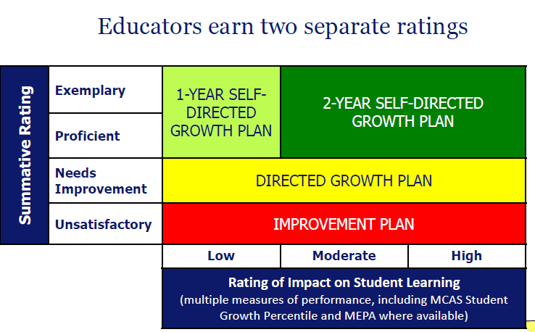
Massachusetts Educator Evaluation Framework
http://www.doe.mass.edu/edeval/101511Overview.pdf
Notes:
Massachusetts has adopted a new system for 2013 that is meant to take a similar systemic approach. It is meant to incorporate self-evaluation as well as expert evaluation, and to include in its standards some alternative ideas about effective teaching, like a teacher’s engagement with families and the community and contribution to the professional culture. It also builds in plans for responding to evaluation ratings with professional development. Districts and unions must negotiate over how much weight to assign to value-added measures and other forms of evaluation, but the state stipulates that evaluation be based on a mix of self-assessment, student feedback, observations, teacher materials, and test scores.

Slide 35
Pause and think:
Pause and think:
What do you now know about methods and uses of teacher quality assessments?
What seems appropriate? What seems fair?
Think about the role(s) you do or plan to play in urban schools (teacher, administrator, parent, policy maker, non-profit partner, counselor, critic…). What measures of teacher quality would you find most desirable, reliable, and/or useful? Why?
Notes:
It’s time again to pause and think!

Slide 36
Assuming it can be accurately and meaningfully measured, how should low teacher quality in urban schools be addressed? By changing who teaches, changing how they learn to teach, or making schooling teacher-proof?
Notes:
So, the issue of teacher quality is far more complicated than it might seem at first, but concern about it is more intense than ever – at a fever pitch. The conventional wisdom suggests that urban, poor, and nonwhite kids are underserved in terms of the level of their teachers’ preparation and experience. But if what we really care about is student learning, it seems that teachers aren’t necessarily the main or even a strong influence on changes in test scores over time. And despite all of this research, the reality is that teachers are clearly trying very hard but we’re not seeing the outcomes that many administrators, policymakers, and families want. Moving on to our next framing question, we face the elephant in the room: What can we do, and what should be done?
Administrators, policymakers, researchers, and teacher unions have initiated a number of strategies to try to improve teacher quality as a way of trying to improve student learning and achievement. In the past five years, there has been a notable shift away from structural approaches to school reform – things like instituting site-based management and small schools, implemented in the hope that changing school and district structures would affect teaching practice and, thus, student learning. Very recently, however, the focus has turned to issues of human capital: who is in the classroom, how are they trained, and how can they be supported? Current efforts focus on changes at all levels of the teaching experience – from the pipeline to the curriculum. These strategies are causing noticeable changes in the urban schools many of you will be working in or studying.

Slide 37
Changing Who Teaches:
Pipeline Strategies
Recruitment & hiring
Compensation
Retention & promotion
Working conditions
Notes:
Some suggest that the issue of teacher quality is really one of recruitment – what kinds of people, with what kinds of characteristics or experiences, do we want to attract to teaching? How can we get more of them? Attention to the “pipeline” of teachers targets labor force tools like recruiting and hiring practices, pay, retention and promotion, and working conditions.

Slide 38
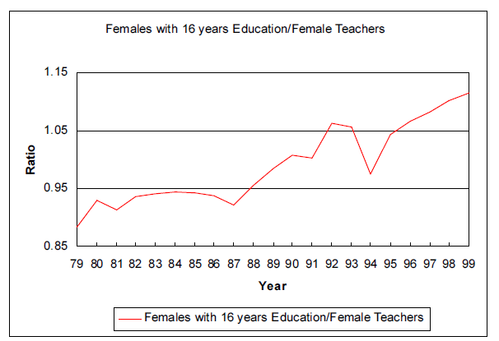
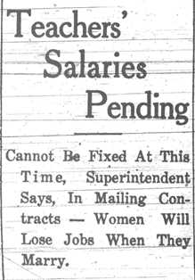
Recruitment & Hiring: Women
Ratio of Wages for Females with College Education to
Female Teachers, 35-44, 1979-1999
Left, dated 1933: http://www.vaschools.history.vt.edu/education/?q=node/39
Right: Temin, 2002
Notes:
One of the challenges facing districts seeking to hire more credentialed people into teaching is that they are competing with other employers who can provide more monetary and other benefits to employees. This has long been true, but has become a greater challenge for teaching since it has traditionally been a field dominated by women, and job opportunities for well educated women have expanded since the women’s rights movement. Women represented less than 20% of the labor force in 1890 but are more than half of all workers today. The expansion of work opportunities was greatest for married women, who used to work far less than single women – in fact, as this article from 1933 shows, many school districts used to require women to leave teaching upon marriage. Today, however, highly educated women are opting to pursue different careers that pay more, offer better or more flexible working conditions, and have greater opportunities for growth or prestige.

Slide 39
Recruitment & Hiring: Race/Ethnicity
Percentage distribution of school teachers by race/ethnicity, percentage minority, school type, and selected school characteristics: 2003-04
School type | Hispanic, single or multiple races | White | Black | Native or Pacific Islander | Asian | Multiracial | Minority
All public schools | 6.2 | 83.1 | 7.9 | 0.7 | 1.3 | 0.7 | 16.9
Central City | 10.4 | 70.5 | 15.1 | 0.7 | 2.2 | 1.1 | 29.5
Urban fringe/ large town | 5.2 | 87.4 | 5.1 | 0.6 | 1.1 | 0.6 | 12.6
Rural/small town | 3.0 | 90.2 | 4.9 | 1.0 | 0.5 | 0.4 | 9.8
Traditional public schools | 6.2 | 83.3 | 7.8 | 0.7 | 1.3 | 0.7 | 16.7
Charter schools | 10.1 | 70.2 | 15.2 | 1.3 | 1.9 | 1.4 | 29.8
All private schools | 4.8 | 88.0 | 4.0 | 0.6 | 1.8 | 0.6 | 12.0
City private schools | 5.9 | 83.7 | 6.1 | 0.9 | 2.6 | 0.8 | 16.3
http://nces.ed.gov/pubs2006/2006313.pdf
Notes:
A similar trend is likely at work among nonwhite workers. There are notably more nonwhite teachers in urban districts than in other areas, but not in proportions comparable to national demographics or the makeup of urban communities. And there are fewer highly credentialed nonwhite teachers in high poverty and majority-minority schools. Pause this presentation to examine ethnoracial teacher representation across districts as presented in this chart.
Teacher ethnicity matters in part because of evidence that teachers may be more effective for students of the teacher’s same race or ethnicity. Such teachers may serve as role models, favor different pedagogical approaches or curriculum designs, or engage different communication styles with students from similar backgrounds.
But the reason for the underrepresentation of teachers of color is not solely one of labor competition. In the case of black teachers, history suggests that other forces have been at work.

Slide 40
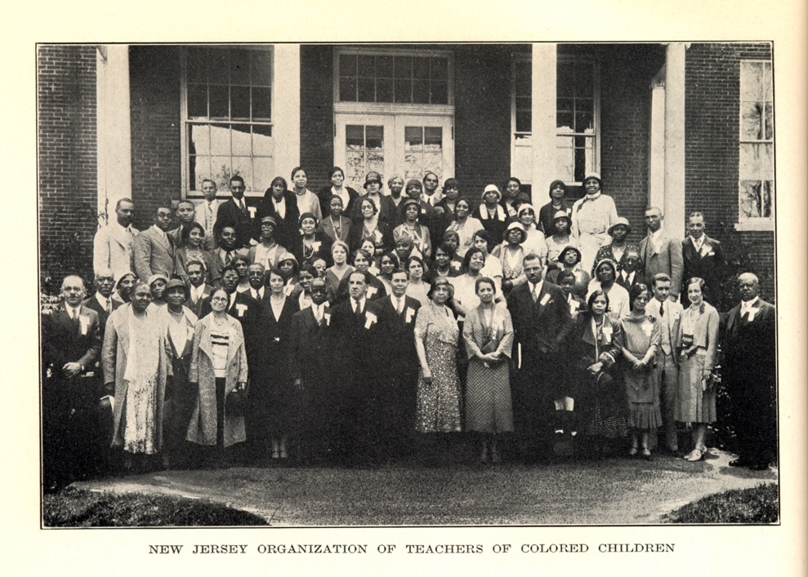
Hiring and Firing of Black Educators
Photo, dated 1932: http://www.njwomenshistory.org/Period_5/TeachersColoredb.htm
Notes:
One of the devastating reactions to desegregation was the decimation of the black teaching force, particularly in the South. Brown v. Board opened up new opportunities for black advancement, but it also prompted an institutional and psychological cost for black communities as mostly white school boards and leaders targeted black teachers for dismissal, demotion, and subjugation in now desegregated schools.

Slide 41
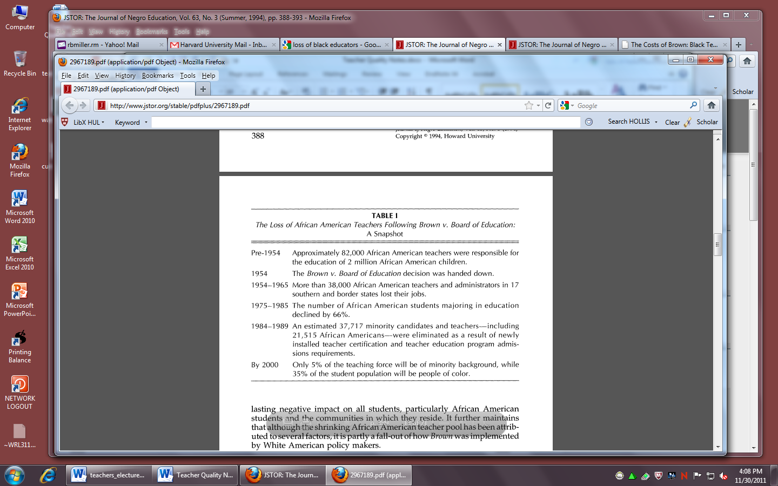
Hiring and Firing of Black Educators
http://eps.education.wisc.edu/reference/displacement.brownconf.pdf
Notes:
As one African-American educator said, integration was tainted because “the power to control desegregation was placed in the hands of those who fought so hard to retain segregation” (Fairclough, 2004). The loss of black educators is not solely attributable to Brown; rather, black Americans have had similar increases in employment opportunities as we discussed before for women. But it did have an important effect. As this chart shows, the teaching force continues to feel the ripple effects of post-Brown­-era displacement of black educators, with disproportionately few African Americans pursuing careers in teaching even as the proportion of non-white students grows.

Slide 42



Recruitment and Training via Alternative Programs
Cheaper
Faster progress & certification
Academic and social supports
Mixed results on effectiveness vs. traditionally trained teachers
Notes:
Probably the best-known efforts to expand the pipeline of incoming teachers especially in urban schools involve alternative certification and teacher training programs. These programs, like Teach for America, the Boston Teacher Residency, and UTeach, are typically less costly, less time-intensive, and have more relaxed standards for attaining certification. The structure of these programs varies quite widely – some are more like emergency certification options, while others are closer to a one- or two-year masters' level program. Many have in place some longer-term supports for teachers' ongoing professional development and socialization.
There is a lot of interest in how teachers from these programs stack up compared to teachers who have more traditional preparation and certification, but it's hard to draw any conclusions because the programs are so different from one another. So far there's not much evidence that the teaching pool from these programs is academically stronger, though they do seem to channel more science and math teachers and more non-white teachers into urban schools. They also attract more males and more people over age 25. So it may be the case that these programs are contributing to filling critical needs areas and diversifying the teaching force in ways that many policymakers and researchers recommend.
Alternative certification programs like Teach for America are built on the practice of recruiting academically successful graduates of selective colleges for teaching in urban schools. The pool of teachers recruited by TFA does tend to have stronger academic credentials than teachers from traditional certification programs, though as we have seen and will discuss further, it's not clear that recruiting those with strong academic backgrounds is going to improve student learning. Some research suggests that Teach for America alumni perform comparably to other teachers in the same school who lack traditional certification, and that they improve with experience. Their students tend to perform slightly less well in reading and math than teachers with traditional, full credentials. However, those TFA teachers who stay in teaching improve at about the same rate as credentialed teachers, and in some studies their students even gain more in math than students of traditionally prepared teachers. This gives further credence to claims that experience is an important characteristic of a high-quality teacher. But the main difficulty in understanding and using TFA as a tool for improving urban teacher quality is that more than half of TFA teachers leave after two years, and 80% leave after three. Retention data is mixed across programs and locales, but some suggest that those who stay in teaching move to higher-income schools just like traditionally certified teachers do. The jury is out on whether TFA or other programs for urban teacher preparation are producing teachers more inclined to stay in urban schools or be more effective in them.

Slide 43
Compensation Strategies
Signing bonuses
Tax abatements
Bonuses for National Board certification
Incentive pay for
  student test results
  teaching understaffed subjects
  working in high-turnover schools
Top-up pay for additional roles such as instructional coach or extracurricular duties
Notes:
Whatever the criteria employers establish for choosing teachers, policymakers and researchers have suggested a number of strategies for attracting and retaining the people they want into teaching. One of the more common targets for reform is in teacher pay. Wages for teachers have declined over the last few decades compared to wages for other college graduates – for women the difference has been between 10 and 20% in recent years, and it’s even greater for women with graduate degrees.
Some states and districts have adopted pay-based strategies to attract more highly qualified people to teaching, and in some cases to low-performing schools. These include “signing bonuses,” especially in hard-to-fill areas, tax credits, and National Board certification pay hikes. Districts and states have also adopted incentive strategies designed to reward teachers for effective work or accomplishments. These “pay for performance” programs are based largely on value-added measures of the kind we discussed earlier. Teachers are also sometimes compensated for taking on additional roles in the school or district.

Slide 44
Compensation Strategies
Percentage of public school districts and private schools that used pay incentives for various reasons, by selected public school characteristics: 2003-04
School type | To reward teachers who have attained Natl. Board for Profl. Teaching Standards certification | To reward excellence in teaching | To reward completion of in-service professional development | To recruit or retain teachers to teach in a less desirable location | To recruit or retain teachers to teach in fields of shortage
All public schools | 18.4 | 7.9 | 24.2 | 4.6 | 11.9
Central City | 27.8 | 19.1 | 30.5 | 9.0 | 20.9
Urban fringe/ large town | 19.2 | 9.3 | 26.5 | 4.8 | 12.1
Rural/small town | 15.7 | 4.5 | 20.7 | 3.8 | 9.9
http://nces.ed.gov/pubs2006/2006313.pdf
Notes:
About 14% of teachers now receive additional compensation in some form. These kinds of policies are more common in urban schools than in suburban and rural schools, as you can see in this chart. The most common programs in all types of districts are those that pay teachers for developing their expertise and credentials through professional development or special certification: interestingly, rewards continue to follow input rather than output criteria.
Though salary adjustments and pay incentives are common responses to the teacher quality issue, there are debates about whether programs targeting pay are effective. Some studies have shown that teachers who earn more remain in teaching longer, and that the inability to buy a home or pay for their own children’s schooling drives many out of teaching. Others claim, however, that the main reasons people choose teaching careers have nothing to do with salary and that selecting candidates who value extrinsic over intrinsic rewards, like finding the work meaningful or personally satisfying, will be detrimental to students.

Slide 45
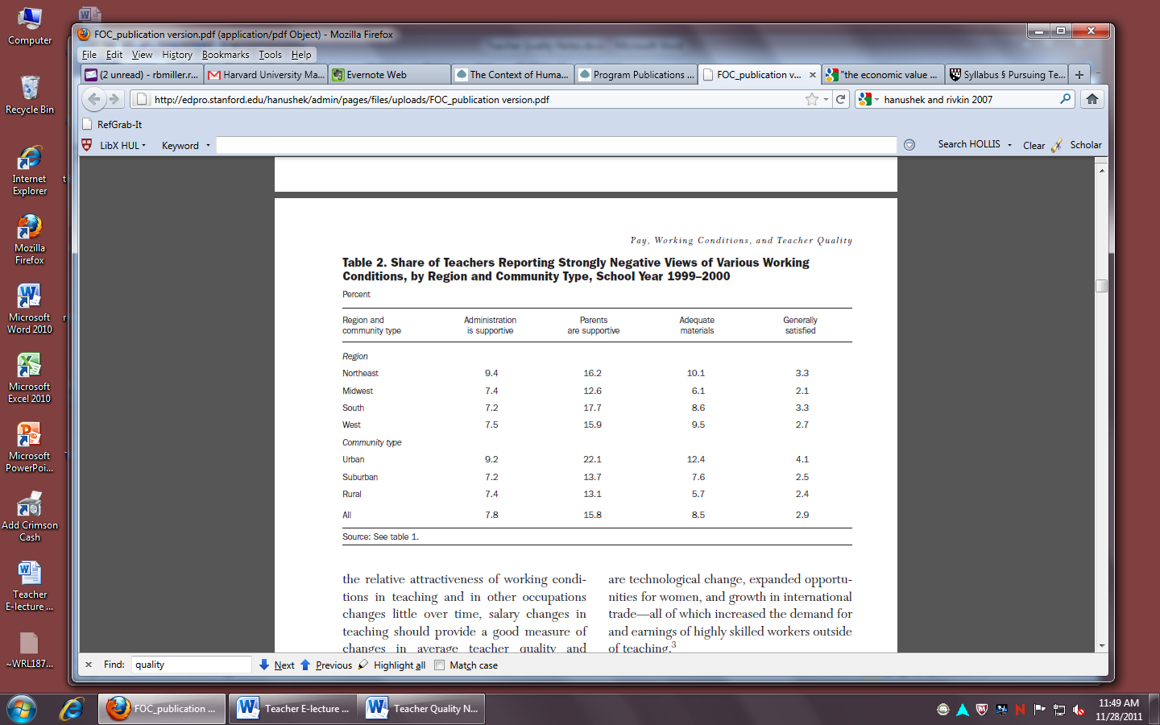
Retention: Working Conditions
Hanushek & Rivkin, 2007
Notes:
Others who criticize salary-based strategies for recruiting qualified teachers argue that working conditions, not teacher pay, are key. As this table shows, urban teachers are more dissatisfied with the support they receive from administrators and parents, the degree of conflict within their schools or departments, and the level of input they have in organizational policies. Teachers’ dissatisfaction with their working conditions can not only lead to high turnover rates among teachers, but it can also affect the cohesiveness and climate of the school, which in turn could affect teacher and student performance.

Slide 46
Improving Working Conditions
Teacher teaming
Paid professional development
Streamlined personnel systems
Shared governance
Notes:
Various strategies for improving working conditions have been proposed by districts and unions: teaming teachers for collaborative work, changing the structure of preparatory periods, paying teachers for professional development time, and simply reducing bureaucracy.
Teacher unions have taken a leading position in negotiating for and collaborating on many of these changes. The Miami-Dade district, for example, sought to give teachers greater agency in making district policy. They created shared decision-making councils comprised of parents, teachers, and administrators. Elsewhere decision-making structures are more school- than district-based; shared structures of school-site management seek to bring teachers into the power structures of these schools.

Slide 47
Pre-service Teacher Prep Reform
Partner with urban districts
Create “residency” programs based on a medical training model
Add coursework addressing multicultural competencies, diverse populations
Focus on high-leverage, practical “teacher moves” rather than on more abstract theory or concepts
Promote data-driven instruction, both by student teachers and by the teacher prep programs themselves
Share best practices across networks
Create university-alternative program partnerships
Notes:
Beyond the pipeline, a number of strategies for improving teacher quality are targeted at teacher preparation and professional development. To begin with, teacher preparation programs are beginning to foster long-term partnerships with urban districts. These partnerships are intended to ensure that mostly white, middle class teacher candidates are experienced and well supervised in working with underserved communities. Some are also designed to increase student teachers’ “clinical” teaching experience, following a medical training model with “teaching schools” rather than “teaching hospitals.” Some programs have also instituted curricular changes that focus on areas that new urban teachers struggle with the most, like issues of diversity and developing students’ multicultural competency, in hopes of better preparing them to succeed in urban schools.
As I’ll discuss in more detail in a minute, some teacher preparation programs are also focusing more on technical “teacher moves” rather than on abstract theory or concepts. Programs such as Teach for America and “no excuses” charter school-based teacher preparation institutes are moving especially strongly in this direction.
These alternative programs also tend to focus strongly on data-driven instruction, often of a quantitative nature. They strive to impart data-driven principles to their teacher corps; they also use quantitative data to assess the effects of their own teacher training programs. These practices have spread rapidly with the development of charter school networks as well as networks of university-based teacher prep programs such as UTeach and partnerships between university-based teacher education programs and alternative certification and pipeline programs.

Slide 48
In-Service Teacher Professional Development Reform
Induction and mentoring support for new teachers lasting 2+ years
Coaching
Instructional rounds
Teaming
Data-driven instruction and professional development
Teacher career ladder: differentiated roles based on experience, expertise, goals
Notes:
In addition to changing how urban teachers are initially trained, educational reformers also advocate for new approaches to professional development for teachers already in the field.
To begin with, in fact, they blur the formerly sharp distinction between pre-service and in-service teachers. The first three years that teachers are in the classroom are a time of tremendous learning and professional growth; but all too often new teachers are left to make sense of things on their own. Some districts, alternative certification programs, and occasionally universities are now providing full time first- and second-year teachers induction and mentoring support. This may be accompanied by subject- or skill-specific coaching, which is often provided to all teachers across the school or district.
Other professional development approaches focus on developing long-term, instructionally-focused, collaborative practices among teams of educators in a school or district. Instructional rounds, which have been developed and disseminated by a team of HGSE professors, are one of the most promising such approaches. Modeled after medical rounds, teams of educators visit classrooms or schools for focused periods of time, and then follow various protocols to describe, analyze, and evaluate the quality of instruction taking place and they select strategies for raising the quality of instruction where needed. This is one specific approach to the more general strategy of teacher teaming, which attempts to create professional learning communities of teachers who work together to strengthen instruction at their schools. These teams are usually either grade- or subject-specific.
I already talked about moves to data-driven instruction at the pre-service level, which also carry over into in-service teaching and professional development.
Finally, there has been work done, including by Kitty Boles and others at HGSE, to try to differentiate the teaching profession and give educators different kinds of instructional (not merely administrative!) roles at different stages of their careers.

Slide 49
Teacher-Proofing Teaching:
Practice-Focused Strategies
Teacher-proof curricula
Practices of effective teachers
Effective micro-moves
Notes:
What about changing teaching practice itself? A number of initiatives are targeted at changing curricula or the strategies teachers use every day in order to reduce individual variability and the risk that students will spend an entire year subject to poor teaching practices.
One of these is direct instruction. Various efforts to standardize or even “teacher-proof” the curriculum date back decades, and though their popularity waned in the 1980s and 90s, some today advocate rigorously scripted teaching as way to ensure consistent practice that addresses all learning goals for all students. A commonly used form of direct instruction, known as Success for All, is a structured reading program that has been used in about 1800 schools, including some in large urban districts like Baltimore and Philadelphia.
Others suggest that the more important target for change isn't the curriculum, per se, but how the teacher performs in the classroom. There is growing research interest in and data about specific high-leverage teaching practices used by teachers with high value-added scores and high peer evaluation rankings. For example, expert peer evaluators in Cincinnati, working with researchers at HGSE, rated value-adding reading teachers highly on using “teaching through questioning and discussion” as opposed to “routinized standards and content focused teaching” (Kane, et al., 2010). More work needs to be done to determine how strong these associations are and whether they might show up in other districts.
Others say that the kinds of practices that matter most are much more granular than this. Doug Lemov's influential book Teach Like a Champion identifies 49 micro-moves used by highly effective teachers in poor schools. His strategies include things like standing in one place while speaking, cold calling on students, and framing things positively rather than negatively – thanking students for good behavior or commending good performance. These strategies are again designed to reduce individual variation by helping novice and even veteran teachers master very specific pedagogical techniques.

Slide 50
Systemic Change
Address recruitment, preparation, working conditions, and professional development
Consider teacher attitudes and beliefs in recruitment
Increase the status of teaching as a profession
Notes:
With this array of tools and policies in play, it’s hard to know which ones are most promising. Some researchers and policymakers advocate adopting a number of these strategies at once, arguing that improving teaching and student learning cannot be accomplished with piecemeal or disconnected initiatives. Many are looking abroad for success stories that we might emulate here in the U.S., and they find just this kind of systemic and dynamic approach at work. In countries where students perform well they see multi-pronged approaches to assuring teacher quality that focus on each of the areas we’ve discussed – recruitment, preparation, working conditions, and professional development – rather than championing any one as a bottleneck.
For example, Finland, Ontario, and Singapore recruit teachers based not solely on their academic records but also on attributes like their commitment to the profession and their capacity to work well with children, assessed through exams and demonstration situations. Finland and Singapore provide teachers ample time for collaboration with peers on curriculum and assessment, and grants them a good deal of autonomy over teaching practice. These countries provide extensive evaluation systems that involve teachers in setting goals, and offers growth opportunities to teachers who are effective. Notably, the pay for teachers varies widely across these countries – the main features that stand out to American observers are the working conditions and status granted teaching professionals.

Slide 51
Pause and think:
Pause and think:
What do you now know about approaches to improving teacher quality in urban schools?
How do these approaches stack up against one another? Do some seem more effective, practical, politically viable, or just than others?
Think about the role(s) you have played or plan to play in urban schools. What approaches to improving teacher quality have been or will be most desirable, reliable, and/or useful? Why?
How has your own experience at HGSE reflected, complemented, or contradicted the strategies outlined in this section of the e-lecture?
Notes:
This is another good time to pause for a self-assessment of your own understanding. It’s also an opportune moment to think about how your own experiences in and with urban schools—and even at HGSE itself—reflect, complement, or contradict the ideas I’ve discussed in this section of the e-lecture.

Slide 52
How do institutions such as unions, charters, education schools, and district bureaucracies promote or impede the recruitment, training, and retention of high-quality teachers in urban areas?
Notes:
With teacher quality the flavor of the month in education policy reform circles, a lot of the attention today is focused on who’s to blame for poor teacher quality in urban areas, and who we should turn to for relief. It reminds me of politics around the Great Depression, in fact, over how to make sure that families got “a chicken in every pot,” except that the current dispute is about how to get “a high-quality teacher in every classroom.” Moving on to our final framing question, therefore, we ask, How do unions, charters, ed schools, and district bureaucracies promote or impede the recruitment, training, and retention of high-quality teachers in urban areas?

Slide 53

Unions
Albert Shanker,
speaking to
UFT teachers
at the
1968
Ocean Hill-
Brownsville strike,
Brooklyn
http://a100educationalpolicy.pbworks.com/w/page/3764852/The%20Firing%20Squad%3A%20History
Notes:
Unions have come under fire amid the feverish focus on teacher quality, being alternately revered and demonized as the key to effective change. On the one hand, critics argue that the job protections and pay structures unions have secured for teachers, and instituted in their contracts, are roadblocks to dismissing ineffective teachers or to incentivizing effective teaching practices. On the other hand, union supporters argue that securing basic protections is necessary to ensure that teaching jobs are humane – to ensure bathroom breaks, limitations on afterschool meetings and obligations, and employment security during life changes, like marriage or pregnancy.
Teacher unions formed in the early twentieth century based on the model of labor unions that were, at the time, securing protections for millions of industrial workers in the U.S. As a result, industry-like practices and values have reigned for much of their history. For instance, unions negotiate detailed job descriptions that can protect teachers from overwork or micromanagement but can also constrain teachers to rigid procedures and job requirements. They also advocate standard rules and pay schedules in order to ensure equal treatment for all workers but these same standards may prevent teachers from receiving commendation for good performance or growing into more differentiated roles that grant them seniority, authority, or decision-making powers. Labor-union tools have proven quite limited for the complex conditions and demands of teaching, and teacher unions have struggled to toe the line between protecting teacher autonomy and job security while staying relevant and responsive to the quality movement.
Most commentators, however, tend to overestimate the influence of unions. They lobby state and federal legislators and negotiate district contracts and policies, but they do not have authority over these policies – for instance, though they are often criticized for protecting tenure for ineffective teachers, it is actually state legislation that establishes the terms of tenure and procedures for dismissal. Union-negotiated contracts specify the mechanisms by which these processes will unfold, but do not establish the policies. A study of Boston schools by the National Center on Teacher Quality found that it was school administrators, and not the union-negotiated contracts, that limited the evaluation and dismissal of teachers.

Slide 54
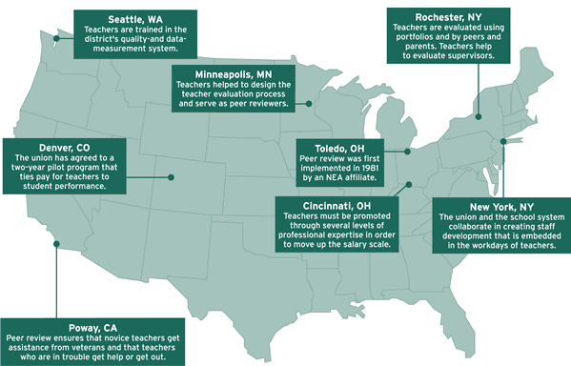
Teacher Professionalism & Agency
http://educationnext.org/deindustrialization/
Notes:
Indeed, in some cases the unions are advocating more progressive policies than districts are willing to institute. Many of the union positions respond to demands for quality-focused reforms in ways that also serve their interest in promoting the status and structure of teaching as a profession, as distinct from teaching as a job. Historically, teaching has been a low-status field in the US for a number of reasons: because it was dominated by women, who were explicitly second-class citizens for much of the nation’s history, and it has lacked common standards and practices that structure professions like medicine and law and that distinguish professionals as having some particular form of expertise. As districts have demanded rigorous teacher evaluation programs, unions have negotiated to develop programs that protect some degree of teacher autonomy and authority over career decisions and evaluation schemas, that ensure opportunities for remediation or ongoing professional development for struggling teachers, and that reward good performance.
For example, some teacher unions have advocated for instituting career ladders that give more opportunities for teachers to grow into varied, specialized, and senior positions over time and with good performance. Rochester was a leader in this area, creating a career ladder that introduced positions for lead teachers with greater salaries. In Toledo, unions negotiated the first agreement to grant authority to teachers to assess their peers and make employment recommendations. There, a committee of teachers and administrators selects and trains experienced teachers to become trained and serve for two years as mentors and peer evaluators. They provide months of close supervision, including through unannounced classroom observations, they model practice to novice teachers, and they provide recommendations on whether to employ or terminate those new teachers, or to provide further mentoring and professional development. They rate teachers on a range of practices including preparation, classroom management, pedagogical and content knowledge, and collegial engagement. This approach became a model for similar programs in Cincinnati, Columbus, and other urban districts. This map highlights a few programs where unions have devised similar kinds of reforms in conjunction with district leaders.

Slide 55
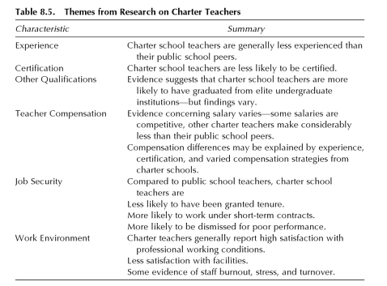
Charter Schools
Brewer & Ahn, 2010
Notes:
Charter schools are also shifting the demographics and dynamics of teacher quality. With charters on the rise, more schools are open to teachers without certification. This chart summarizes some of the research on charters; you might want to pause here and read over it before I elaborate a bit.
Nineteen of the 41 states with charter schools require certification for charter teachers, but the remainder have no requirements or allow waivers. In the 1999-2000 school year, 72% of charter school teachers were certified, compared with 93% of public school teachers. Just like public schools, there are more teachers without certification in urban charters compared to suburban charters. Because of these charter policies, charter schools may attract an older and more diverse teacher workforce than traditional public schools. In 2003-4, charters had 29.8% minority teachers compared to 16.7% in traditional public schools.
Charter school teachers tend to attract teachers from more competitive colleges and with higher SAT scores, but, as we have seen, it’s not clear that these characteristics are related to teacher effectiveness. Also as we saw, charter teachers are more likely to be in their first three years of teaching than other teachers: about 43% of charter teachers are in their first three years of teaching compared to 18% in traditional public schools. Charter school teachers are often non-unionized, so charter schools have much greater flexibility – and much more variation – in salaries, hiring policies, evaluation, compensation, and work conditions. Some evidence suggests that charter school teachers have more influence over school governance than public teachers, they have somewhat lighter workloads, and that they are more satisfied with their working conditions, but, again, the variation is extremely wide. Some studies suggest that the greater autonomy granted charter teachers also leads to more teacher burnout.
Charters also introduce some challenges to contract conditions. Most states – 25 out of the 41 with charters – allow schools to decide whether to participate in collective bargaining, nine require them to participate in collective bargaining, and others have more complex policies involving some degree of autonomy. For instance, New Jersey allows schools autonomy in determining teacher pay but requires them to comply with district maximums and minimums. In some states charter policies result in lower teacher pay, on average, while in others charter teachers earn a bit more. Because of their flexible structures, charter schools tend to use alternative personnel policies and strategies, like offering one-year contracts, regular evaluations, dismissal for performance, and merit-based pay, to try to stay effective.
A major concern of urban public school advocates is that charter schools, with their more flexible policies and often attractive working conditions, might be poaching the most desirable teachers from traditional public schools. The contracts and conditions of teacher transfer vary by state, and there isn’t good data on how often teachers leave traditional publics for charters. Some districts attempt to control the impact of poaching by requiring teachers to obtain district-level permission to leave their public school for a charter, and their exact requirements vary – for example, some restrict traditional public school teachers to spending one to five years in a charter school.

Slide 56
Education Schools
Concerns
Low quality of teacher prep students
Disconnect between theory and practice
Lack of clinical expertise among faculty
Lack of accountability
Proposed Reforms
Partnerships with districts and innovative alternative programs
Rigorous accountability for results
Notes:
Since I teach in and most of you attend the Harvard Graduate School of Education, clearly this slide is unnecessary, as we all know that ed schools are perfect. Well, maybe not entirely perfect—and anyway, there are other ed schools beyond just Harvard, so I suppose this slide may be useful after all…
So, what possible concerns could be raised about education schools? Critics of traditional, university-based teacher preparation argue that these programs typically attract young, White, middle-class women who rarely interact with people different from themselves, and many of whom are reluctant to work in predominantly minority, low-income areas and who hold low expectations for urban students. They also point out that prospective elementary teachers, especially, have far lower SAT and GRE scores than do college and graduate students in general. There is a great deal of worry that education schools draw from a fairly shallow, uncompetitive pool.
University-based teaching programs are also castigated for focusing on theory rather than practice and using faculty who have not seen the inside of a K-12 classroom for years, if ever. One study (Levine, 2006) reported that two thirds of alumni of education schools say their program did not prepare them for the realities of teaching, and one-third claim that faculty were disconnected from schools and that the ed school curriculum is outdated. Unfortunately, these ills are unlikely to right themselves quickly, as university-based teacher training programs are insulated from any real accountability.
Given these critiques, what are education schools to do? (Other than Harvard, of course, which we’ll assume is perfect. ☺) I’ve talked about a number of reforms already. One major reform is the establishment of on-going, robust partnerships with urban districts and with innovative, flexible, and cutting-edge alternative programs. A second, still very new approach, is actually to hold universities accountable for the quality of teachers that they produce. Louisiana has mandated this statewide, applying the same kinds of outcome-based assessments of teacher prep programs—with all their attendant statistical and pragmatic challenges—as we’ve seen with respect to student achievement.

Slide 57
District Bureaucracies
Rigid and fragmented structures can impede recruitment and hiring
Limited capacity to innovate
Growing reporting demands require more personnel
Budget shortfalls impose trade-offs between administrative and teaching positions
May be designed to alleviate teachers’ organizational responsibilities so they can focus on instruction
Notes:
Another factor that’s easy to overlook is that teacher quality is technically inseparable from the bureaucracy of schools. District human resources offices are in charge of recruiting and hiring, and are often managers of employee evaluations, development, and benefits. There isn’t much research evidence about the effectiveness of school bureaucracies, but anecdotal horror stories of qualified candidates getting lost in the shuffle suggest that there might be skeletons in managers’ closets. The few qualitative studies that do exist show that effective hiring is impeded by rigid and fragmented organizational structures and cultures and outdated technology. Consider, for example, that new hires in San Diego don’t learn until August where they will be working – quality applicants can easily be lost in favor of jobs that give them time to find a place to live. What is the point of identifying and screening these potentially highly qualified and hopefully effective teachers if they can’t get hired or navigate the system once they’re in it?
We might expect that district organizational structures would be shrinking, relative to the teaching force or school resources, as attention has turned to the crucial role of teachers in student achievement. But district staffs are expanding in order to meet the reporting demands of states and federal funding programs like Race to the Top. Anne Bryant, executive director of the National School Boards Association, told one reporter, “The question is are we supposed to lay off teachers to hire data collectors?” She added, “Our districts are literally dying from the increased bureaucracy placed on them” (Downey, 2011).

Slide 58
Pause and think:
Pause and think:
What have you learned that really surprised you? How does this change your thinking about teachers in urban schools?
What practical insights do you want to hold onto?
How does this e-lecture jive with or complement the assigned readings?
What are you still confused or wondering about? What do you want to explore in more detail during class?
Notes:
Time for a final “pause and think” session! I hope this e-lecture, and the accompanying questions, have been helpful. I look forward to seeing you in class!

Slide 59
Sources
Alexander, Karl L., Doris R. Entwisle, and Linda S. Olson (2001). “Schools, Achievement, and Inequality: A Seasonal Perspective.” Educational Evaluation and Policy Analysis 23: 171-191.
Alexander, Karl L., Doris R. Entwisle, and Linda Steffel Olson (2007). “Lasting Consequences of the Summer Learning Gap.” American Sociological Review 72: 167-180.
Almy, Sarah & Christina Theokas (2010). “Not Prepared for Class: High-Poverty Schools Continue to Have Fewer In-Field Teachers.” The Education Trust.
Angus, David L. (2001). “Professionalism and the Public Good: A Brief History of Teacher Certification.” Jeffrey Mirel, ed. Washington, DC: Thomas B. Fordham Foundation.
Aud, Susan, Mary Ann Fox, & Angelina KewalRamani (2010). Status and Trends in the Education of Racial and Ethnic Groups, Washington, DC: U.S. Dept. of Education, National Center for Education Statistics, Institute of Education Sciences.
Bohte, John (2001). “School Bureaucracy and Student Performance at the Local Level.” Public Administration Review 61(1): 92-99.
Boyd, Don, Erin Dunlop, Hamp Lankford, Susanna Loeb, Patten Mahler, Rachel O'Brien, & Jim Wyckoff (2010). “Alternative Certification in the Long Run: Student Achievement, Teacher Retention and the Distribution of Teacher Quality in New York City.” Columbia, MO: The Association for Education Finance and Policy.
Boyd, Donald, Hamilton Lankford, Susanna Loeb, Jonah Rockoff, & James Wyckoff (2008). “The Narrowing Gap in New York City Teacher Qualifications and its Implications for Student Achievement in High-Poverty Schools.” Journal of Policy Analysis and Management 27(4): 793–818.
Brewer, Dominic J. and June Ahn (2010). “Taking Measure: What do we know about teachers in charter schools?” In Julian R. Betts & Paul T. Hill, eds., Taking Measure of Charter Schools: Better Assessments, Better Policymaking, Better Schools, Lanham MD: Rowman & Littlefield, pp. 129-154.
Center for Urban and Multicultural Education, Indiana University (n.d.). “Teacher Licensure (Certification). Research Brief.”
Cooper, Harris, Barbara Nye, Kelly Charlton, James Lindsay, and Scott Greathouse (1996). “The Effects of Summer Vacation on Achievement Test Scores: A Narrative and Meta-Analytic Review.” Review of Educational Research 66: 227-268.

Slide 60
Sources
Hanushek, Eric A. and Steven G. Rivkin (2007). “Pay, Working Conditions, and Teacher Quality.” Future of Children 17(1): 69-86.
Hudson, Mildred J. and Barbara J. Holmes (1994). “Missing Teachers, Impaired Communities: The Unanticipated Consequences of Brown v. Board of Education on the African American Teaching Force at the Precollegiate Level.” The Journal of Negro Education 63(3): 388-393.
Coopersmith, Jared (2009). “Characteristics of Public, Private, and Bureau of Indian Education Elementary and Secondary School Teachers in the United States: Results from the 2007-08 Schools and Staffing Survey.” Washington, DC: U.S. Dept. of Education, National Center for Education Statistics, Institute of Education Sciences.
Dee, Thomas S. “Teachers, Race and Student Achievement in a Randomized Experiment." The Review of Economics and Statistics 86, 1 (February 2004): 195-210.
Downey, Maureen (2011, June 5). “School districts ‘dying from the increased bureaucracy.’” The Atlanta Journal-Constitution, “Get Schooled” Blog.
Fairclough, Adam (2004). “The Costs of Brown: Black Teachers and School Integration.” The Journal of American History 91(1): 43-55.
Fifer, Molly E. and Alan B. Krueger (2006). “Advancing Opportunity, Prosperity and Growth.” Policy Brief No. 2006-03, The Hamilton Project, The Brookings Institution.
Fultz, Michael (2004). "Overcoming Historical Amnesia: The Displacement of Black Educators Post-Brown.” Paper presented at “Fifty Years After Brown v. Board of Education: Race and Equal Educational Opportunity in the United States,” February 4-6, 2004, University of Wisconsin-Madison.
Glazerman, Steven, Dan Goldhaber, Susanna Loeb, Douglas Staiger, Stephen Raudenbush, & Grover Whitehurst. "Value-Added: It's Not Perfect, But It Makes Sense.” Education Week 30(15).
Green, Elizabeth (2010). “Building a better teacher.” The New York Times. March, 2, 2010.
Haberman, Martin (2010). “Selecting and Preparing Urban Teachers.” Education News.
Hanushek, Eric A. (2002). “Teacher Quality.” In Lance T. Izumi and Williamson M. Evers, eds., Teacher Quality. Palo Alto: Hoover Press.

Slide 61
Sources
Hanushek, Eric A., John F. Kain, Steven G. Rivkin, and Gregory F. Branch (2007). “Charter school quality and parental decision making with school choice,” Journal of Public Economics 91(5-6): 823-848.
Jacob, Brian A. (2007). “The Challenges of Staffing Urban Schools with Effective Teachers.” Future of Children 17(1): 129-153.
Jacob, Brian A., Thomas J. Kane, Jonah E. Rockoff, Douglas O. Staiger (2009). “Can You Recognize an Effective Teacher When You Recruit One?” CLOSUP Working Paper Series Number 11.
Johnson, Susan Moore (2005). “Working in Schools.” In Susan Fuhrman & Marvin Lazerson, eds., The Public Schools, New York, NY: Oxford University Press, pp. 160-187.
Kane, Thomas J., Eric S. Taylor, John H. Tyler, and Amy L. Wooten (2010). “Identifying Effective Classroom Practices Using Student Achievement Data.” NBER Working Paper 15803.
Kerchner, Charles Taylor (2001). “Deindustrialization.” Education Next 1(3): 46-50.
Kim, Jimmy (2004). “Summer Reading and the Ethnic Achievement Gap.” Journal of Education for Students Placed at Risk (JESPAR) 9:2, 169-188.
Lankford, Hamilton, Susanna Loeb, and James Wyckoff (2002). “Teacher Sorting and the Plight of Urban Schools: A Descriptive Analysis.” Educational Evaluation and Policy Analysis 24(1): 37-62.
Lemov, Doug (2010). Teach Like A Champion. San Francisco, CA: Jossey-Bass.
Levine, Arthur (2006). Educating School Teachers. New York: The Education Schools Project.
Massachusetts Department of Elementary and Secondary Education (2011, October). “Overview of the New Massachusetts Educator Evaluation Framework
Massachusetts Working Group on Teacher Evaluation of the National Center for Fair & Open Testing (2011). “Flawed Massachusetts Teacher Evaluation Proposal Risks Further Damage to Teaching and Learning.”
Ng, Jennifer C. (2003). “Teacher Shortages in Urban Schools: The Role of Traditional and Alternative Certification Routes in Filling the Voids.” Education and Urban Society 35(4): 380-398.
Papay, John (2007). Aspen Institute Datasheet: The Teaching Workforce. Washington, D.C.: The Aspen Institute.

Slide 62
Sources
Pelayo, Icela and D.J. Brewer (2010). “Teacher Quality in Education Production.” In Penelope Peterson, Eva Baker and Barry McGaw, eds., International Encyclopedia of Education (Third Edition), Oxford: Elsevier, pp. 438-442.
Policy Studies Associates (2005). “Teacher quality and student achievement: Research review.” Washington, DC: The Center for Public Education.
Ravitch, Diane (2002), "A Brief History of Teacher Professionalism," White House Conference on Preparing Tomorrow's Teachers, Washington, DC.
Rothman, Robert and Patte Barth (2009). “Does highly qualified mean highly effective?” Center for Public Education.
Rothman, Robert and Linda Darling-Hammond (2001). “Teacher and School Leader Effectiveness: Lessons Learned from High-Performing Systems.” Washington DC: Alliance For Excellent Education.
Rothstein, Jesse (2009). “Teacher Quality in Educational Production: Tracking, Decay, and Student Achievement.”
Strizek, Gregory A., Jayme L. Pittsonberger, Kate E. Riordan, Deanna M. Lyter, and Greg F. Orlofsky (2006). “Characteristics of Schools, Districts, Teachers, Principals, and School Libraries in the United States: 2003-04 Schools and Staffing Survey.” Washington, DC: U.S. Dept. of Education, National Center for Education Statistics, Institute of Education Sciences.
Temin, Peter (2002). "Teacher Quality And The Future Of America," Eastern Economic Journal 28(3): 285-300.
Vasquez Heilig, Julian and Su Jin Jez, (2010). “Teach For America: A Review of the Evidence.” East Lansing, MI: The Great Lakes Center for Education Research & Practice.
Weisberg, D., Sexton, S., Mulhern, J., & Keeling, D. (2009). The Widget Effect: Our national failure to acknowledge and act on differences in teacher effectiveness.
Winerip, Michael (2011, November 28). “Principals Protest Increased Use of Test Scores to Evaluate Educators.” New York Times.
Zins, Joseph E., Michelle R. Bloodworth, Roger P. Weissberg & Herbert J. Walberg (2007). “The Scientific Base Linking Social and Emotional Learning to School Success.” Journal of Educational and Psychological Consultation 17(2-3): 191-210.

